Slide 1
Trees
Jordi Cortadella and Jordi Petit
Department of Computer Science

Slide 2
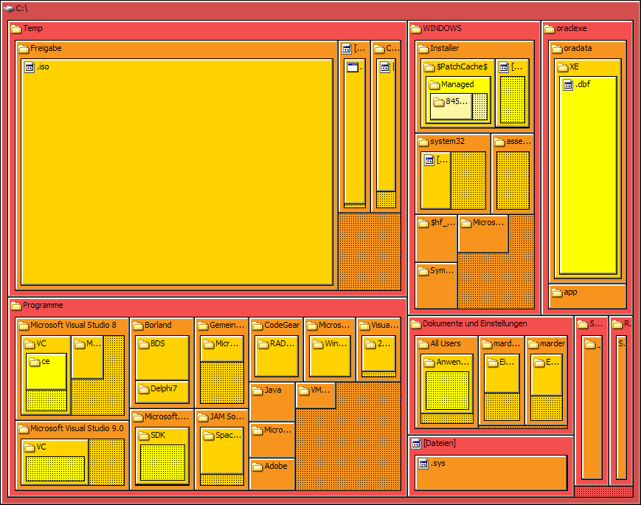
Trees
Data are often organized hierarchically
source: https://en.wikipedia.org/wiki/Tree_structure

Slide 3
Filesystems

Slide 4
Company structure

Slide 5
Mind maps

Slide 6
Genealogical trees

Slide 7
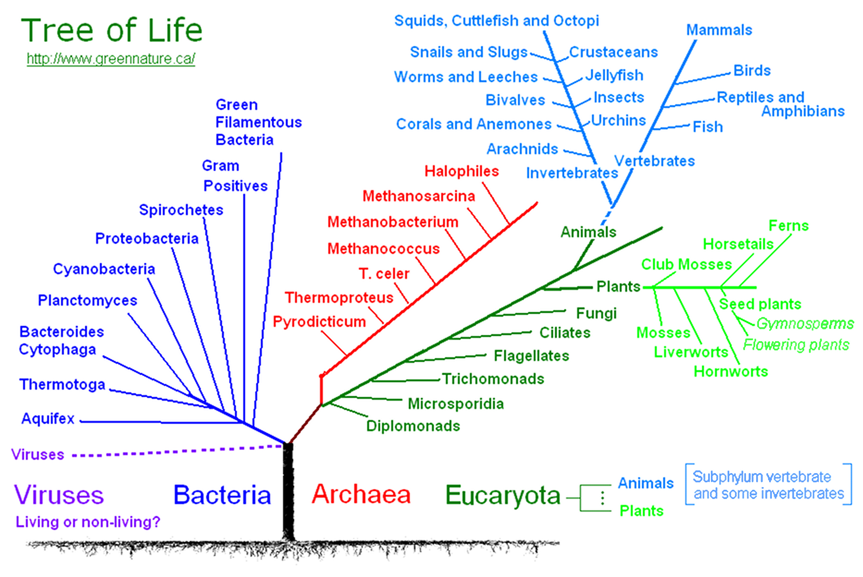

Slide 8
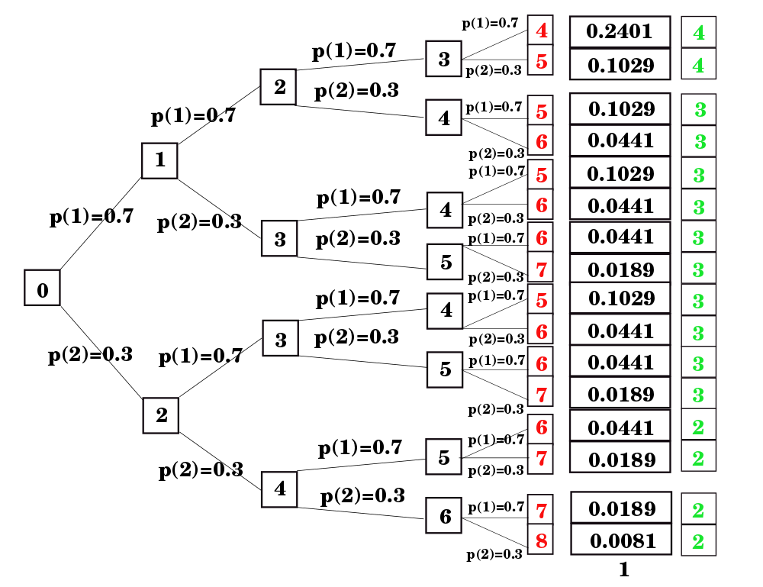
Probability trees

Slide 9
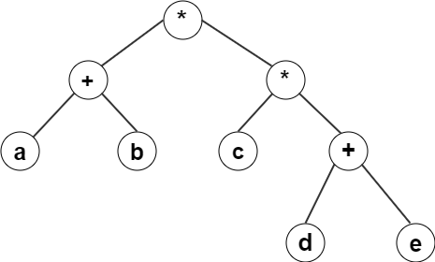
Expression trees
(a + b) * c * (d + e)

Slide 10
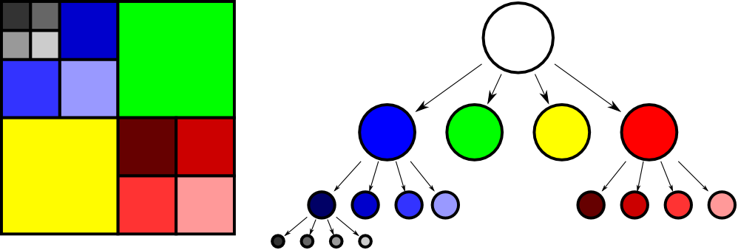
Image representation (quad-trees)

Slide 11
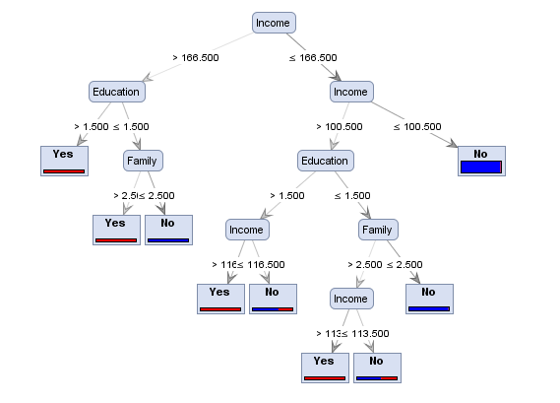
Decision trees
source: http://www.simafore.com/blog/bid/94454/A-simple-explanation-of-how-entropy-fuels-a-decision-tree-model

Slide 12
Tree: definition
Graph theory: a tree is an undirected graph in which any two vertices are connected by exactly one path.
Recursive definition (CS). A non-empty tree T consists of:
a root node $r$
a list of non-empty trees $T_{1},T_{2},…, T_{n}$ that hierarchically depend on $r$. The list can be possibly empty ($n≥0$).
$$r$$
$$T_{1}$$
$$T_{2}$$
$$T_{n}$$
•••

Slide 13
Tree: nomenclature
A
B
C
D
E
F
G
H
I
J
K
L
M
N
P
Q
$A$ is the root node.
Nodes with no children are leaves (e.g., $B$ and $P$).
Nodes with the same parent are siblings (e.g., $K$, $L$ and $M$).
The depth of a node is the length of the path from the root to the node. Examples: depth($\text{A}$)=0, depth($\text{L}$)=2, depth($\text{Q}$)=3.

Slide 14
Tree: representation
There is a plethora of data structures that can be used to represent a tree, e.g., a hierarchical list.
1
2
3
4
[root, child₁, child₂, …, child_{n}]
5
6
7
another tree
8
9
tree = [1, [2], [3, [5], [6, [8], [9]]], [4, [7]] ]

Slide 15
Tree: Abstract Data Type
from dataclasses import dataclass from typing import TypeVar, Generic T = TypeVar('T') @dataclass class Tree(Generic[T]):
"""Class to represent a generic tree"""
data: T children: list[Tree[T]] def size(t: Tree) -> int: return 1 + sum(size(c) for c in t.children)
def num_levels(t: Tree) -> int: # implement it!
1
2
3
4
5
6
7
8
9

Slide 16
Write a tree
home
doc
letter.doc
pres.ppt
courses
AC2
AP2
P01.pdf
P02.pdf
COM
PIE1
index.txt
README
home doc letter.doc pres.ppt README courses AC2 AP2 P01.pdf P02.pdf COM PIE1 index.txt
def write(t: Tree[T], depth: int = 0) -> None:
"""Writes a tree indented according to the depth"""

Slide 17
Write a tree
def write(t: Tree[T], depth: int = 0) -> None: """Writes a tree indented according to the depth""" # print the root print(' '*2*depth, t.data, sep='') # print the children with depth + 1 for c in t.children: write(c, depth + 1)
This function executes a preorder traversal of the tree: each node is processed before the children.

Slide 18
Write a tree (postorder traversal)
home
doc
letter.doc
pres.ppt
courses
AC2
AP2
P01.pdf
P02.pdf
COM
PIE1
index.txt
README
letter.doc pres.ppt doc README AC2 P01.pdf P02.pdf AP2 COM PIE1 courses index.txt home
Postorder traversal: each node is processed after the children.

Slide 19
Write a tree (postordre traversal)
def write_postorder(t: Tree[T], depth: int = 0) -> None: """Writes a tree (in postorder) indented according to the depth""" # print the children with depth + 1 for c in t.children: write_postorder(c, depth + 1) # print the root print(' '*2*depth, t.data, sep='')
This function executes a postorder traversal of the tree: each node is processed after the children.

Slide 20
Binary tree: definition
A binary tree is a finite set of nodes that either
is empty, or
is comprised of three disjoint sets of nodes: a root node and two binary trees called its left and right subtrees
r
$$T_{left}$$
$$T_{right}$$

Slide 21
Binary tree: representation
Data structures to represent binary trees are typically based on the definition of a node.
from dataclasses import dataclass, field from typing import TypeVar, Generic, Optional, Iterator T = TypeVar('T')
@dataclass
class Node(Generic[T]): """Node of a bin tree"""
data: T
left: 'BinTree[T]' = field(default = None)
right: 'BinTree[T]' = field(default = None) BinTree = Optional[Node[T]] NodeIter = Iterator[Node[T]]
r
$$T_{left}$$
$$T_{right}$$

Slide 22
Binary tree: representation
1
Node
1
2
3
2
3
4
5
6
4
5
6

Slide 23
Example: expression trees
+
+
*
a
*
+
g
b
c
*
f
d
e
Expression tree for: a + b∗c + (d∗e + f) ∗ g
Postfix representation: a b c ∗ + d e ∗ f + g ∗ +
How can the postfix representation be obtained?

Slide 24
Example: expression trees
Expressions are represented by strings in postfix notation in which 'a'…'z' represent operands and '+' and '∗' represent operators.
Exprtree: TypeAlias = BinTree[str] def build_expr(expr: str) -> Exprtree: """Builds an expression tree from a correct expression represented in postfix notation""" def infix_expr(t: Exprtree) -> str: """Generates a string with the expression in infix notation""" def eval_expr(t: Exprtree, v: dict[str, int]) -> int: """Evaluates an expression taking v as the value of the variables (e.g., v['a'] contains the value of a)"""

Slide 25
Example: expression trees
def main(): t = build_expr('a b c * + d e * f + g * +') print(infix_expr(t)) print(eval_expr(t, {'a':3, 'b':1, 'c':0, 'd':5, 'e':2, 'f':1, 'g':6}))
Output: ((a+(b*c))+(((d*e)+f)*g))
69

Slide 26
How to build an expression tree
a b c ∗ + d e ∗ f + g ∗ +
+
*
+
+
*
*
a
b
c
d
e
f
g

Slide 27
How to build an expression tree
a b c ∗ + d e ∗ f + g ∗ +
Stack
a

Slide 28
How to build an expression tree
a b c ∗ + d e ∗ f + g ∗ +
Stack
a
b

Slide 29
How to build an expression tree
a b c ∗ + d e ∗ f + g ∗ +
Stack
a
b
c

Slide 30
How to build an expression tree
a b c ∗ + d e ∗ f + g ∗ +
Stack
*
a
a
b
b
c
c

Slide 31
How to build an expression tree
a b c ∗ + d e ∗ f + g ∗ +
Stack
+
*
a
b
c

Slide 32
How to build an expression tree
a b c ∗ + d e ∗ f + g ∗ +
Stack
+
*
a
b
c
d

Slide 33
How to build an expression tree
a b c ∗ + d e ∗ f + g ∗ +
Stack
+
*
a
b
c
d
e

Slide 34
How to build an expression tree
a b c ∗ + d e ∗ f + g ∗ +
Stack
+
*
*
a
b
c
d
e

Slide 35
How to build an expression tree
a b c ∗ + d e ∗ f + g ∗ +
Stack
+
*
*
a
b
c
d
e
f

Slide 36
How to build an expression tree
a b c ∗ + d e ∗ f + g ∗ +
Stack
+
+
*
*
a
b
c
d
e
f

Slide 37
How to build an expression tree
a b c ∗ + d e ∗ f + g ∗ +
Stack
+
+
*
*
a
b
c
d
e
f
g

Slide 38
How to build an expression tree
a b c ∗ + d e ∗ f + g ∗ +
*
Stack
+
+
*
*
a
b
c
d
e
f
g

Slide 39
How to build an expression tree
a b c ∗ + d e ∗ f + g ∗ +
+
*
Stack
+
+
*
*
a
b
c
d
e
f
g

Slide 40
Example: expression trees
def build_expr(expr: str) -> Exprtree: """Builds an expression tree from a correct expression represented in postfix notation"""
# Create a list of all characters (without spaces)
expr_char = [x for x in expr if not x.isspace()]
stack: list[Node[str]] = list()
for c in expr_char:
if c.isalpha():
# We have an operand. Create a leaf node
stack.append(Node(c))
else:
# We have an operator (+ or *)
right = stack.pop()
left = stack.pop()
stack.append(Node(c, left, right))
# The stack has only one element: the root of the expression
return stack.pop()

Slide 41
Example: expression trees
def infix_expr(t: Exprtree) -> str: """Generates a string with the expression in infix notation""" if not t.left: # it is a leaf node (operand) return t.data # We have an operator. Add enclosing parenthesis (for safety) return '(' + infix_expr(t.left) + t.data + infix_expr(t.right) + ')'
Inorder traversal: node is visited between the left and right children.
Exercise: redesign infix_expr to minimize the number of parenthesis.

Slide 42
Example: expression trees
def eval_expr(t: Exprtree, v: dict[str, int]) -> int: """Evaluates an expression taking v as the value of the variables (e.g., v['a'] contains the value of a)""" if not t.left: # it is a leaf node: return the value return v[t.data] # We have an operator: evaluate subtrees and operate left = eval_expr(t.left, v) right = eval_expr(t.right, v) return left + right if t.data == '+' else left * right

Slide 43
Tree traversals
A
Let us consider generators to visit the nodes of the tree in some specific order.
B
C
t: BinTree[str] = … # some tree constructor
Lpreorder = [n.data for n in preorder(t)]
Lpostorder = [n.data for n in postorder(t)] Linorder = [n.data for n in inorder(t)] Llevels = [n.data for n in level_order(t)]
D
E
F
G
H
I
J
K
Lpreorder: ['A', 'B', 'D', 'G', 'H', 'E', 'I', 'C', 'F', 'J', 'K']
Lpostorder: ['G', 'H', 'D', 'I', 'E', 'B', 'J', 'K', 'F', 'C', 'A'] Linorder: ['G', 'D', 'H', 'B', 'E', 'I', 'A', 'J', 'F', 'K', 'C'] Llevels: ['A', 'B', 'C', 'D', 'E', 'F', 'G', 'H', 'I', 'J', 'K']

Slide 44
Tree traversals
# Remember: # BinTree = Optional[Node[T]] # NodeIter = Iterator[Node[T]] def preorder(t: BinTree) -> NodeIter: """Iterator to visit the nodes in preorder""" if t: yield t yield from preorder(t.left) yield from preorder(t.right) def postorder(t: BinTree) -> NodeIter: """Iterator to visit the nodes in postorder""" if t: yield from postorder(t.left) yield from postorder(t.right) yield t

Slide 45
Tree traversals
def inorder(t: BinTree) -> NodeIter: """Iterator to visit the nodes in inorder""" if t: yield from inorder(t.left) yield t yield from inorder(t.right) def level_order(t: BinTree) -> NodeIter: """Iterator to visit the nodes by levels""" if not t: return q: deque[Node] = deque([t]) while q: n = q.popleft() yield n if n.left: q.append(n.left) if n.right: q.append(n.right)

Slide 46
Tree visitors
A
B
C
A visitor is a function that is applied to all nodes of a tree.
Similar to the map function applied to iterables (e.g., lists)
D
E
F
G
H
I
J
K
def visit_preorder(t: BinTree[T], f: Callable[[T], T]) -> None:
"""Visits all the nodes of the tree in preorder and applies f() to the data. The result is reassigned to the data"""
Type: Callable[[T1,…Tn], Tr]. A function with parameters [T1,…,Tn] and result Tr.

Slide 47
Tree visitors
def visit_preorder(t: BinTree[T], f: Callable[[T], T]) -> None: """Applies f to all data in preorder""" if t: t.data = f(t.data) visit_preorder(t.left, f) visit_preorder(t.right, f) # Example def square(x: int) -> int: return x*x
t: Bintree[int] = … # some tree constructor visit_preorder(t, square) # squares all data in the tree # equivalent with lambda: visit_preorder(t, lambda x: x*x)

Slide 48
Exercises

Slide 49
Expression tree
Modify infixExpr for a nicer printing:
Minimize number of parenthesis.
Add spaces around + (but not around ∗).
Extend the functions to support other operands, including the unary – (e.g., –a/b).

Slide 50
Binary tree types
Design the function "def check_type(t: BinTree) -> bool:" for each type of tree.
Full Binary Tree: each node has 0 or 2 children.
Complete Binary Tree: all levels are filled entirely with nodes, except the lowest level. In the lowest level, all nodes reside on the left side.
Perfect Binary Tree: all the internal nodes have exactly two children and all leaves are at the same level.
Balanced Binary Tree: the tree height is $\text{O}(\log{n})$, where $n$ is the number of nodes. The height of the left and right subtrees of each node should vary by at most one.
Degenerated Binary Tree: every internal node has a single child.
(balanced)
(unbalanced)

Slide 51
Intersection of binary trees
Design the function def intersection(t1: BinTree[T], t2: BinTree[T], f: Callable[[T, T], T]) -> BinTree[T]:
t1:
3
that returns the common structure of both trees and combines the values of the common nodes with the function f.
1
3
4
2
0
intersection(t1, t2, lambda x, y: x*y)
1
4
6
t2:
2
2
9
2
3
8
2
0
8
2
1
9

Slide 52
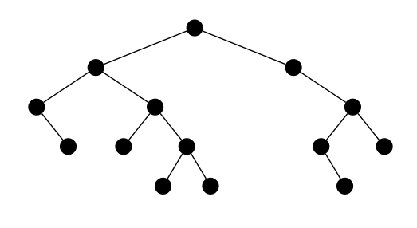
Binary tree: nodes per level
from dataclasses import dataclass from typing import Optional BinTree = Optional['Node']
@dataclass
class Node: """Node of a bin tree"""
left: BinTree
right: BinTree def num_levels(t: BinTree) -> int:
"""Returns the number of levels of a tree""" ...
def nodes_per_level(t: BinTree) -> list[int]:
"""Returns a list with the number of nodes
for each level of the tree""" ...
nodes_per_level: [1, 2, 3, 5, 3]
Write the code for the functions num_levels and nodes_per_level. In case you need any auxiliary function, you have to write the code and include a docstring with the complete specification of the function.
The class Node and the specification of num_levels and nodes_per_level cannot be modified.

Slide 53
Traversals: Full Binary Trees
A Full Binary Tree is a binary tree where each node has 0 or 2 children.
Draw the full binary trees corresponding to the following tree traversals:
Preorder: 2 7 3 6 1 4 5; Postorder: 3 6 7 4 5 1 2
Preorder: 3 1 7 4 9 5 2 6 8; Postorder: 1 9 5 4 6 8 2 7 3
Given the pre- and post-order traversals of a binary tree (not necessarily full), can we uniquely determine the tree?
If yes, prove it.
If not, show a counterexample.

Slide 54
Traversals: Binary Trees
Draw the binary trees corresponding the following traversals:
Preorder: 3 6 1 8 5 2 4 7 9; Inorder: 1 6 3 5 2 8 7 4 9
Level-order: 4 8 3 1 2 7 5 6 9; Inorder: 1 8 5 2 4 6 7 9 3
Postorder: 4 3 2 5 9 6 8 7 1; Inorder: 4 3 9 2 5 1 7 8 6
Describe an algorithm that builds a binary tree from the preorder and inorder traversals.

Slide 55
Drawing binary trees
We want to draw the skeleton of a binary tree as it is shown in the figure. For that, we need to assign $(x,y)$ coordinates to each tree node. The layout must fit in a pre-defined bounding box of size $W×H$, with the origin located in the top-left corner. Design the function: T = TypeVar('T')
Coordinate = tuple[float, float]
Coordinates = dict[Bintree, Coordinate]
def draw(t: Bintree, w: float, h: float) -> Coordinates: that returns a dictionary with the coordinates of all tree nodes in such a way that the lines that connect the nodes do not cross.
$$(0,0)$$
$$(W,H)$$

