Slide 1
Graphs: Maximum Flows
Jordi Cortadella and Jordi Petit
Department of Computer Science

Slide 2
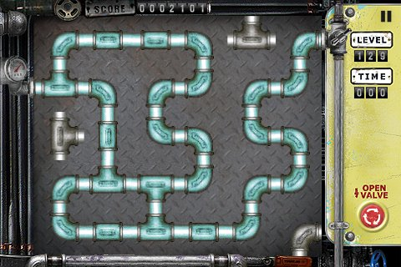
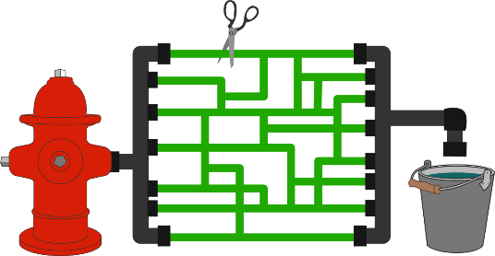
Max-flow/min-cut problems
How much water can you pump from source to target?
OpenValve, by JAE HYUN LEE
What is the fewest number of green tubes that need to be cut so that no water will be able to flow from the hydrant to the bucket?
Max-flow/Min-cut algorithm. Brilliant.org. https://brilliant.org/wiki/max-flow-min-cut-algorithm/

Slide 3
Max-flow/min-cut problems: applications
Networks that carry data, water, oil, electricity, cars, etc.
How to maximize usage?
How to minimize cost?
How to maximize reliability?
Multiple application domains:
Computer networks
Image processing
Computational biology
Airline scheduling
Data mining
Distributed computing
…

Slide 4
Max-flow problem
a
2
d
2
3
Model:
A directed graph $G=\left(V,E\right)$.
Two special nodes $s,t∈V$.
Capacities $c_{e}>0$ on the edges.
Goal: assign a flow $f_{e}$ to each edge $e$ of the network satisfying:
$0≤f_{e}≤c_{e}$ for all $e∈E$ (edge capacity not exceeded)
For all nodes $u$ (except $s$ and $t$), the flow entering the node is equal to the flow exiting the node: $\sum_{\left(w,u\right)∈E}{f_{wu}=\sum_{\left(u,z\right)∈E}{f_{uz}}.}$
Size of a flow: total quantity sent from $s$ to $t$ (equal to the quantity leaving $s$): $$\text{size}\left(f\right)=\sum_{\left(s,u\right)∈E}{f_{su}}$$
0
10
1
3
2
1
2
s
1
b
1
t
3
1
0
1
4
5
4
5
c
5
e
5

Slide 5
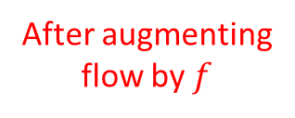
Max-flow problem: intuition
a
Find an augmenting path
s
t
b
An augmenting path may reverse some of the flow previously assigned
$$c$$
After augmenting flow by $f$
$$c−f$$
$$0$$
$$f$$

Slide 6
Augmenting paths
a
2
d
a
2
d
3
10
1
3
2
1
2
s
3
b
1
1
t
s
3
b
1
t
4
5
1
c
5
e
c
e
Flow
Given a flow, an augmenting path represents a feasible additional flow from $s$ to $t$.
a
d
a
2
d
2
1
2
s
b
t
s
3
b
1
t
4
4
4
5
c
4
e
c
4
e
Augmenting path
New flow

Slide 7
Augmenting paths
a
2
d
a
2
d
3
10
1
3
2
s
3
b
1
1
t
s
b
1
1
t
4
5
3
5
c
5
e
c
4
e
Flow
Augmenting paths can have forward and backward edges.
a
d
a
2
d
1
2
1
s
b
backward
t
s
b
1
t
1
1
4
5
c
1
e
c
5
e
Augmenting path
New flow

Slide 8
Augmenting paths
Given a flow $f$, an augmenting path is a directed path from $s$ to $t$, which consists of edges from $E$, but not necessarily in the same direction. Each of these edges $e$ satisfies exactly one of the following two conditions:
$e$ is in the same direction as in $E$ (forward) and $f_{e}<c_{e}$. The difference $c_{e}−f_{e}$ is called the slack of the edge.
$e$ is in the opposite direction (backward) and $f_{e}>0$. It represents the fact that some flow can be borrowed from the current flow.

Slide 9
Residual graph
a
2
d
3
10
1
3
s
3
b
1
1
t
4
5
c
5
e
Graph
2
a
2
d
a
d
2
2
1
3
1
10
s
b
t
s
3
b
1
1
t
1
1
3
3
5
1
5
4
c
4
e
c
1
e
Flow
forward
Residual graph
backward

Slide 10
Ford-Fulkerson algorithm: example
Flow
a
d
Residual
a
2
d
3
10
1
3
s
b
t
s
3
b
1
1
t
4
5
c
e
c
5
e
a
1
d
1
a
1
d
1
1
1
3
2
10
s
b
1
t
s
3
b
1
t
1
1
1
4
4
1
c
1
e
c
4
e
a
2
d
2
a
d
2
2
1
3
1
10
s
b
1
1
t
s
b
t
3
1
1
2
2
4
3
c
e
1
1
c
4
e

Slide 11
Ford-Fulkerson algorithm: example
a
2
d
a
2
d
2
2
1
3
1
10
s
b
1
1
t
s
3
b
1
t
1
5
3
3
1
5
4
c
4
e
c
1
e
a
2
d
a
2
d
2
1
2
1
2
1
10
1
s
b
1
t
s
3
b
1
1
t
4
5
4
5
c
5
e
c
5
e
a
2
d
a
2
d
2
1
2
2
1
1
1
10
2
s
1
b
t
1
1
s
2
b
1
1
t
4
5
4
5
c
5
e
c
5
e

Slide 12
Ford-Fulkerson algorithm
def Ford-Fulkerson($G$, $s$, $t$) $→f$: """Input: A directed Graph $G\left(V,E\right)$ with edge capacities $c_{e}$. $s$ and $t$ and the source and target of the flow. Output: A flow $f$ that maximizes the size of the flow. For each $\left(u,v\right)∈E$, $f(v,u)$ represents its flow. """ for all $\left(u,v\right)∈E$: $f\left(u,v\right)=c\left(u,v\right)$ # Forward edges $f\left(v,u\right)=0$ # Backward edges while there exists a path $p=s⇝t$ in the residual graph: $f\left(p\right)=min⁡\{f\left(u,v\right):\left(u,v\right)∈p\}$ for all $\left(u,v\right)∈p$: $f\left(u,v\right)=f\left(u,v\right)−f(p)$ $f\left(v,u\right)=f\left(v,u\right)+f(p)$

Slide 13
Ford-Fulkerson algorithm: complexity
Finding a path in the residual graph requires $O(\left|E\right|)$ time (using BFS or DFS).
How many iterations (augmenting paths) are required?
The worst case is really bad: $\text{O}(C⋅\left|E\right|)$, with $C$ being the largest capacity of an edge (if only integral values are used).
By selecting the path with fewest edges (using BFS) the maximum number of iterations is $\text{O}(\left|V\right|⋅\left|E\right|)$.
By carefully selecting fat augmenting paths (using some variant of Dijkstra’s algorithm), the number of iterations can be reduced.
Ford-Fulkerson algorithm is $\text{O}(|V|⋅{\left|E\right|}^{2})$ if BFS is used to select the path with fewest edges (Edmonds-Karp algorithm).

Slide 14
Max-flow problem
Cut: An $(s,t)$-cut partitions the nodes into two disjoint groups, $L$ and $R$, such that $s∈L$ and $t∈R$.
$$L$$
a
2
d
$$R$$
For any flow $f$ and any $(s,t)$-cut $(L,R)$: $$\text{size}\left(f\right)≤\text{capacity}\left(L,R\right).$$
3
10
1
3
s
3
b
1
1
t
4
5
c
5
e
The max-flow min-cut theorem:
The size of the maximum flow equals the capacity of the smallest $(s,t)$-cut.
The augmenting-path theorem: A flow is maximum iff it admits no augmenting path.

Slide 15
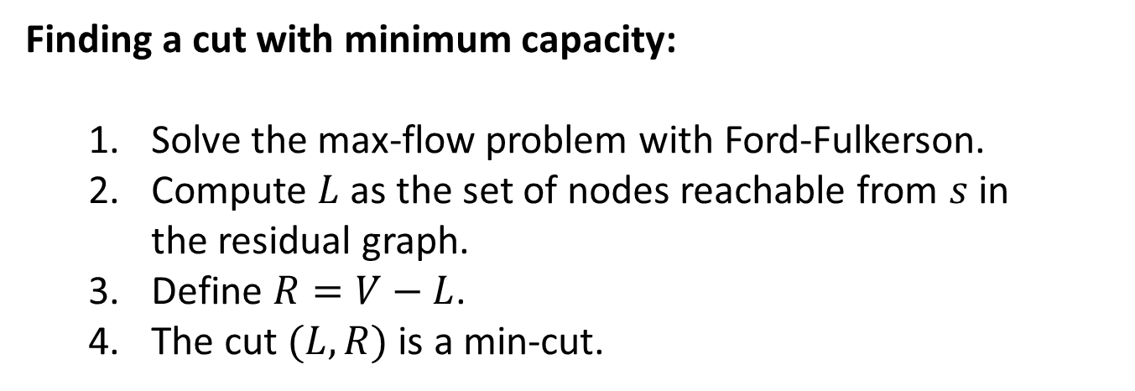
Min-cut algorithm
a
2
d
a
2
d
2
1
2
2
1
1
1
10
2
s
1
b
t
1
1
s
2
b
1
1
t
4
5
4
5
c
5
e
c
5
e
Flow
Residual graph
Finding a cut with minimum capacity:
Solve the max-flow problem with Ford-Fulkerson.
Compute $L$ as the set of nodes reachable from $s$ in the residual graph.
Define $R=V−L$.
The cut $(L,R)$ is a min-cut.

Slide 16
Bipartite matching
BOYS
GIRLS
Aleix
Anna
Bernat
Berta
Carles
Cristina
David
Duna
There is an edge between a boy and a girl if they like each other.
Can we pick couples so that everyone has exactly one partner that he/she likes?
Bad matching: if we pick (Aleix, Anna) and (Bernat, Cristina), then we cannot find couples for Berta, Duna, Carles and David.
A perfect matching would be: (Aleix, Berta), (Bernat, Duna), (Carles, Anna) and (David, Cristina).

Slide 17
Bipartite matching
Aleix
Anna
1
1
1
Bernat
Berta
1
s
1
1
t
Carles
Cristina
1
1
David
Duna
Reduced to a max-flow problem with $c_{e}=1$.
Question: can we always guarantee an integer-valued flow?
Property: if all edge capacities are integer, then the optimal flow found by Ford-Fulkerson’s algorithm is integral. It is easy to see that the flow of the augmenting path found at each iteration is integral.

Slide 18
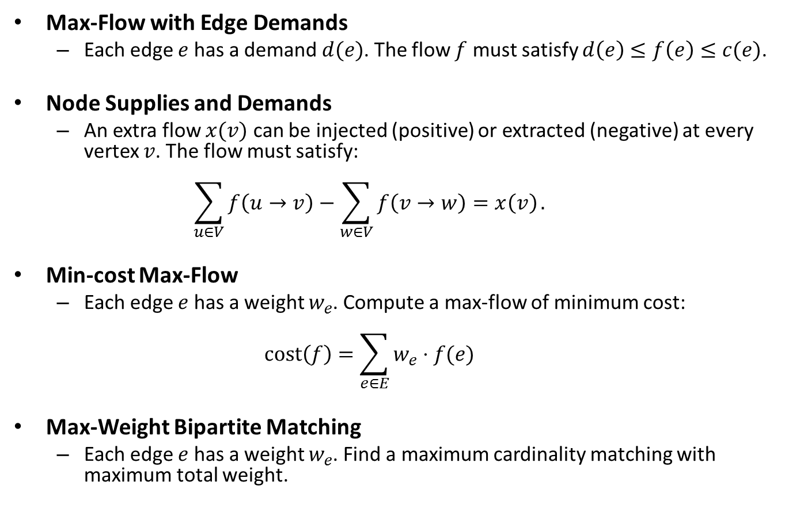
Extensions of Max-Flow
Max-Flow with Edge Demands
Each edge $e$ has a demand $d(e)$. The flow $f$ must satisfy $d\left(e\right)≤f\left(e\right)≤c(e)$.
Node Supplies and Demands
An extra flow $x(v)$ can be injected (positive) or extracted (negative) at every vertex $v$. The flow must satisfy: $\sum_{u∈V}{f\left(u→v\right)−\sum_{w∈V}{f\left(v→w\right)=x\left(v\right)}}.$
Min-cost Max-Flow
Each edge $e$ has a weight $w_{e}$. Compute a max-flow of minimum cost: $\text{cost}\left(f\right)=\sum_{e∈E}{w_{e}⋅f(e)}$
Max-Weight Bipartite Matching
Each edge $e$ has a weight $w_{e}$. Find a maximum cardinality matching with maximum total weight.

Slide 19
exercises

Slide 20
Flow network (from [DVP2008])
A
4
D
5
G
6
2
1
2
10
S
1
B
E
12
20
2
6
10
C
5
F
4
T
Find the maximum flow from S to T. Give a sequence of augmenting paths that lead to the maximum flow.
Draw the residual graph after finding the maximum flow.
Find a minimum cut between S and T.

