Slide 1
Graphs: Minimum Spanning Trees
Jordi Cortadella and Jordi Petit
Department of Computer Science

Slide 2
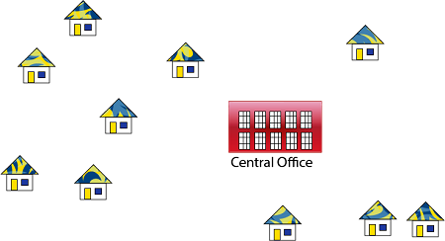
Laying a communication network
Source: https://www.javatpoint.com/applications-of-minimum-spanning-tree

Slide 3
Laying a communication network
Source: https://www.javatpoint.com/applications-of-minimum-spanning-tree

Slide 4
Minimum Spanning Trees
1
Nodes are computers
Edges are links
Weights are maintenance cost
Goal: pick a subset of edges such that
the nodes are connected
the maintenance cost is minimum
A
C
E
4
3
4
2
4
5
B
D
F
4
6
The solution is not unique. Find another one !
A
1
C
E
2
4
5
Property:
An optimal solution cannot contain a cycle.
B
D
F
4

Slide 5
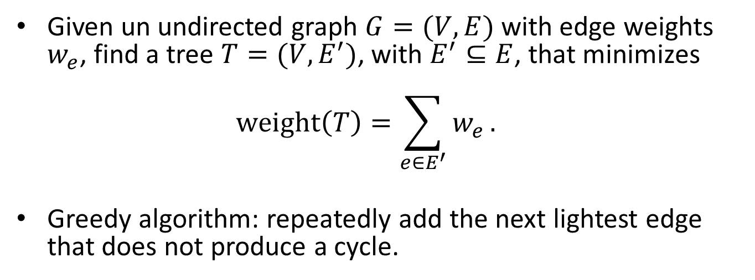
Minimum Spanning Tree
Given un undirected graph $G=(V,E)$ with edge weights $w_{e}$, find a tree $T=(V,E^{′})$, with $E^{′}⊆E$, that minimizes $\text{weight}\left(T\right)=\sum_{e∈E^{′}}{w_{e}}.$
Greedy algorithm: repeatedly add the next lightest edge that does not produce a cycle.
A
6
C
5
E
A
C
E
5
4
1
2
3
4
4
1
2
3
4
B
D
F
B
D
F
2
4
Note: We will now see that this strategy guarantees an MST.

Slide 6
Properties of trees
Definition: A tree is an undirected graph that is connected and acyclic.
Property: Any connected, undirected graph $G=\left(V,E\right)$ has $\left|E\right|≥\left|V\right|−1$ edges.
Property: A tree on $n$ nodes has $n−1$ edges.
Start from an empty graph. Add one edge at a time making sure that it connects two disconnected components. After having added $n−1$ edges, a tree has been formed.
Property: Any connected, undirected graph $G=(V,E)$ with $\left|E\right|=\left|V\right|−1$ is a tree.
It is sufficient to prove that $G$ is acyclic. If not, we can always remove edges from cycles until the graph becomes acyclic.
Property: Any undirected graph is a tree iff there is a unique path between any pair of nodes.
If there would be two paths between two nodes, the union of the paths would contain a cycle.

Slide 7
The cut property
$$S$$
$$V−S$$
$$e$$
$$e′$$
Suppose edges $X$ are part of an MST of $G=\left(V,E\right)$. Pick any subset of nodes $S$ for which $X$ does not cross between $S$ and $V−S$, and let $e$ be the lightest edge across this partition. Then $X∪\{e\}$ is part of some MST.
Proof (sketch): Let $T$ be an MST and assume $e$ is not in $T$. If we add $e$ to $T$, a cycle will be created with another edge $e′$ across the cut $(S,V−S)$. We can now remove $e′$ and obtain another tree $T^{′}$ with $\text{weight}\left(T^{′}\right)≤\text{weight}(T)$. Since $T$ is an MST, then the weights must be equal.

Slide 8
The cut property: example
A
1
C
3
E
A
1
C
3
E
2
2
2
3
1
2
MST $T$
1
B
D
F
B
D
F
1
4
1
A
1
C
E
A
1
C
E
2
1
2
MST $T′$
1
3
3
B
D
F
B
D
F
1
$$S$$
$$V−S$$

Slide 9
Minimum Spanning Tree
Any scheme like this works (because of the properties of trees):
$X=\left\{ \right\}$ # The set of edges of the MST repeat $\left|V\right|−1$ times: pick a set $S⊂V$ for which $X$ has no edges between $S$ and $V−S$ let $e∈E$ be the minimum-weight edge between $S$ and $V−S$ $X=X∪\{e\}$
$$S$$
$$V−S$$
$$e$$

Slide 10
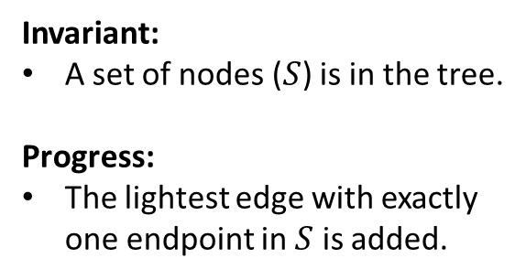
MST: two strategies
$$S$$
$$V−S$$
Invariant:
A set of nodes ($S$) is in the tree.
Progress:
The lightest edge with exactly one endpoint in $S$ is added.
$$e$$
Prim’s algorithm
Invariant:
A set of trees (forest) has been constructed.
Progress:
The lightest edge between two trees is added.
$$e$$
Kruskal’s algorithm

Slide 11
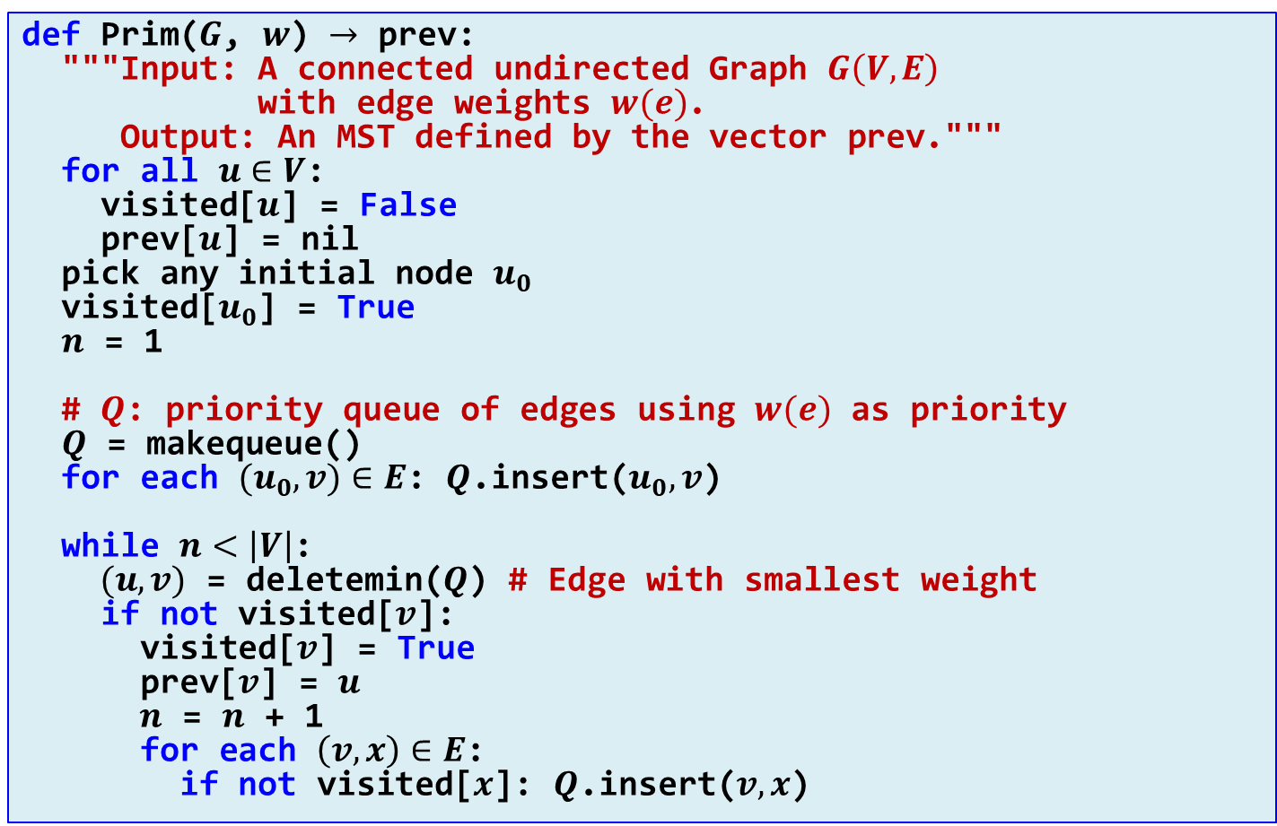
Prim’s algorithm
def Prim($G$, $w$) $→$ prev: """Input: A connected undirected Graph $G\left(V,E\right)$ with edge weights $w(e)$. Output: An MST defined by the vector prev.""" for all $u∈V$: visited[$u$] = False prev[$u$] = nil pick any initial node $u_{0}$ visited[$u_{0}$] = True $n$ = 1 # $Q$: priority queue of edges using $w(e)$ as priority $Q$ = makequeue() for each $(u_{0},v)∈E$: $Q$.insert($u_{0},v$) while $n<\left|V\right|$: $(u,v)$ = deletemin($Q$) # Edge with smallest weight if not visited[$v$]: visited[$v$] = True prev[$v$] = $u$ $n\text{ = }n\text{ + 1}$ for each $\left(v,x\right)∈E$: if not visited[$x$]: $Q$.insert($v,x$)
visited
Complexity: $\text{O}(|E|\log{|V|)}$

Slide 12
Prim’s algorithm
A
6
C
5
E
A
C
E
5
4
1
2
3
4
4
1
3
4
B
D
F
B
D
F
2
4
2
$$Q:$$
(AD,4) (AB,5) (AC,6)
(DB,2) (DC,2) (DF,4) (AB,5) (AC,6)
(BC,1) (DC,2) (DF,4) (AB,5) (AC,6)
(DC,2) (CF,3) (DF,4) (AB,5) (CE,5) (AC,6)
(CF,3) (DF,4) (AB,5) (CE,5) (AC,6)
(DF,4) (FE,4) (AB,5) (CE,5) (AC,6)
(FE,4) (AB,5) (CE,5) (AC,6)

Slide 13
Kruskal’s algorithm
Informal algorithm:
Sort edges by weight.
Visit edges in ascending order of weight and add them as long as they do not create a cycle.
How do we know whether a new edge will create a cycle?
def Kruskal($G$, $w$) $→$ MST: """Input: A connected undirected Graph $G\left(V,E\right)$ with edge weights $w_{e}$. Output: An MST defined by the edges in MST.""" MST = {} sort the edges in $E$ by weight for all $\left(u,v\right)∈E$, in ascending order of weight: if (MST has no path connecting $u$ and $v$): MST = MST $∪\{\left(u,v\right)\}$

Slide 14
Disjoint sets
A data structure to store a collection of disjoint sets.
Operations:
makeset($x$): creates a singleton set containing just $x$.
find($x$): returns the identifier of the set containing $x$.
union($x$, $y$): merges the sets containing $x$ and $y$.
Kruskal’s algorithm uses disjoint sets and calls
makeset: $|V|$ times
find: $2⋅|E|$ times
union: $\left|V\right|−1$ times

Slide 15
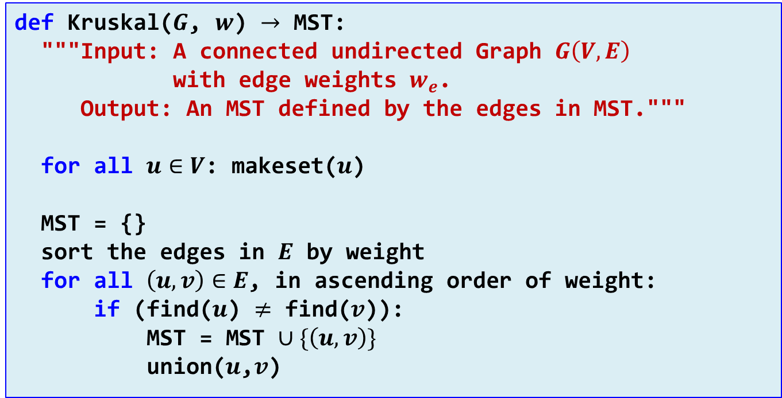
Kruskal’s algorithm
def Kruskal($G$, $w$) $→$ MST: """Input: A connected undirected Graph $G\left(V,E\right)$ with edge weights $w_{e}$. Output: An MST defined by the edges in MST.""" for all $u∈V$: makeset($u$) MST = {} sort the edges in $E$ by weight for all $\left(u,v\right)∈E$, in ascending order of weight: if (find($u$) $≠$ find($v$)): MST = MST $∪\{\left(u,v\right)\}$ union($u$,$v$)

Slide 16
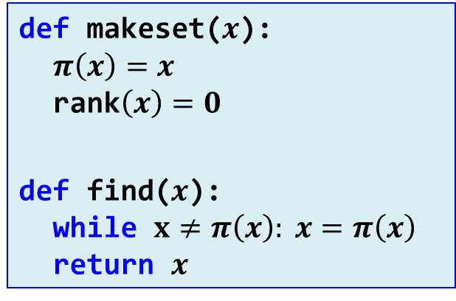
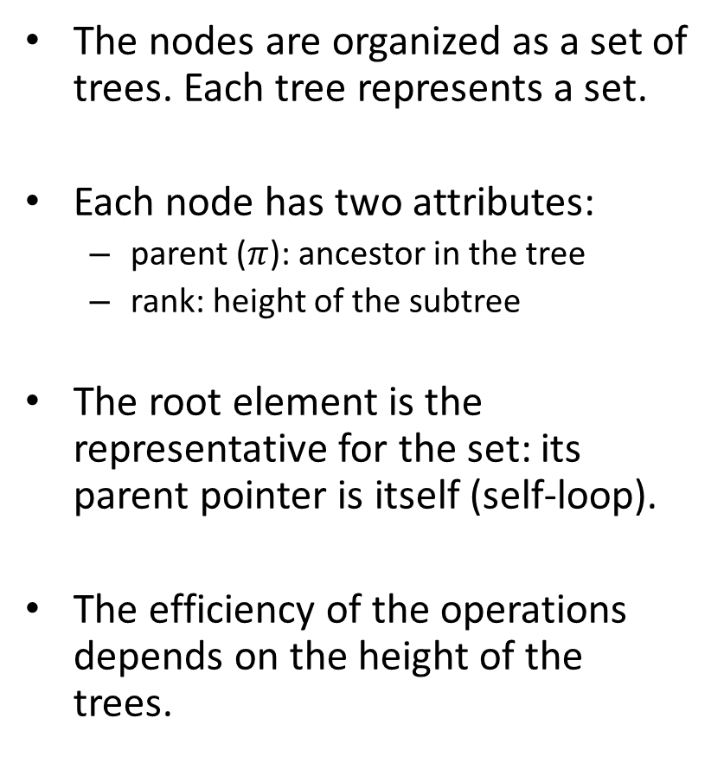
Disjoint sets
The nodes are organized as a set of trees. Each tree represents a set.
Each node has two attributes:
parent ($π$): ancestor in the tree
rank: height of the subtree
The root element is the representative for the set: its parent pointer is itself (self-loop).
The efficiency of the operations depends on the height of the trees.
E
H
B
C
D
F
G
A
def makeset($x$): $π\left(x\right)=x$ $\text{rank}\left(x\right)=0$
def find($x$): while $x≠π\left(x\right): x=π\left(x\right)$ return $x$

Slide 17
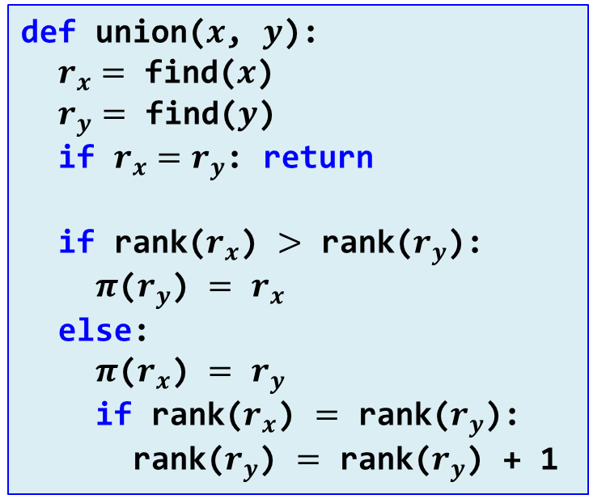
Disjoint sets
E
H
B
C
D
F
def union($x$, $y$): $r_{x}=$ find($x$) $r_{y}=$ find($y$) if $r_{x}=r_{y}$: return if rank($r_{x}$) $>$ rank($r_{y}$): $π$($r_{y}$) $=$ $r_{x}$ else: $π$($r_{x}$) $=$ $r_{y}$ if rank($r_{x}$) $=$ rank($r_{y}$): rank($r_{y}$) $=$ rank($r_{y}$) + 1
G
A
def makeset($x$): $π\left(x\right)=x$ $\text{rank}\left(x\right)=0$
def find($x$): while $x≠π\left(x\right): x=π\left(x\right)$ return $x$

Slide 18
Disjoint sets
After makeset($A$),…,makeset($G$):
$$A^{0}$$
$$B^{0}$$
$$C^{0}$$
$$D^{0}$$
$$E^{0}$$
$$F^{0}$$
$$G^{0}$$
After union($A$,$D$), union($B$,$E$), union($C$,$F$):
$$D^{1}$$
$$E^{1}$$
$$F^{1}$$
$$G^{0}$$
$$A^{0}$$
$$B^{0}$$
$$C^{0}$$
After union($C$,$G$), union($E$,$A$):
After union($B$,$G$):
$$D^{2}$$
$$F^{1}$$
$$D^{2}$$
$$E^{1}$$
$$E^{1}$$
$$F^{1}$$
$$A^{0}$$
$$C^{0}$$
$$G^{0}$$
$$A^{0}$$
$$B^{0}$$
$$B^{0}$$
$$C^{0}$$
$$G^{0}$$
Property: Any root node of rank $k$ has at least $2^{k}$ nodes in its tree.
Property: If there are $n$ elements overall, there can be at most $n/{2^{k}}$ nodes of rank $k$.
Therefore, all trees have height $≤\log{n}$.

Slide 19
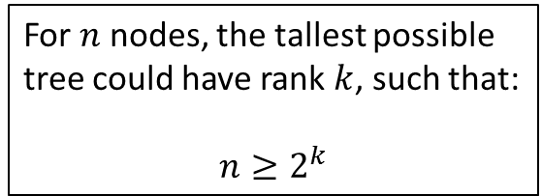
Disjoint sets
Property 1: proof by induction
Property 2:
rank $k+1$
For $n$ nodes, the tallest possible tree could have rank $k$, such that: $$n≥2^{k}$$
rank $k$
rank $k$
$$≥2^{k}$$
$$≥2^{k}$$
$$k≤\log_{2}{n}$$
$$≥2^{k+1}$$
Therefore, find($x$) is $\text{O}(\log{n})$
Property 1: Any root node of rank $k$ has at least $2^{k}$ nodes in its tree.
Property 2: If there are $n$ elements overall, there can be at most $n/{2^{k}}$ nodes of rank $k$.
Therefore, all trees have height $≤\log{n}$.

Slide 20
Disjoint sets: path compression
Complexity of Kruskal’s algorithm: $\text{O}(|E|\log{|V|)}$.
Sorting edges: $\text{O}\left(\left|E\right|\log\left|E\right|\right)=\text{O}(|E|\log{|V|)}$.
Find + union ($2⋅|E|$ times): $\text{O}(\left|E\right|\log\left|V\right|)$.
How about if the edges are already sorted or sorting can be done in linear time (weights are integer and small)?
Path compression:
A
A
A
B
C
$$≡$$
B
C
E
F
$$≡$$
B
C
D
E
F
G
D
E
D
G
F
G

Slide 21
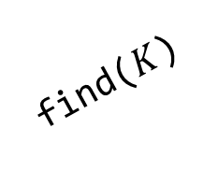
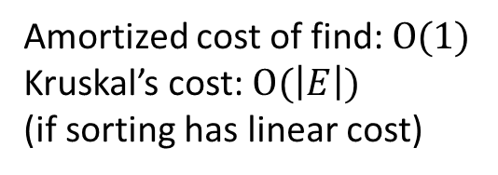
Disjoint sets: path compression
def find($x$): if $x≠π\left(x\right): π(x)\text{= }\text{find}(π\left(x\right))$ return $π(x)$
$$A^{3}$$
$$A^{3}$$
$$B^{0}$$
$$C^{1}$$
$$E^{2}$$
find($I$)
$$B^{0}$$
$$C^{1}$$
$$E^{2}$$
$$F^{1}$$
$$I^{0}$$
$$D^{0}$$
$$F^{1}$$
$$G^{1}$$
$$H^{0}$$
$$D^{0}$$
$$G^{1}$$
$$H^{0}$$
$$J^{0}$$
$$I^{0}$$
$$J^{0}$$
$$K^{0}$$
find($K$)
$$K^{0}$$
$$A^{3}$$
Amortized cost of find: $\text{O}(1)$ Kruskal’s cost: $\text{O}(\left|E\right|)$ (if sorting has linear cost)
$$B^{0}$$
$$C^{1}$$
$$E^{2}$$
$$F^{1}$$
$$I^{0}$$
$$K^{0}$$
$$G^{1}$$
$$D^{0}$$
$$H^{0}$$
$$J^{0}$$

Slide 22
exercises

Slide 23
Minimum Spanning Trees
Calculate the shortest path tree from node A using Dijkstra’s algorithm.
Calculate the MST using Prim’s algorithm. Indicate the sequence of edges added to the tree and the evolution of the priority queue.
Calculate the MST using Kruskal’s algorithm. Indicate the sequence of edges added to the tree and the evolution of the disjoint sets. In case of a tie between two edges, try to select the one that is not in Prim’s tree.
10
J
I
8
12
6
3
K
3
A
10
H
5
7
8
9
7
C
10
B
G
9
2
6
8
13
10
D
E
F
12

