Slide 1
Graphs: A* search
Jordi Cortadella and Jordi Petit
Department of Computer Science

Slide 2
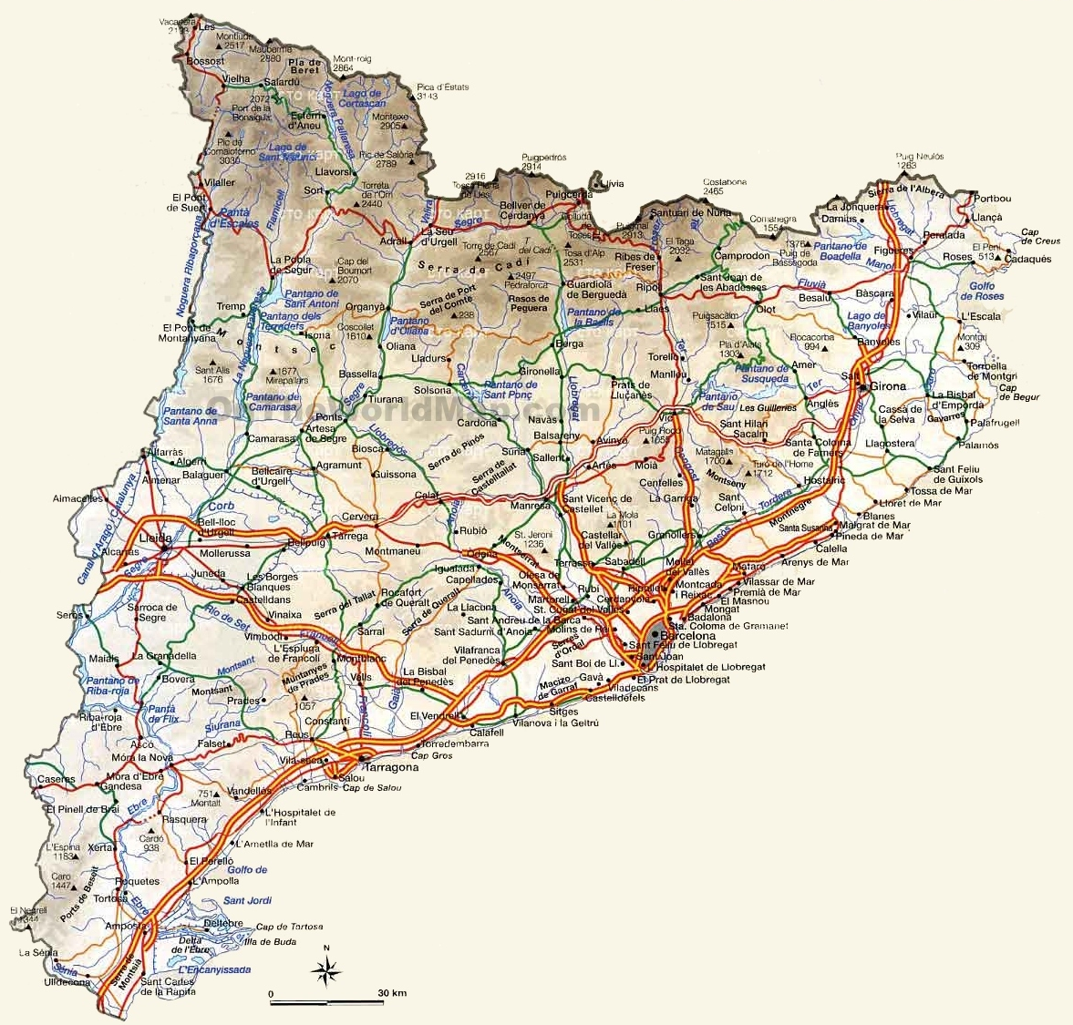
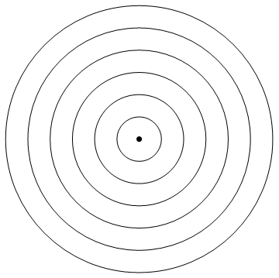
Shortest path between two nodes
How to find the shortest path from Barcelona to Girona?
Easy: run Dijkstra from Barcelona
Girona
Lleida
Barcelona
Dijkstra will find ALL shortest paths from Barcelona
Do we really need to waste computations exploring roads that go to Lleida, Amposta or Vielha?

Slide 3
A* search algorithm
Original paper: P. E. Hart, N. J. Nilsson and B. Raphael, "A Formal Basis for the Heuristic Determination of Minimum Cost Paths," in IEEE Transactions on Systems Science and Cybernetics, vol. 4, no. 2, pp. 100-107, July 1968.
A* is a class of graph searching strategies using ad hoc heuristic information. A* guarantees optimal solutions when the heuristic information meets certain properties.

Slide 4
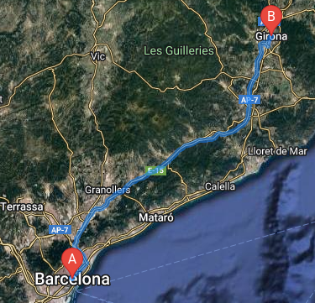
A* search: heuristic guidance
Girona
?
?
?
?
?
?
Barcelona
What is the most promising node to explore?
Heuristic: select nodes that reduce the straight-line distance to the target

Slide 5
A* search: intuition
$$n$$
$$h(n)$$
source
$$g(n)$$
goal
How to extend the path and find the next node $n$?
For each node $n$ calculate $f\left(n\right)=g\left(n\right)+h(n)$
$g(n)$ is the cost of the path from the source to $n$
$h(n)$ is the estimated cost of the cheapest path from $n$ to the goal
Select the node with minimum $f(n)$

Slide 6
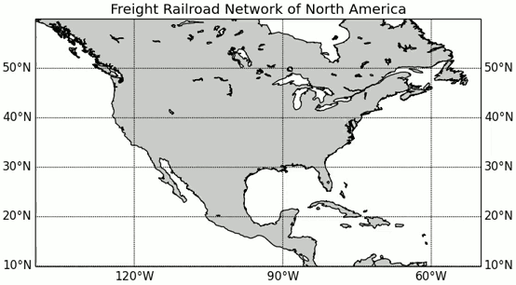
Example: train network
Finding the optimum path from Washington, D.C. and Los Angeles
$h(x)$ is the great-circle distance (the shortest possible distance on a sphere) to the target
Source: https://en.wikipedia.org/wiki/A*_search_algorithm

Slide 7
A* algorithm for shortest paths
def Astar_search($G$, $s$, $t$, $c$, $h$) $→$ pred: """Input: Graph $G(V,E)$, source node $s$, target node $t$, positive edge costs $\{c\left(e\right): e∈E\}$, function to estimate the cost to the target $\{h\left(v\right): v∈V\}$ Output: pred[$u$] has the predecessor in the shortest path from $s$ to $t$, if $t∉$ pred, no path exists from $s$ to $t$ """ f = {} # dictionary for the f value ($∞$ if not present) g = {} # dictionary for the g value ($∞$ if not present) pred = {} # dictionary of predecessors g[$s$] = 0 f[$s$] = $h$($s$) Q = {$s$} # open nodes: priority queue sorted by f while not Q.empty(): $u$ = Q.deletemin() # get open node with min cost if $u$ == $t$: return for all $\left(u,v\right)∈E$: gv = g[$u$] + $c(u,v)$ if gv < g[$v$]: # g[$v$]=$∞$ if $v∉$ g g[$v$] = gv f[$v$] = gv + $h$($v$) pred[$v$] = $u$ Q.add($v$) # new open node (or update if already in Q)
g[$u$]
$$c(u,v)$$
$h$($v$)
$$s$$
$$u$$
$$v$$
$$t$$

Slide 8
Running A*: example
9
3
6
3
4
B
C
D
$$h$$
3
5
11
0
A
1
H
0
$$g$$
4
5
7
5
4
E
5
F
3
G
A
11
Q = {A(11)}

Slide 9
Running A*: example
9
3
6
3
4
B
C
D
$$h$$
3
3
5
11
0
A
1
H
0
$$g$$
4
5
7
5
4
E
5
F
3
G
4
A
11
12
B
E
11
Q = {E(11), B(12)}

Slide 10
Running A*: example
9
3
6
3
4
B
C
D
$$h$$
3
3
5
5
11
0
A
1
H
0
$$g$$
4
5
7
5
4
E
5
F
3
G
4
9
A
11
12
B
E
11
Q = {C(11), B(12), F(14)}
C
11
F
14

Slide 11
Running A*: example
9
3
6
3
4
B
C
D
$$h$$
3
3
5
8
5
11
0
A
1
H
0
$$g$$
4
5
7
5
4
E
5
F
3
G
4
9
A
11
12
B
E
11
Q = {B(12), D(12), F(14)}
C
11
F
14
D
12

Slide 12
Running A*: example
9
3
6
3
4
B
C
D
$$h$$
3
3
5
8
5
11
0
A
1
H
0
$$g$$
4
5
7
5
4
E
5
F
3
G
4
9
A
11
12
B
E
11
Q = {D(12), F(14)}
12
C
C
11
F
14
D
12

Slide 13
Running A*: example
9
3
6
3
4
B
C
D
$$h$$
3
3
5
8
5
11
0
A
1
H
0
$$g$$
4
5
7
5
4
E
5
F
3
G
4
9
A
11
12
B
E
11
Q = {H(13), F(14)}
12
C
C
11
F
14
Finally, H is selected and the algorithm terminates
Backtrack from H to find the selected path
D
12
H
13

Slide 14
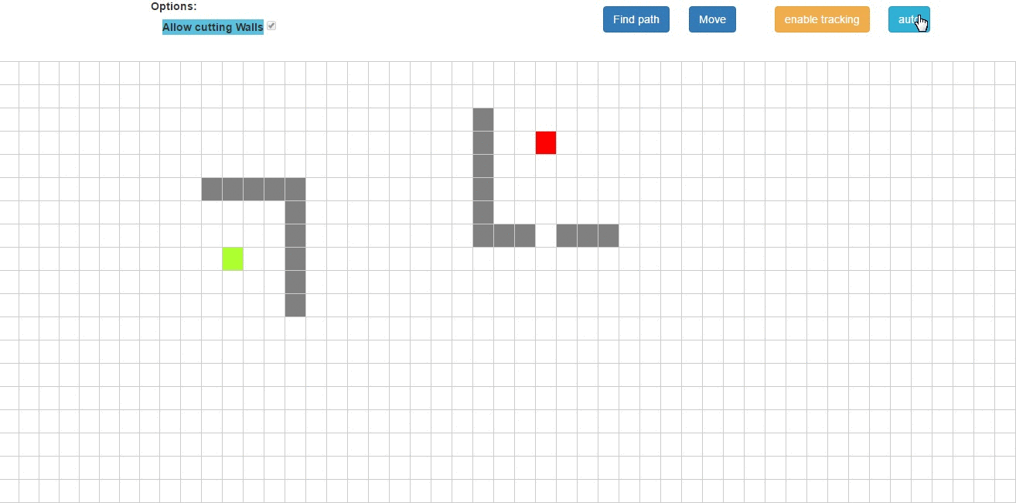
Avoiding obstacles
Source: https://github.com/vittin/A-Star/

Slide 15
The heuristic function: $h(x)$
A* relies on a good heuristic to estimate the cost to reach the goal
How about using a "bad" heuristic function?
Does the algorithm find the optimum path?
Does it run efficiently?
Let us study the concepts of admissible and consistent heuristic function

Slide 16
Admissibility
A heuristic function is said to be admissible if it never overestimates the cost of reaching the goal
Example: the straight-line distance in a map is an admissible function (no path can be shorter than the straight line)
85 km
101 km

Slide 17
Admissibility
Important result:
If $h(x)$ is admissible, A* will find the optimum path
Proof (informal):
A* will never overlook a path with lower cost, since a node $v$ with lower $f(v)$ than the goal will exist in the set of open nodes before the goal is reached.

Slide 18
Consistency
A heuristic function $h(x)$ is said to be consistent (or monotone) if $h\left(u\right)≤c\left(u,v\right)+h\left(v\right)$ for every edge $(u,v)$ with cost $c(u,v)$
Important result:
If $h(x)$ is consistent, A* is guaranteed to find an optimal path without processing any node more than once
$$h(u)$$
$$t$$
$$g(u)$$
$$u$$
$$s$$
$$h(v)$$
$$c(u,v)$$
$$v$$

Slide 19
Consistency
If $h(x)$ is consistent then $f(x)$ is an increasing function
$$h(u)$$
$$t$$
$$g(u)$$
$$u$$
$$s$$
$$h(v)$$
$$c(u,v)$$
$$v$$
$$h\left(u\right)≤c\left(u,v\right)+h\left(v\right)$$
$$f$$
$$f\left(v\right)=f\left(u\right)−h\left(u\right)+c\left(u,v\right)+h\left(v\right)$$
$$≥f(u)$$
$$f(u)$$
source
$$u$$
$$v$$
goal

Slide 20
Example
Goal: find the shortest path from A to H
The $h$ function is not admissible (it overestimates the cost to the goal)
Example: $h\left(\text{C}\right)=12$. The solution may not be optimal
$$h$$
7
12
6
3
3
B
C
D
3
7
9
0
A
1
H
4
8
4
2
5
E
5
F
3
G
Visited nodes during the A* search: A B E F G H

Slide 21
Example
Goal: find the shortest path from A to H.
The $h$ function is admissible (it does not overestimate the cost to the goal)
The $h$ function is not consistent, e.g., $h\left(\text{E}\right)>d\left(\text{E},\text{C}\right)+h(\text{C})$
The solution will be optimal. Some nodes may be visited more than once
$$h$$
7
5
2
3
3
B
C
D
3
7
9
0
A
1
H
4
8
4
2
5
E
5
F
3
G
Visited nodes during the A* search: A B C D E C D F G H

Slide 22
Example
Goal: find the shortest path from A to H.
The $h$ function is admissible (it does not overestimate the cost to the goal)
The $h$ function is consistent
The solution will be optimal and the nodes will be visited once at most
$$h$$
7
5
2
3
3
B
C
D
3
7
9
0
A
1
H
4
5
4
2
5
E
5
F
3
G
Visited nodes during the A* search: A E B C D F G H

Slide 23
Complexity
The time complexity of A* highly depends on the heuristic function. The worst-case complexity is $\text{O}(b^{d})$, where
$d$ is the depth of the shortest path
$b$ is the average branching factor (number of successor nodes of each node)
Each heuristic has an effective branching factor $b^{∗}$, and the number of visited nodes is: $1+b^{∗}+{\left(b^{∗}\right)}^{2}+⋯+{\left(b^{∗}\right)}^{d}$
Good heuristics have small values for $b^{∗}$ (the optimal heuristic has $b^{∗}=1$)

Slide 24
Complexity
A* may not terminate if the graph is infinite and no path exists to the target
A* keeps all generated nodes in memory. There are memory-bounded heuristic searches:
Iterative deepening A*: guided DFS, no priority queue, nodes may be visited multiple times
Simplified Memory-Bounded A* (SMA*): nodes with highest f-cost pruned from the queue
and others ...

Slide 25
EXERCISES

Slide 26
Shortest path
A
3
F
10
7
6
6
1
H
3
2
D
7
8
B
5
G
2
8
3
1
3
5
I
1
E
5
C
5
3
5
3
J
Find the shortest path from A to J using the A* algorithm.
The red numbers next to the nodes represent the heuristic value.
Questions:
Is the heuristic admissible?
Is the heuristic consistent?
Report the visited node at each step of the algorithm

Slide 27
8-puzzle problem
Initial state
Goal
2 | 8 | 3
1 | 6 | 4
7 |  | 5
1 | 2 | 3
8 |  | 4
7 | 6 | 5
Use the A* algorithm to find the smallest sequence of shifts to reach the goal. Depict the search tree
Consider:
$g(n)$ = depth of the node (number of shifts)
$h(n)$ = number of misplaced tiles

Slide 28
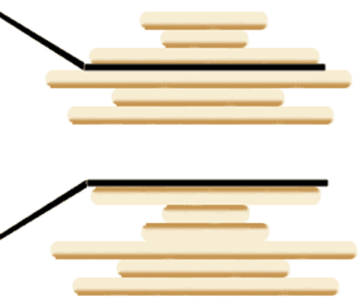
Pancake sorting
You have a disordered stack of pancakes of different sizes. You want to sort this pile (smallest pancake on top, largest one at the bottom) using a spatula by flipping parts of the stack
Describe how you would use A* to find the shortest sequence of flips that sort the pile
Define the initial state, successor states, and the functions $g(n)$ and $h(n)$. Make sure $h(n)$ is admissible

