Slide 1
Priority Queues
Jordi Cortadella and Jordi Petit
Department of Computer Science

Slide 2
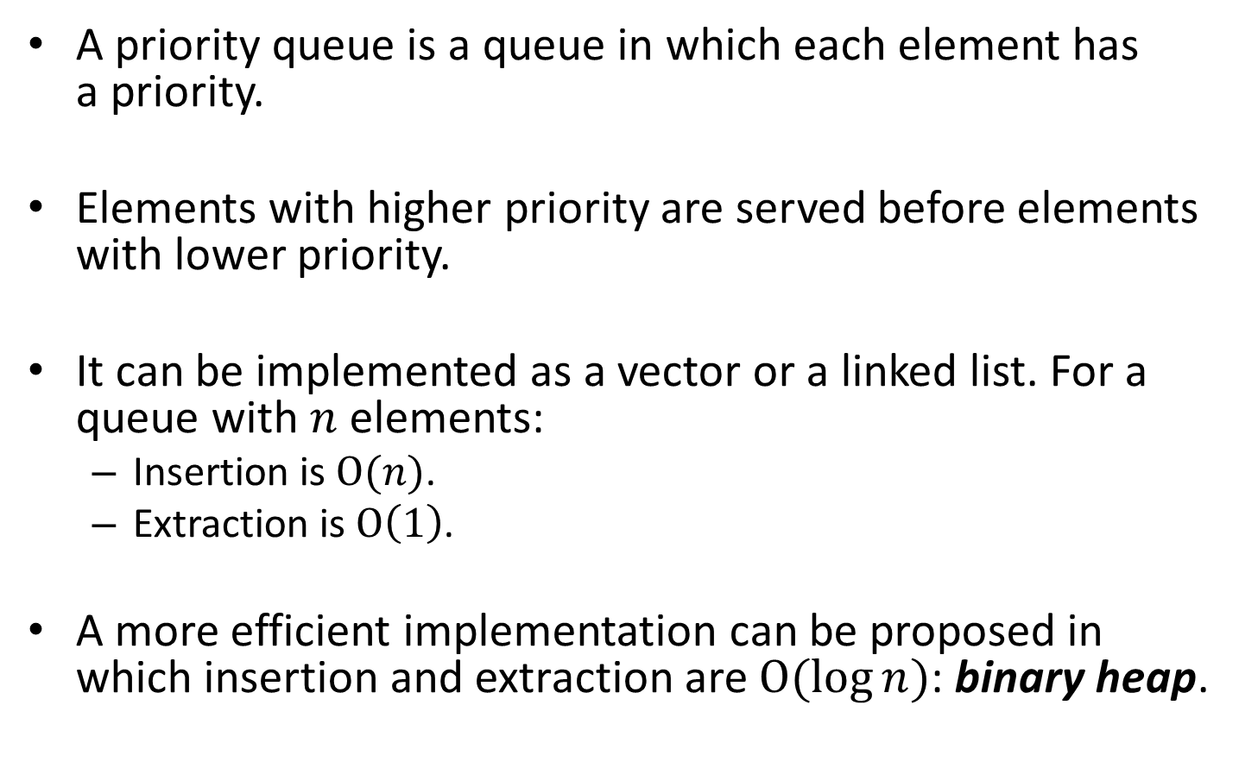
A priority queue
A priority queue is a queue in which each element has a priority.
Elements with higher priority are served before elements with lower priority.
It can be implemented as a vector or a linked list. For a queue with $n$ elements:
Insertion is $\text{O}(n)$.
Extraction is $\text{O}\left(1\right)$.
A more efficient implementation can be proposed in which insertion and extraction are $\text{O}(\log{n})$: binary heap.

Slide 3
Binary Heap
13
21
24
31
16
19
26
65
33
68
$$h=3$$
$$h=2$$
$$h=1$$
$$h=0$$
Complete binary tree (except at the bottom level).
Height $h$: between $2^{h}$ and $2^{h+1}−1$ nodes.
For $N$ nodes, the height is $\text{O}(\log{N})$.
It can be represented in a vector.
0 | 1 | 2 | 3 | 4 | 5 | 6 | 7 | 8 | 9 | 10 | 11 | 12 | 13 | 14 | 15
 | 13 | 21 | 16 | 24 | 31 | 19 | 68 | 65 | 26 | 33

Slide 4
Binary Heap
13
21
24
31
16
19
26
65
33
68
$$i$$
𝑖
$$2i$$
2𝑖
$$2i+1$$
2𝑖+1
$$\left\lfloor i/2\right\rfloor$$
⌊𝑖∕2⌋
$i$ (even)
𝑖 (even)
$i+1$ (odd)
𝑖+1 (odd)
Locations in the vector:
Heap-Order Property: the key of the parent of X is smaller than (or equal to) the key in X.
0 | 1 | 2 | 3 | 4 | 5 | 6 | 7 | 8 | 9 | 10 | 11 | 12 | 13 | 14 | 15
 | 13 | 21 | 16 | 24 | 31 | 19 | 68 | 65 | 26 | 33

Slide 5
Binary Heap
13
21
24
31
16
19
26
65
33
68
Two main operations on a binary heap:
Insert a new element
Remove the min element
Both operations must preserve the properties of the binary heap:
Completeness
Heap-Order property

Slide 6
Binary Heap: insert 14
13
21
24
31
16
19
26
65
14
33
68
Insert in the last location
13
21
24
14
16
19
26
65
31
33
68
… and bubble up …
13
14
24
21
16
19
26
65
31
33
68
done !

Slide 7
Binary Heap: remove min
13
14
24
21
16
19
26
65
31
33
68
13
Extract the min element and move the last one to the root of the heap
31
14
24
21
16
19
26
65
33
68
… and bubble down …
14
31
24
21
16
19
26
65
33
68

Slide 8
Binary Heap: remove min
14
31
24
21
16
19
26
65
33
68
14
21
24
31
16
19
26
65
33
68
done !

Slide 9
Binary Heap: complexity
Bubble up/down operations do at most $h$ swaps, where $h$ is the height of the tree and $h=\left\lfloor \log_{2}{N}\right\rfloor$
Therefore:
Getting the min element is $\text{O}(1)$
Inserting a new element is $\text{O}(\log{N})$
Removing the min element is $\text{O}(\log{N})$

Slide 10
Binary Heap: other operations
Let us assume that we have a method to know the location of every key in the heap.
Increase/decrease key:
Modify the value of one element in the middle of the heap.
If decreased → bubble up.
If increased → bubble down.
Remove one element:
Set value to $−∞$, bubble up and remove min element.

Slide 11
Building a heap from a set of elements
Heaps are sometimes constructed from an initial collection of $N$ elements. How much does it cost to create the heap?
Obvious method: do $N$ insert operations.
Complexity: $\text{O}(N\log{N})$
Can it be done more efficiently?

Slide 12
Building a heap from a set of elements
15
8
3
1
4
7
13
2
10
6
9
12
5
11
14
bubble down
15
8
3
1
4
7
13
2
10
6
9
12
5
11
14
15
8
3
1
4
5
13
2
10
6
9
12
7
11
14
15
8
3
1
4
5
13
2
10
6
9
12
7
11
14
15
8
2
1
4
5
13
3
10
6
9
12
7
11
14
15
8
2
1
4
5
13
3
10
6
9
12
7
11
14
15
1
2
6
4
5
13
3
10
8
9
12
7
11
14
1
2
3
6
4
5
13
15
10
8
9
12
7
11
14

Slide 13
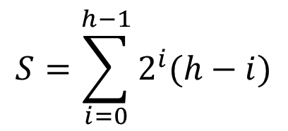
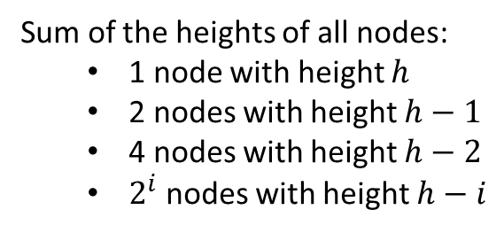
Building a heap: implementation
def heapify(L: list[T]) -> None: """Converts a list into a heap (assuming L[0] is not used)""" for i in range(len(L)//2, 0, -1): bubble_down(L, i)
v:
Sum of the heights of all nodes:
1 node with height $h$
2 nodes with height $h−1$
4 nodes with height $h−2$
$2^{i}$ nodes with height $h−i$
3
$$S=\sum_{i=0}^{h−1}{2^{i}(h−i)}$$
2
2
1
1
1
1
0
0
0
0
0
0
0
0
$$S=h+2\left(h−1\right)+4\left(h−2\right)+8\left(h−3\right)+16\left(h−4\right)+⋯+2^{h−1}(1)$$
$$2S=2h+4\left(h−1\right)+8\left(h−2\right)+16\left(h−3\right)+⋯+2^{h}(1)$$
Subtract the two equations:
$$S=−h+2+4+8+⋯+2^{h−1}+2^{h}=\left(2^{h+1}−1\right)−\left(h+1\right)=\text{O}(N)$$
A heap can be built from a collection of items in linear time.

Slide 14
Exercises

Slide 15
Exercise: insert/remove element
Given the binary heap implemented in the following vector, draw the tree represented by the vector.
Execute the following sequence of operations
insert(8); remove_min(); insert(6); insert(18); remove_min();
and draw the tree after the execution of each operation.
 | 6 | 7 | 9 | 10 | 11 | 12 | 13 | 15 | 19 | 14 | 21 | 17 | 16

Slide 16
Exercise: guess $a$ and $b$
Consider the binary heap of integer keys implemented by the following vector:
After executing the operations insert(8) and remove_min() the contents of the binary heap is:
Discuss about the possible values of $a$ and $b$. Assume there can never be two identical keys in the heap.
 | 3 | 7 | $$a$$ | 10 | 15 | 18 | $$b$$ | 25 | 13 | 20 | 17 | 22 | 19
 | 7 | 10 | 8 | $$b$$ | 15 | 18 | $$a$$ | 25 | 13 | 20 | 17 | 22 | 19

Slide 17
Exercise: the $k$-th element
The $k$-th element of $n$ sorted vectors.
Let us consider $n$ vectors sorted in ascending order.
Design an algorithm with cost $Θ(k\log{n}+n)$ that finds the $k$-th global smallest element.

Slide 18
Exercise: bubble-up/down
Give an implementation for the methods bubble_up and bubble_down of a heap:
def bubble_up(L: list[T], int i) -> None: """Bubbles up the element at location i"""
def bubble_down(L: list[T], int i) -> None: """Bubbles down the element at location i"""

