Slide 1
Iterating over data with Python
Jordi Cortadella and Jordi Petit
Department of Computer Science

Slide 2
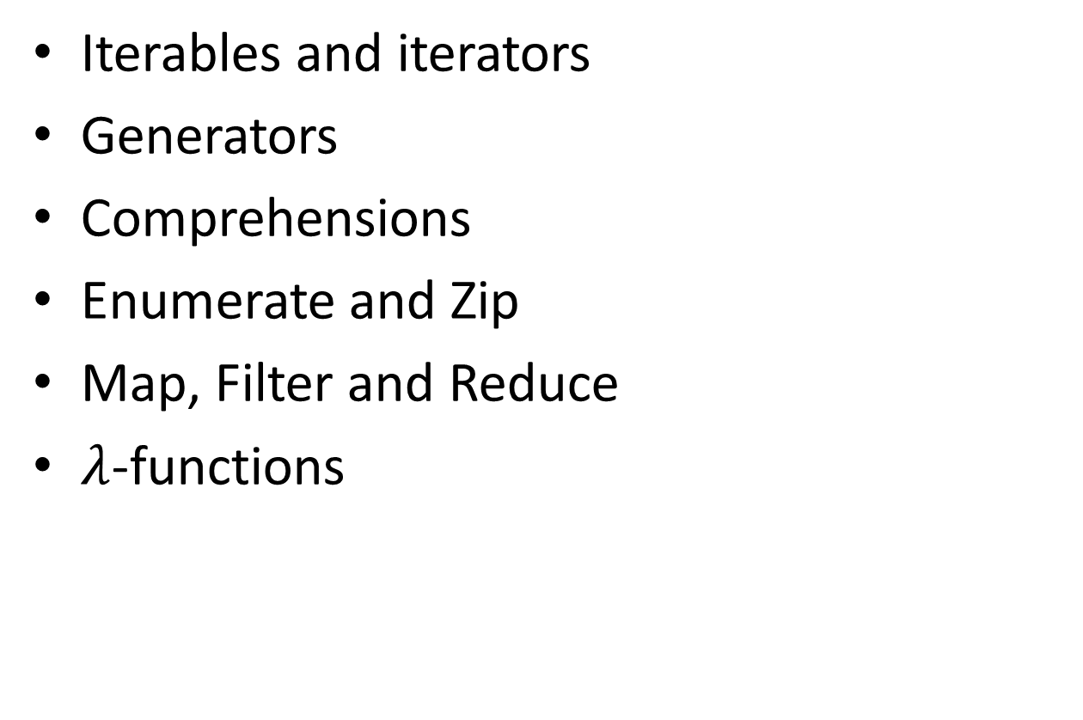
Outline
Iterables and iterators
Generators
Comprehensions
Enumerate and Zip
Map, Filter and Reduce
$λ$-functions

Slide 3
ITERABLES and iterators

Slide 4
Iterables
Iterables are containers of data in which we can iterate to obtain elements one by one
Lists, tuples, sets, dictionaries, strings, etc. are iterables
Iterators are objects used to iterate over iterables
Two important functions:
iter(): creates an iterator from an iterable
next(): returns the next item
Iterable
iter()
Iterator
next()
when another element is available
when the iterator is exhausted
next()
Returns next element
StopIteration (exception)

Slide 5
Iterables: example
>>> lst = [1, 2, 3] # lst is an iterable
>>> it = iter(lst) # it is an iterator
>>> next(it) 1
>>> next(it) 2
>>> next(it) 3
>>> next(it) Traceback (most recent call last): File "<stdin>", line 1, in <module> StopIteration >>>
next() raises a StopIteration exception when no more items are available

Slide 6
next(it, default)
it = iter(some_iterable) # Creates an iterable
# next(it, default) does not raise any exception. # Instead, it returns the default value. v = next(it, None) while v is not None: do_something(v) v = next(it, None)
# Equivalent code for v in it: do_something(v)

Slide 7
generators

Slide 8
Designing data pipelines
Big data systems often have to process long streams of data with pipelines chaining different operations.
How to store the data between operations?
Operation 1 (return data)
Operation 2
Large data storage

Slide 9
Designing data pipelines
Big data systems often have to process long streams of data with pipelines chaining different operations.
How to store the data between operations?
Operation 1 (return data)
Operation 2
Large data storage

Slide 10
Generators
A mechanism to avoid storage of large amounts of data.
Generators are lazy iterators that do not store the whole data structures in memory.
Operation 1 (yield data)
Operation 2

Slide 11
Generators: example
>>> def natural_numbers(): ... n = 0 ... while True: ... yield n ... n += 1 ...
>>> for i in natural_numbers(): ... if is_prime(i): ... print(i) ... 2 3 5 7 11 ... 672131
672137
672143
^CTraceback (...) ...
KeyboardInterrupt
>>>
>>> gen = natural_numbers() >>> next(gen) 0 >>> next(gen) 1 >>> next(gen) 2 >>> next(gen) 3 ...

Slide 12
Hamming numbers
Hamming numbers are those numbers whose only prime divisors are 2, 3, and 5.
Examples:
20 is a Hamming number ($2^{2}⋅3^{0}⋅5^{1}$)
21 is not a Hamming number ($3⋅7$)
Exercise: design a program that prints the $n$ smallest Hamming numbers.
Strategy: for every Hamming number $2^{i}⋅3^{j}⋅5^{k}$, we can generate three new numbers by increasing each one of the exponents.
How to generate them in ascending order?

Slide 13
Hamming numbers
Generating the next Hamming numbers:
How to generate them in ascending order?
Use a priority queue to store the pending numbers
How to avoid repetitions?
Remember the last delivered number
$$2^{i}⋅3^{j}⋅5^{k}$$
$$2^{i+1}⋅3^{j}⋅5^{k}$$
$$2^{i}⋅3^{j+1}⋅5^{k}$$
$$2^{i}⋅3^{j}⋅5^{k+1}$$

Slide 14
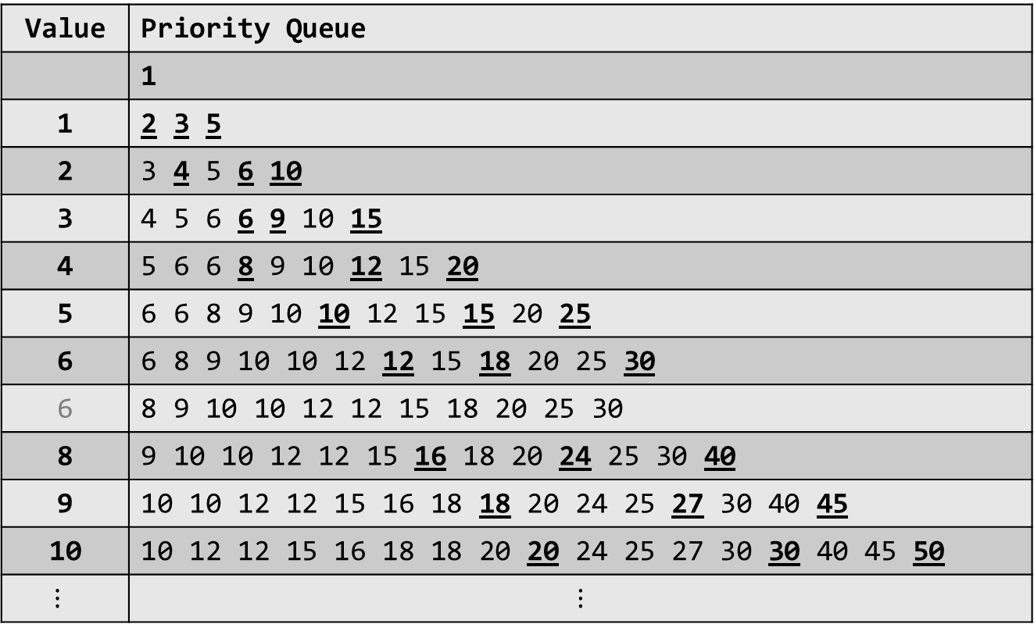
Hamming numbers: simulation
Value | Priority Queue
 | 1
1 | 2 3 5
2 | 3 4 5 6 10
3 | 4 5 6 6 9 10 15
4 | 5 6 6 8 9 10 12 15 20
5 | 6 6 8 9 10 10 12 15 15 20 25
6 | 6 8 9 10 10 12 12 15 18 20 25 30
6 | 8 9 10 10 12 12 15 18 20 25 30
8 | 9 10 10 12 12 15 16 18 20 24 25 30 40
9 | 10 10 12 12 15 16 18 18 20 24 25 27 30 40 45
10 | 10 12 12 15 16 18 18 20 20 24 25 27 30 30 40 45 50
$$⋮$$ | $$⋮$$

Slide 15
Hamming numbers
import heapq from typing import Iterator def hamming_numbers() -> Iterator[int]: """Generates all Hamming numbers in ascending order""" pq = [1] # priority queue storing Hamming numbers prev = 0 # the last delivered number while True: value = heapq.heappop(pq) # get the smallest number if value != prev: # avoid repetitions yield value # deliver the value and wait (lazy) prev = value for x in 2, 3, 5: # generate new numbers nxt = x*value heapq.heappush(pq, nxt)

Slide 16
Hamming numbers
1
2
3
4
5
6
8
9
10
12
15
16
18
20
24
25
27
30
32
36
def main(n: int) -> None: """Test to print first n hamming numbers""" hammings = hamming_numbers() # the generator for _ in range(n): print(next(hammings)) if __name__ == '__main__':
main(20)

Slide 17
Merging sequences
Functions can receive iterators as parameters and generate iterators as results
Let us design a function that merges two sorted iterators and generated a sorted iterator
$⋯$ 15 10 8 1
merge
$⋯$ 11 10 8 6 5 3 1
$⋯$ 11 6 5 3

Slide 18
Merging sequences: typing
from typing import Iterator, TypeVar, Protocol # This is an abstract class that contains the __lt__ # operator (<). No need to implement it. class Comparable(Protocol): def __lt__(self: 'T', other: 'T') -> bool: ... # This is a generic type. The bound attribute indicates # that the type must contain the operators of Comparable. T = TypeVar('T', bound=Comparable) # The merge function dealing with sequences of elements # that are "Comparable" (i.e., the type contains the # the operator <). def merge(a: Iterator[T], b: Iterator[T]) -> Iterator[T]: """reads two sorted iterators and generates a sorted iterator by merging them""" ...

Slide 19
Merging sequences: code
def merge(a: Iterator[T], b: Iterator[T]) -> Iterator[T]: """reads two sorted iterators and generates a sorted iterator by merging them"""
x, y = next(a, None), next(b, None)
while x is not None and y is not None:
if x < y:
yield x
x = next(a, None)
else:
yield y
y = next(b, None)
if x is not None:
yield x
yield from a # delivers values from another iterator
if y is not None:
yield y
yield from b

Slide 20
COMPREHENSIONS

Slide 21
Comprehensions
Set builder notation. Example: $S=\left\{x^{2} \right| x<1000, x \text{is} \text{prime}\}$
Conventional Python using a for loop: s = {} for x in range(1000): if is_prime(x): s.add(x**2)
Using comprehensions: s = {x**2 for x in range(1000) if is_prime(x)}

Slide 22
Nested comprehensions
# Given a list of words, create a dictionary with the key-value # pairs <word: number of vowels> words = ['cat', 'kangaroo', 'lion', 'dog', 'hippopotamus']
# We can use s.count(x) to count the number of occurrences # of x in the string s, e.g., 'kangaroo'.count('o') is 2
vowels = {w: sum(w.count(x) for x in 'aeiou') for w in words}
print(vowels) {'cat': 1, 'kangaroo': 4, 'lion': 2, 'dog': 1, 'hippopotamus': 5}
# Let us print a list of the words with more than 3 vowels
print([w for w in vowels.keys() if vowels[w] > 3]) ['kangaroo', 'hippopotamus']

Slide 23
Creating matrices with comprehensions
# Let us create a 4x4 identity matrix matrix = [[0]*4]*4 for i in range(4): matrix[i][i] = 1
# Surprise! What’s wrong? print(matrix) [[1, 1, 1, 1], [1, 1, 1, 1], [1, 1, 1, 1], [1, 1, 1, 1]]
# Let us use comprehensions matrix = [[1 if i==j else 0 for j in range(4)] for i in range(4)] print(matrix) [[1, 0, 0, 0], [0, 1, 0, 0], [0, 0, 1, 0], [0, 0, 0, 1]]
# How to create a zero matrix with n rows and m columns matrix = [[0]*m for _ in range(n)]

Slide 24
Generator expressions: example
>>> import sys >>> # A list comprehension >>> squares_lc = [i**2 for i in range(10**6)] >>> # It generates a long list (larger than 8Mb) >>> sys.getsizeof(squares_lc) 8448728
>>> >>> # But we can also create a generator using (…) >>> squares_gc = (i**2 for i in range(10**6)) >>> sys.getsizeof(squares_gc) 104
>>> # and we can iterate over the generator >>> for n in squares_gc: ... if is_prime(n+1): ... print(n+1) ...

Slide 25
Enumerate and Zip

Slide 26
enumerate
# Different ways of printing indices and values lst = [x**2 for x in range(100)]
for i in range(len(lst)): print(i, lst[i])
i = 0 for v in lst: print(i, v) i += 1
for i, v in enumerate(lst): print(i, v)
# It also works for generators! lst_gen = (x**2 for x in range(100)) for i, v in enumerate(lst_gen): print(i, v)

Slide 27
Hamming numbers
1
2
3
4
5
6
8
9
10
12
15
16
18
20
24
25
27
30
32
36
def main(n: int) -> None: """Test to print first n hamming numbers""" for i, x in enumerate(hamming_numbers()): if i == n: break print(x) if __name__ == '__main__':
main(20)

Slide 28
zip
>>> # Zipping lists >>> lst1 = [x**2 for x in range(100)] >>> lst2 = [2*x for x in range(100)] >>> lst3 = zip(lst1, lst2) >>> # lst3 is an iterator! >>> print(lst3) <zip object at 0x7fd8d8beacc0> >>> for x, y in lst3: ... print(x, y) ... 0 0 1 2 4 4 9 6 16 8 25 10 36 12 49 14
lst1
lst2
lst3

Slide 29
zipping and unzipping
>>> # Let us zip two lists >>> letters = ['a', 'b', 'c', 'd'] >>> numbers = [1, 2, 3, 4] >>> ln_zip = zip(letters, numbers) >>> list_ln = list(ln_zip) >>> print(list_ln) [('a', 1), ('b', 2), ('c', 3), ('d', 4)]
# Now we can unzip the list of tuples >>> lett, numb = zip(*list_ln)
>>> print('letters =', lett) letters = ('a', 'b', 'c', 'd') >>> print('numbers =', numb) numbers = (1, 2, 3, 4)

Slide 30
MAP, FILTER and REDUCE

Slide 31
map, filter and reduce
Loops, comprehensions and generators are techniques used to process data in iterable objects.
The functions map(), filter() and reduce() provide a functional programming approach to achieve similar goals.
They can be applied to any iterable object (list, tuple, set, …)
These functions can provide a very elegant solution to compute expressions like this: $\sum_{0≤i<n, is_prime(i)}{i^{2}}$

Slide 32
map, filter, reduce: auxiliary functions
def square(x: int) -> int: return x*x
def add(x: int, y: int) -> int: return x + y
def is_prime(n: int) -> bool: if n <= 1: return False d = 2 while d*d <= n: if n%d == 0: return False d += 1 return True

Slide 33
map
lst = [1, 2, 3, 4, 5, 6]
# map creates an iterator that applies a function # to all elements of the iterable object result = map(square, lst) list(result) # Output: [1, 4, 9, 16, 25, 36]

Slide 34
filter
# filter creates an iterator that selects the # elements that satisfy the filtering condition result = filter(is_prime, range(30)) list(result) # Output: [2, 3, 5, 7, 11, 13, 17, 19, 23, 29]

Slide 35
reduce
from functools import reduce
# reduce visits all elements and executes a # function that "accumulates" their values result = reduce(add, range(10)) result # Output: 45
# An initial value can also be specified result = reduce(add, range(10), 5) result # Output: 50

Slide 36
Back to our problem
$$\sum_{0≤i<n, is_prime(i)}{i^{2}}$$
generator: range(n)
filter: is_prime(i)
map: square(x)
reduce: add(x,y)
r
n = 10**7 r = reduce(add, map(square, filter(is_prime, range(n)))) print(r) # Output: 21113978675102768574
Important: no intermediate lists are generated. Very low storage is required (< 1000 bytes). By using lists to store the intermediate results, about 400Mb of storage would be required.

Slide 37
Pythonic Boolean reductions
any() and all() are particular cases of reduce functions with Boolean results.
>>> numbers = [2, 3, 7, 11, 13, 23]
>>> all(is_prime(x) for x in numbers) True
>>> all(x%2 == 1 for x in numbers) False
>>> any(6 < x < 12 for x in numbers) True
>>> words = ['cat', 'kangaroo', 'lion', 'dog', 'hippopotamus']
>>> all(len(w) > 10 for w in words) False
>>> any(len(w) > 10 for w in words) True
>>> all(len(w) < 15 for w in words) True
>>> any(w[0] == 'h' for w in words) True

Slide 38
Pythonic numerical reductions
sum(), min() and max() are particular cases of reduce functions with numerical parameters.
>>> numbers = [5, 8, -2, 6, 0]
>>> sum(numbers) 17
>>> sum(numbers, start=10) # with an initial value of the sum 27
>>> min(numbers) -2
>>> max(numbers) 8
>>> sum(numbers)/len(numbers) # mean 3.4
>>> a, b = [3, -4, 2], [1, 3, -1] # two vectors
>>> sum([x*y for x, y in zip(a, b)]) # dot product of a and b -11
>>> # a more memory-efficient solution, why? >>> sum(x*y for x, y in zip(a, b)) -11

Slide 39
Generate or list?
import random, sys, time n = 200_000_000 a = [random.random() for _ in range(n)] b = [random.random() for _ in range(n)] tinit = time.perf_counter() gen = (x*y for x,y in zip(a,b)) sum_gen = sum(gen) time_gen = time.perf_counter() – tinit size_gen = sys.getsizeof(gen) tinit = time.perf_counter() lst = [x*y for x,y in zip(a,b)] sum_lst = sum(lst) time_lst = time.perf_counter() – tinit size_lst = sys.getsizeof(lst) print(f'time: gen={time_gen:.2f} secs, list={time_lst:.2f} secs') print(f'memory: gen={size_gen} bytes, list={size_lst:,} bytes')
time: gen=13.51 secs, list=12.32 secs
memory: gen=104 bytes, list=1,693,045,240 bytes

Slide 40
MapReduce
A programming model for big data sets using parallel, distributed algorithms
map
mapped data
reduce
input data
map
mapped data
reduce
host
map
mapped data
reduce
map
mapped data
reduce

Slide 41
$λ$-functions

Slide 42
$λ$-functions
Lambda functions are anonymous functions that receive parameters and return expressions
Syntax: lambda parameters: expression is equivalent to: def anonymous(parameters): return expression
Examples: lambda x: x*x lambda x, y: x+y

Slide 43
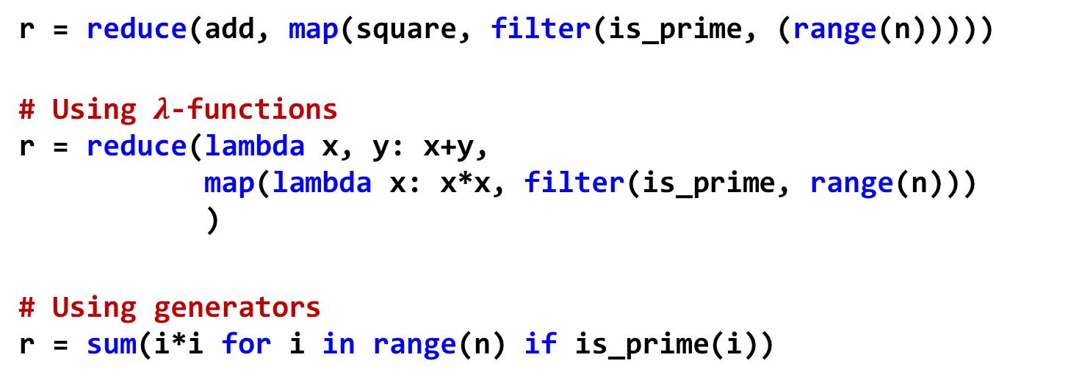
Using $λ$-functions in map/filter/reduce
$$\sum_{0≤i<n, is_prime(i)}{i^{2}}$$
r = reduce(add, map(square, filter(is_prime, (range(n)))))
# Using $λ$-functions r = reduce(lambda x, y: x+y, map(lambda x: x*x, filter(is_prime, range(n))) )
# Using generators r = sum(i*i for i in range(n) if is_prime(i))

Slide 44
Conclusions
Processing long streams of data is one of the main tasks of big data systems. Memory storage is one of the critical resources
When designing data pipelines exploit lazy evaluation mechanisms to generate data upon demand and avoid unnecessary data storage

Slide 45
EXERCISES

Slide 46
Comprehensions
Create a dictionary where the keys are the numbers of a list and the values are the highest one-digit divisor of each number
Create a list with all positive numbers smaller than $n$ that are divisible by some number included in a list called divisors
Given a rectangular matrix (list of lists), calculate its transpose using list comprehensions

Slide 47
Generating the Fibonacci series
Design a generator of the Fibonacci series
Given a list of divisors, design a generator that generates the Fibonacci numbers that are divisible by all divisors of the list. Example: divisors = [3, 5, 7, 11] gen = (…) # design the generator for x in gen: print(x) Output: 0 102334155 23416728348467685 5358359254990966640871840 1226132595394188293000174702095995 ...

Slide 48
Intersection of sequences
Implement the function intersect with the following specification: from typing import Iterator, TypeVar, Protocol class Comparable(Protocol): def __lt__(self: 'T', other: 'T') -> bool: ... T = TypeVar('T', bound=Comparable) def intersect(a: Iterator[T], b: Iterator[T]) -> Iterator[T]: """reads two sorted iterators and generates a sorted iterator with only the common elements""" ... # Example: # a = [1, 3, 5, 5, 6, 7, 10, 13, 16, 18] # b = [2, 5, 5, 8, 13, 13, 15, 16, 20] # output: [5, 13, 16]

Slide 49
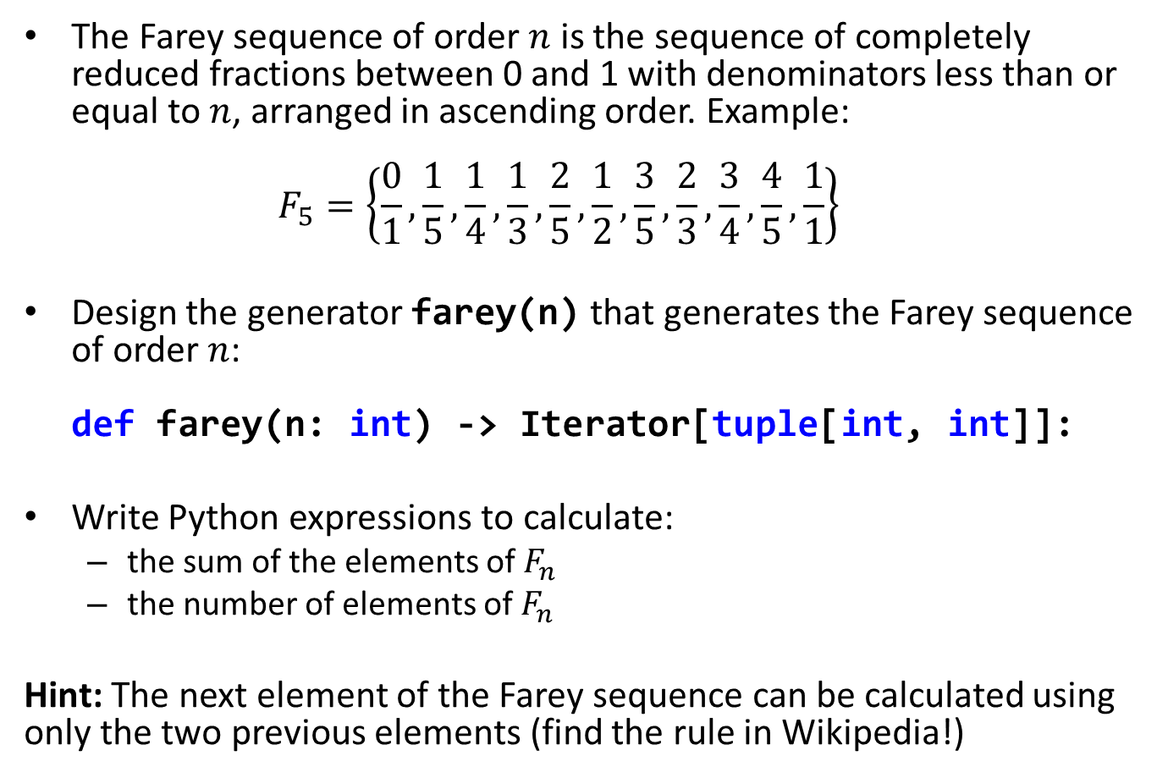
Farey sequence
The Farey sequence of order $n$ is the sequence of completely reduced fractions between 0 and 1 with denominators less than or equal to $n$, arranged in ascending order. Example: $F_{5}=\left\{\frac{0}{1},\frac{1}{5},\frac{1}{4},\frac{1}{3},\frac{2}{5},\frac{1}{2},\frac{3}{5},\frac{2}{3},\frac{3}{4},\frac{4}{5},\frac{1}{1}\right\}$
Design the generator farey(n) that generates the Farey sequence of order $n$: def farey(n: int) -> Iterator[tuple[int, int]]:
Write Python expressions to calculate:
the sum of the elements of $F_{n}$
the number of elements of $F_{n}$
Hint: The next element of the Farey sequence can be calculated using only the two previous elements (find the rule in Wikipedia!)

Slide 50
Filter/reduce pipeline
Design two versions of the following function using a filter-reduce pipeline:
One version with auxiliary functions
One version with lambda functions
from dataclasses import dataclass from typing import Iterable from functools import reduce
@dataclass class Person: name: str age: int salary: float def avg_salary(people: Iterable[Person], min_age: int, max_age: int) -> float: """Returns the average salary of the people with age between min_age and max_age"""

