Slide 1
Divide & Conquer (I)
Jordi Cortadella and Jordi Petit
Department of Computer Science

Slide 2
Divide-and-conquer algorithms
Strategy:
Divide the problem into smaller subproblems of the same type of problem
Solve the subproblems recursively
Combine the answers to solve the original problem
The work is done in three places:
In partitioning the problem into subproblems
In solving the basic cases at the tail of the recursion
In merging the answers of the subproblems to obtain the solution of the original problem

Slide 3
Conventional product of polynomials
Example:

Slide 4
Conventional product of polynomials
Polynomial = list[float]
def mul(p: Polynomial, q: Polynomial) -> Polynomial: """Returns p$×$q (product of polynomials)""" # degree(p) = len(p)-1, degree(q) = len(q)-1 # degree(r) = degree(p)+degree(q) r: Polynomial = [0]*(len(p) + len(q) - 1) for i, pi in enumerate(p): for j, qj in enumerate(q): r[i+j] += pi*qj return r
Complexity analysis:
Multiplication of polynomials of degree $n$: $\text{O}\left(n^{2}\right)$
Addition of polynomials of degree $n$: $\text{O}(n)$

Slide 5
Product of polynomials: Divide&Conquer
Assume that we have two polynomials with $n$ coefficients (degree $n−1$)
$$n−1$$
$$n/2$$
$$0$$
$$P:$$
$$P_{L}$$ | $$P_{R}$$
$$Q:$$
$$Q_{L}$$ | $$Q_{R}$$
← Shown later

Slide 6
Product of complex numbers
The product of two complex numbers requires four multiplications: $\left(a+bi\right)\left(c+di\right)=ac−bd+\left(bc+ad\right)i$
Carl Friedrich Gauss (1777-1855) noticed that it can be done with just three: $ac, bd$ and $\left(a+b\right)\left(c+d\right)$ $bc+ad=\left(a+b\right)\left(c+d\right)−ac−bd$
A similar observation applies for polynomial multiplication.

Slide 7
Product of polynomials with Gauss’s trick

Slide 8
Polynomial multiplication: recursive step
$$P$$
1 | -2 | 3 | 2 | 0 | -1
2 | 1 | 0 | -1 | 3 | 0
$$Q$$
$$P_{L}$$
1 | -2 | 3
2 | 1 | 0
$$P_{L}+P_{R}$$
3 | -2 | 2
1 | 4 | 0
$$P_{R}$$
2 | 0 | -1
-1 | 3 | 0
$$Q_{L}$$
$$Q_{L}+Q_{R}$$
$$Q_{R}$$
2 | -3 | 4 | 3 | 0
3 | 10 | -6 | 8 | 0
-2 | 6 | 1 | -3 | 0
2 | -3 | 4 | 3 | 0
-2 | 6 | 1 | -3 | 0
$${P_{L}Q}_{R}+P_{R}Q_{L}$$
3 | 7 | -11 | 8 | 0
-2 | 6 | 1 | -3 | 0
3 | 7 | -11 | 8 | 0
2 | -3 | 4 | 3 | 0
2 | -3 | 4 | 6 | 7 | -11 | 6 | 6 | 1 | -3 | 0

Slide 9
Pattern of recursive calls
$$n$$
Branching factor: 3
$$n/2$$
$$n/2$$
$$n/2$$
$$n/4$$
$$n/4$$
$$n/4$$
$$n/4$$
$$n/4$$
$$n/4$$
$$n/4$$
$$n/4$$
$$n/4$$
… … …
$\log_{2}{n}$ levels
2
2
2
2
… … …
1
1
1
1
1
1
1
1
1
1
1
1

Slide 10
Useful reminders
Sum of geometric series with ratio $r$: $S=k+kr+kr^{2}+kr^{3}+⋯+kr^{n−1}=k\left(\frac{1−r^{n}}{1−r}\right)$ For a decreasing series ($r<1$): $S≤\frac{k}{1−r}$
Logarithms: $\log_{b}{n}=\log_{b}{a}⋅\log_{a}{n}$
$$a^{\log_{b}{n}}=a^{{(log}_{a}{n)(}\log_{b}{a})}=n^{\log_{b}{a}}$$

Slide 11
Complexity analysis
The time spent at level $k$ is $3^{k}∙\text{O}\left(\frac{n}{2^{k}}\right)= {\left(\frac{3}{2}\right)}^{k}∙\text{O}(n)$
For $k=0$, runtime is $\text{O}\left(n\right)$.
For $k=\log_{2}{n}$, runtime is $\text{O}\left(3^{\log_{2}{n}}\right)$, which is equal to $\text{O}\left(n^{\log_{2}{3}}\right)$.
The runtime per level increases geometrically by a factor of 3/2 per level. The sum of any increasing geometric series is, within a constant factor, simply the last term of the series.
Therefore, the complexity is $\text{O}\left(n^{1.59}\right)$.

Slide 12
A popular recursion tree
n
Branching factor: 2
n/2
n/2
$\log_{2}{n}$ levels
n/4
n/4
n/4
n/4
… … …
2
2
2
2
2
2
… … …
1
1
1
1
1
1
1
1
1
1
1
1
Example: efficient sorting algorithms.
$$T\left(n\right)=2∙T\left(\frac{n}{2}\right)+ \text{O}\left(n\right)$$
Algorithms may differ on the amount of work done at each level: $\text{O}\left(n^{c}\right)$

Slide 13
Examples
Algorithm | Branch | c | Runtime equation
Power ($x^{y}$) | 1 | 0 | $$T\left(y\right)=T\left(y/2\right)+ \text{O}(1)$$
Binary search | 1 | 0 | $$T\left(n\right)=T\left(n/2\right)+ \text{O}(1)$$
Merge sort | 2 | 1 | $$T\left(n\right)=2∙T\left(n/2\right)+ \text{O}(n)$$
Polynomial product | 4 | 1 | $$T\left(n\right)=4∙T\left(n/2\right)+ \text{O}(n)$$
Polynomial product (Gauss) | 3 | 1 | $$T\left(n\right)=3∙T\left(n/2\right)+ \text{O}(n)$$

Slide 14
Master theorem
Typical pattern for Divide&Conquer algorithms:
Split the problem into $a$ subproblems of size $n/b$
Solve each subproblem recursively
Combine the answers in $\text{O}(n^{c})$ time
Running time: $T\left(n\right)=a∙T\left(n/b\right)+\text{O}(n^{c})$
Master theorem: $T\left(n\right)=\left\{\begin{matrix}\text{O}\left(n^{c}\right) & \text{if} a<b^{c} \\ \text{O}\left(n^{c}\log{n}\right) & \text{if} a=b^{c} \\ \text{O}\left(n^{\log_{b}{a}}\right) & \text{if} a>b^{c}\end{matrix}\right.$

Slide 15
Master theorem: recursion tree
Size $n$
Branching factor $a$
Size $n/b$
Size $n/b^{2}$
Depth $\log_{b}{n}$
…….
…
Size $1$
Width $a^{\log_{b}{n}}=n^{\log_{b}{a}}$

Slide 16
Master theorem: proof
For simplicity, assume $n$ is a power of $b$.
The base case is reached after $\log_{b}{n}$ levels.
The $k$th level of the tree has $a^{k}$ subproblems of size $n/{b^{k}}$.
The total work done at level $k$ is: $a^{k}×\text{O}{\left(\frac{n}{b^{k}}\right)}^{c}=\text{O}\left(n^{c}\right)×{\left(\frac{a}{b^{c}}\right)}^{k}$
As $k$ goes from 0 (the root) to $\log_{b}{n}$ (the leaves), these numbers form a geometric series with ratio $a/{b^{c}}$. We need to find the sum of such a series. $T\left(n\right)=\text{O}\left(n^{c}\right)⋅\left(1+\frac{a}{b^{c}}+\frac{a^{2}}{b^{2c}}+\frac{a^{3}}{b^{3c}}+⋯+\frac{a^{\log_{b}{n}}}{b^{(\log_{b}{n)c}}}\right)$
$\log_{b}{n}$ terms

Slide 17
Master theorem: proof
Case $a/{b^{c}<1}$. Decreasing series. The sum is dominated by the first term ($k=0$): $\text{O}(n^{c})$.
Case $a/{b^{c}>1}$. Increasing series. The sum is dominated by the last term ($k=\log_{b}{n}$): $n^{c}{\left(\frac{a}{b^{c}}\right)}^{\log_{b}{n}}=n^{c}\left(\frac{a^{\log_{b}{n}}}{{\left(b^{\log_{b}{n}}\right)}^{c}}\right)=a^{\log_{b}{n}}=n^{\log_{b}{a}}$
Case $a/{b^{c}=1}$. We have $\text{O}\left(\log{n}\right)$ terms all equal to $\text{O}(n^{c})$.

Slide 18
Master theorem: visual proof
$$n^{c}$$
$$n^{c}$$
$$a<b^{c}$$
$\log_{b}{n}$ levels
$$a>b^{c}$$
$$n^{c}$$
$$n^{c}$$
$$n^{c}$$
$$n^{c}$$
•••
$$n^{c}$$
$$→0$$
$$\frac{a^{\log_{b}{n}}}{n^{c}}$$
$$n^{c}$$
$$n^{\log_{b}{a}}$$
$$n^{c}\log{n}$$
$\log_{b}{n}$ levels
$$a=b^{c}$$
$$n^{c}$$

Slide 19
Master theorem: examples
Running time: $T\left(n\right)=a∙T\left(n/b\right)+\text{O}\left(n^{c}\right)$ $$T\left(n\right)=\left\{\begin{matrix}\text{O}\left(n^{c}\right) & \text{if} a<b^{c} \\ \text{O}\left(n^{c}\log{n}\right) & \text{if} a=b^{c} \\ \text{O}\left(n^{\log_{b}{a}}\right) & \text{if} a>b^{c}\end{matrix}\right.$$
Algorithm | a | c | Runtime equation | Complexity
Power ($x^{y}$) | 1 | 0 | $$T\left(y\right)=T\left(y/2\right)+ \text{O}(1)$$ | $$\text{O}(\log{y})$$
Binary search | 1 | 0 | $$T\left(n\right)=T\left(n/2\right)+ \text{O}(1)$$ | $$\text{O}(\log{n})$$
Merge sort | 2 | 1 | $$T\left(n\right)=2∙T\left(n/2\right)+ \text{O}(n)$$ | $$\text{O}(n\log{n})$$
Polynomial product | 4 | 1 | $$T\left(n\right)=4∙T\left(n/2\right)+ \text{O}(n)$$ | $$\text{O}(n^{2})$$
Polynomial product (Gauss) | 3 | 1 | $$T\left(n\right)=3∙T\left(n/2\right)+ \text{O}(n)$$ | $$\text{O}(n^{\log_{2}{3}})$$
$b=2$ for all the examples

Slide 20
Product multiplication
Fundamental question: Can polynomials be multiplied efficiently when the degree is large?
Answer: yes (FFT: Fast Fourier Transform)
FFT is an essential algorithm for efficient signal analysis. The algorithm will not be explained in this course.

Slide 21
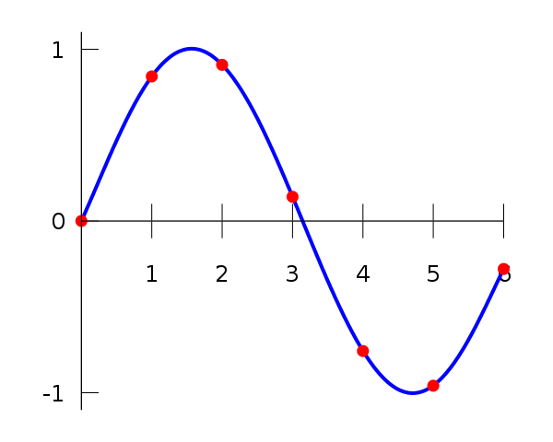
Polynomials: point-value representation
Fundamental Theorem (Gauss): A degree-$n$ polynomial with complex coefficients has exactly $n$ complex roots.
Corollary: A degree-$n$ polynomial $A(x)$ is uniquely identified by its evaluation at $n+1$ distinct values of $x$.

Slide 22
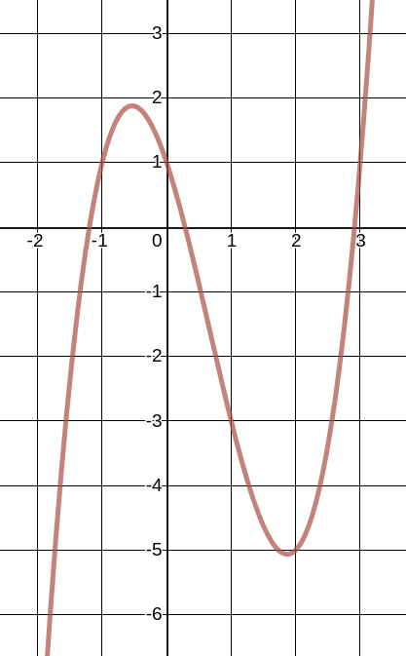
Polynomial representation
$$P\left(x\right)=x^{3}−2x^{2}−3x+1$$
$$P\left(x\right)=(1,−2,−3,1)$$
Coefficient representation
Evaluation
Interpolation
Point-value representation
$$P\left(x\right)=\{\left(−1,1\right),\left(0,1\right),\left(1,−3\right),\left(2,−5\right)\}$$

Slide 23
Conversion between both representations
representation | addition | multiplication | evaluation
coefficient | $$\text{O}(n)$$ | $$\text{O}(n^{2})$$ | $$\text{O}(n)$$
point-value | $$\text{O}(n)$$ | $$\text{O}(n)$$ | $$\text{O}(n^{2})$$
evaluation
$$a_{0},a_{1},⋯,a_{n−1}$$
$$\left(x_{0},y_{0}\right),⋯,\left(x_{n−1},y_{n−1}\right)$$
interpolation
Coefficient representation
Point-value representation
Could we have an efficient algorithm to move from coefficient to point-value representation and vice versa?
Fast Fourier Transform (FFT): $\text{O}(n \log{n})$

Slide 24
Fourier series
Periodic function $f(t)$ of period $1$: $f\left(t\right)=\frac{a_{0}}{2}+\sum_{n=1}^{∞}{a_{n}\cos{(2πnt)}}+\sum_{n=1}^{∞}{b_{n}\sin{(2πnt)}}$
Fourier coefficients: $a_{n}=2\int_{0}^{T}{f(t)\cos{(2πnt) dt, b_{n}=2\int_{0}^{T}{f(t)\sin\left(2πnt\right) dt }}}$
Fourier series is fundamental for signal analysis (to move from time domain to frequency domain, and vice versa)

Slide 25
Why Fourier Transform?

