Slide 1
Abstract Data Types (II) (and Object-Oriented Programming)
Jordi Cortadella and Jordi Petit
Department of Computer Science

Slide 2
Public or private?
What should be public?
Only the methods that need to interact with the external world. Hide as much as possible. Make a method public only if necessary.
What should be private?
All the attributes.
The internal methods of the class.
Can we have public attributes?
Theoretically yes (Python and C++ allow it).
Recommendation: never define a public attribute.
Observation: Python does not support public/private attributes and methods. There is no protection to prevents a bad use.
The naming conventions (underscores) are used to distinguish them.

Slide 3
Class Point: a new implementation
Let us assume that we need to represent the point with polar coordinates for efficiency reasons (e.g., we need to use them very often).
We can modify the private section and the implementation of the class without modifying the specification of the public methods.
The API (a contract between designers and users) should not be modified.
Do you know what a deprecated method is?
Not recommended, possibly superseded by another method
Likely to be removed or discontinued in the future

Slide 4
Class Point: a new implementation
class Point: """A class to represent and operate with two-dimensional points""" # Declaration of attributes (recommended for type checking)
_radius: float # radius of the polar coordinates
_angle: float # angle of the polar coordinates def __init__(self, x: float = 0, y: float = 0):
"""Constructor with x and y coordinates"""
self._radius = math.sqrt(x*x + y*y) self._angle = 0 if x == 0 and y == 0 else math.atan2(y/x) def x(self) -> float:
"""Returns the x coordinate""" return self._radius*math.cos(self._angle) def y(self) -> float:
"""Returns the y coordinate""" return self._radius*math.sin(self._angle) def distance(self, p: Optional['Point']) -> float:
"""Returns the distance to point p (or the distance to the origin if p is None)"""
dx, dy = self.x(), self.y()
if p is not None: dx -= p.x() dy –= p.y()
return math.sqrt(dx*dx + dy*dy)
Works without any change (but it can be done more efficiently)

Slide 5
Class Point: a new implementation
def angle(self) -> float: """Returns the angle of the polar coordinates""" return self._angle def __add__(self, p: 'Point') -> 'Point': """Returns a new point by adding the coordinates of two points. This method is associated to the + operator""" return Point(self.x() + p.x(), self.y() + p.y()) def __eq__(self, p: 'Point') -> bool: """Checks whether two points are equal. This method is associated to the == operator""" return self.x() == p.x() and self.y() == p.y()
Discussion:
How about using _x and _y (or _radius and _angle) as "public" attributes?
Programs using p._x and p._y would not be valid for the new implementation.
Programs using p.x() and p.y() would still be valid.
Recommendation:
All attributes should be private.

Slide 6
A new class: Rectangle
We will only consider rectilinear rectangles (axis-aligned).
A rectilinear rectangle can be represented in different ways:
$$w$$
UR
$$h$$
LL
LL
Two points (extremes of diagonal)
One point, width and height

Slide 7
Rectangle: abstract view
Create
Scale
ur
Rotate
Rectangle(ll,ur)
ll
scale(0.5)
rotate(false)
Move
Flip (horizontally/vertically)
(11,10)
(1,8)
move(10,2)
Intersection
Point inside?

Slide 8
Rectangle: ADT (incomplete)
from point import Point class Rectangle: """Class to operate with rectilinear rectangles""" def __init__(self, ll: Point, ur: Point): """Constructor using the LL and UR corners""" ... def area(self) -> float: """Returns the area of the rectangle""" ...
def scale(self, s: float) -> None: """Scales the rectangle with a factor s > 0""" ...
def __mul__(self, r: 'Rectangle') -> 'Rectangle': """Returns the intersection with another rectangle""" ...

Slide 9
Rectangle: using the ADT
# Creates a rectangle 4x5 r1 = Rectangle(Point(0,0), Point(4,5)) # Creates a rectangle 8x4 r2 = Rectangle(Point(0,0), Point(8,4)) r1.move(2, 3) # Moves the rectangle r1.scale(1.2) # Scales the rectangle area1 = r1.area() # Calculates the area r3 = r1*r2;
if r3.empty(): …

Slide 10
Rectangle: ADT
from point import Point class Rectangle: """Class to operate with rectilinear rectangles""" # Private attributes to represent a rectangle _ll: Point # Lower-left corner of the rectangle _w: float # width of the rectangle (>= 0) _h: float # height of the rectangle (>= 0)
def __init__(self, ll: Point, ur: Point): """Constructor using the LL and UR corners""" assert ll.x() <= ur.x() and ll.y() <= ur.y() self._ll = Point(ll.x(), ll.y()) self._w = ur.x() – ll.x() self._h = ur.y() – ll.y()
Note: Python does not support function overloading. Classes can only have one constructor.

Slide 11
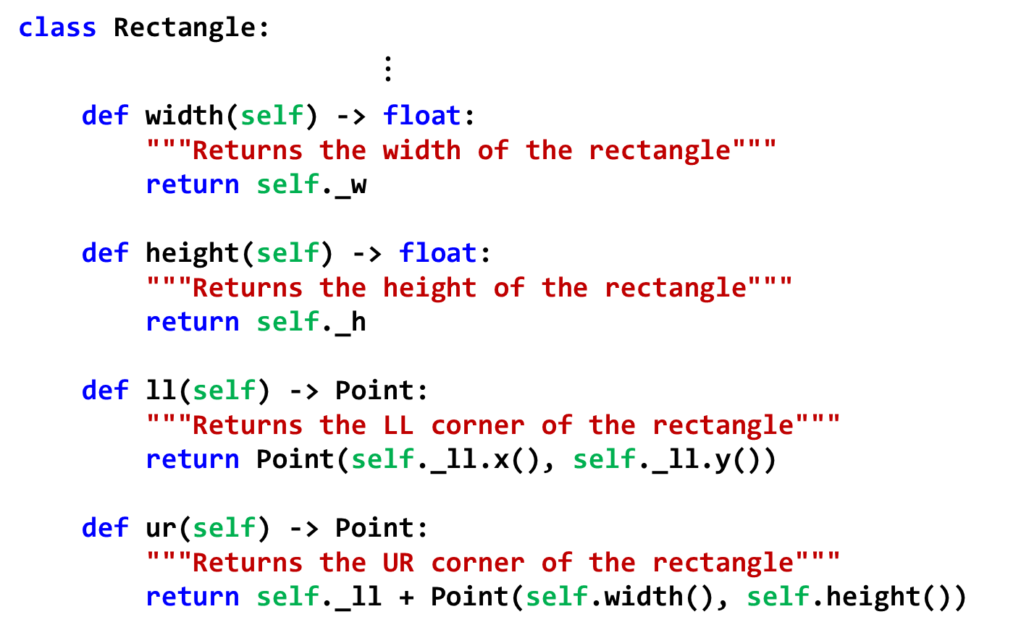
Rectangle: ADT
class Rectangle: $⋮$
def width(self) -> float: """Returns the width of the rectangle""" return self._w def height(self) -> float: """Returns the height of the rectangle""" return self._h def ll(self) -> Point: """Returns the LL corner of the rectangle""" return Point(self._ll.x(), self._ll.y()) def ur(self) -> Point: """Returns the UR corner of the rectangle""" return self._ll + Point(self.width(), self.height())
Discussion: what if ll() would return self._ll (instead of a copy)?

Slide 12
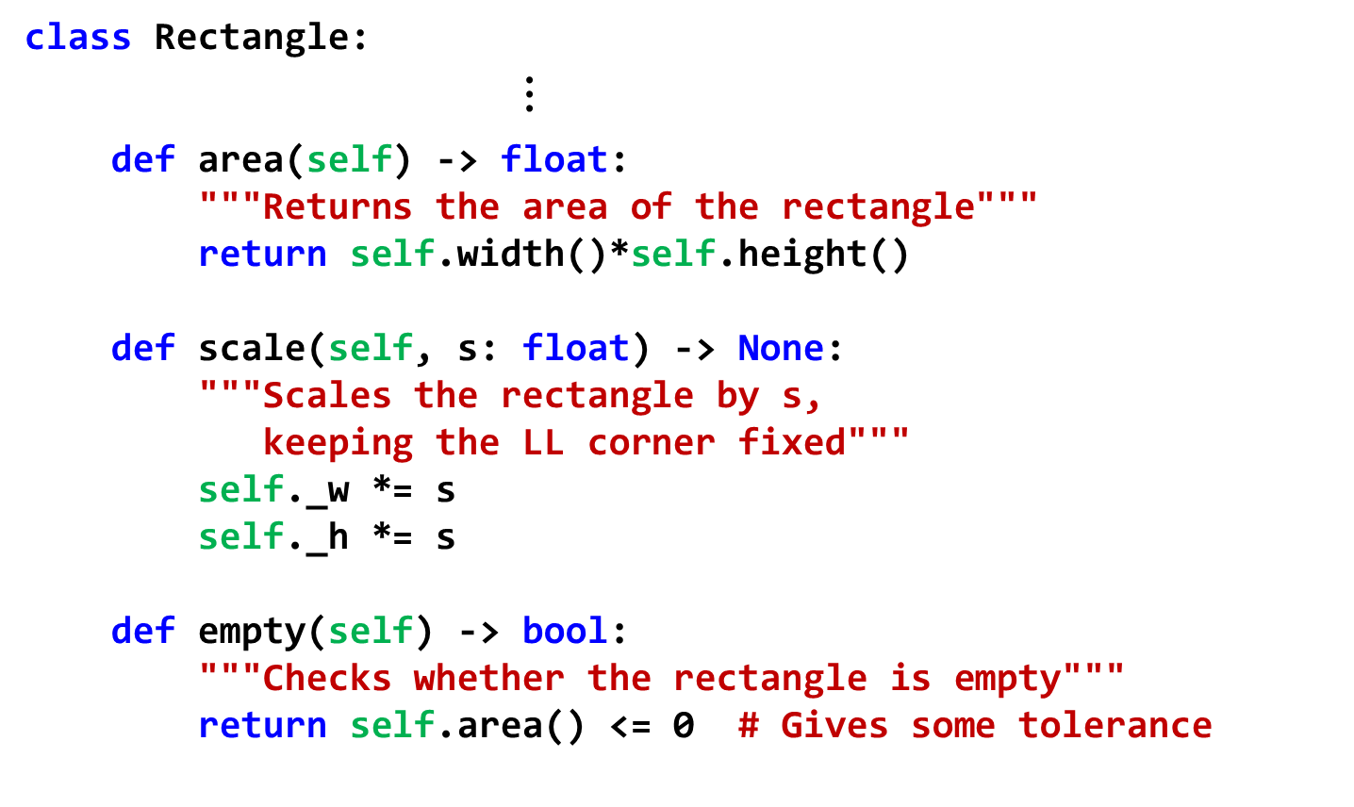
Rectangle: ADT
class Rectangle: $⋮$
def area(self) -> float: """Returns the area of the rectangle""" return self.width()*self.height() def scale(self, s: float) -> None: """Scales the rectangle by s, keeping the LL corner fixed""" self._w *= s self._h *= s def empty(self) -> bool: """Checks whether the rectangle is empty""" return self.area() <= 0 # Gives some tolerance

Slide 13
Rectangle: ADT
class Rectangle: $⋮$
def __mul__(self, r: 'Rectangle') -> 'Rectangle': """Returns the intersection of two rectangles""" # Calculate the ll coordinates r1ll, r2ll = self.ll(), r.ll() ll_x = max(r1ll.x(), r2ll().x()) ll_y = max(r1ll.y(), r2ll().y()) # Calculate the ur coordinates r1ur, r2ur = self.ur(), r.ur() ur_x = min(r1ur.x(), r2ur().x()) ur_y = min(r1ur.y(), r2ur().y()) # Check if no intersection: return empty rectangle if ur_x <= ll_x or ur_y <= ll_y: return Rectangle(Point(0,0), Point(0,0)) return Rectangle(Point(ll_x, ll_y), Point(ur_x, ur_y))
self
r

Slide 14
Let us work with rectangles
r1 = Rectangle(Point(2,3), Point(6,8)) area1 = r1.area() # area1 = 20 r2 = Rectangle(Point(3,5), Point(5, 9)) # Check whether the point (4,7) is inside the # intersection of r1 and r2. in = (r1*r2).isPointInside(Point(4,7))
r2.rotate(false) // r2 is rotated counterclockwise r2 *= r1; // Intersection with r1
Exercise: draw a picture of R1 and R2 after the execution of the previous code.

Slide 15
A Python session with rational numbers
>>> from rational import Rational # from file rational.py
>>> a = Rational(4, -6) # construct with num and den
>>> print(a)
-2/3
>>> b = Rational(4) # integer value
>>> print(b)
4
>>> print((a+b).num(), (a+b).den())
10 3
>>> c = Rational() # c = 0
>>> if a < c:
... print(a, "is negative")
...
-2/3 is negative
>>> print(a*b) # uses the __str__ method (see later)
-8/3
>>> a/b # uses the __repr__ method (see later)
Rational(-1/6)
>>>

Slide 16
The Rational class in Python
class Rational: """Class to represent rational numbers""" # Private attributes: # Invariant: _den > 0 and gcd(_num, _den) = 1 _num: int # numerator _den: int # denominator (invariant: _den > 0) def __init__(self, num: int = 0, den: int = 1): assert den != 0 self._num, self._den = num, den self._simplify()

Slide 17
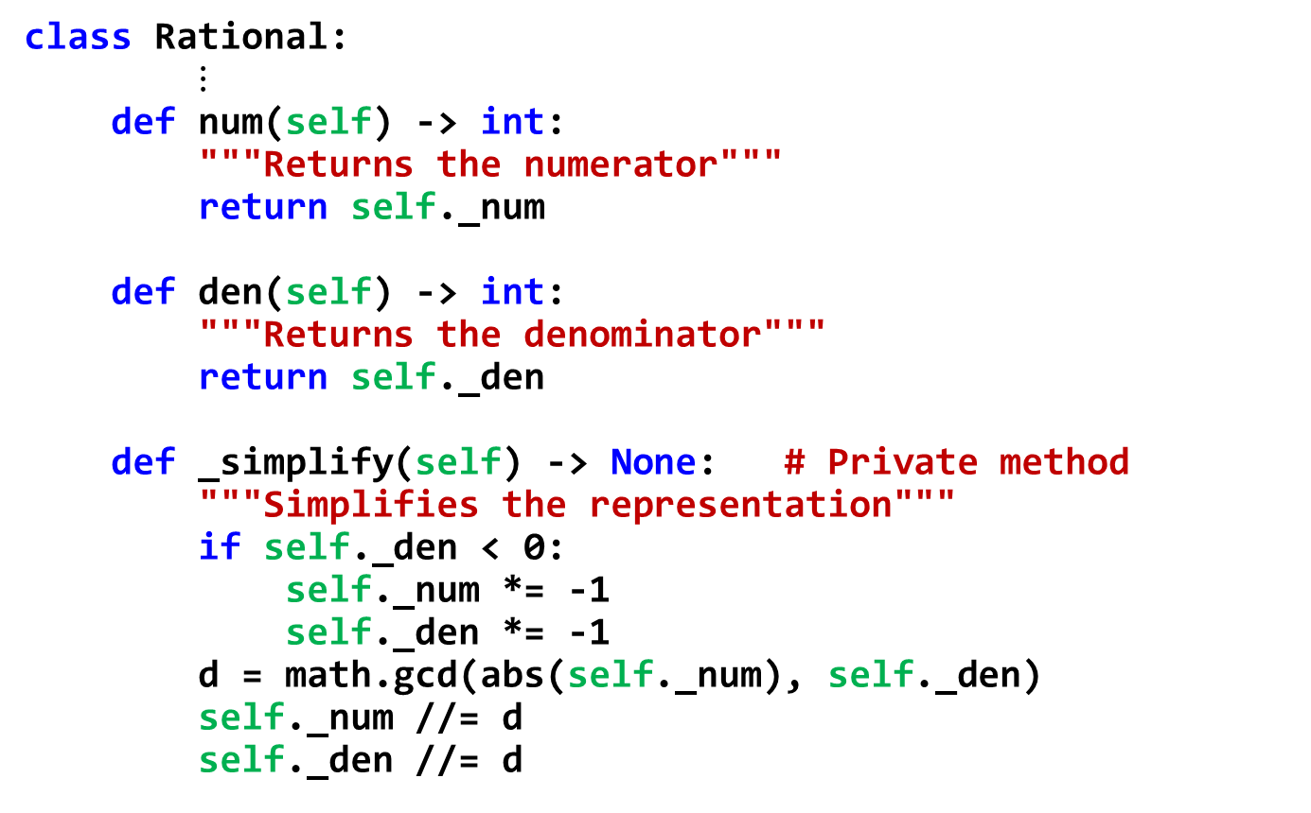
The Rational class in Python
class Rational: $⋮$ def num(self) -> int: """Returns the numerator""" return self._num def den(self) -> int: """Returns the denominator""" return self._den def _simplify(self) -> None: # Private method """Simplifies the representation""" if self._den < 0: self._num *= -1 self._den *= -1 d = math.gcd(abs(self._num), self._den) self._num //= d self._den //= d

Slide 18
Magic representation methods
class Rational: $⋮$ def __str__(self) -> str: """Returns a user-friendly string with information about the value of the object. It is invoked by str(x) or print(x).""" if self._den == 1: return str(self._num) return f"{self._num}/{self._den}" def __repr__(self) -> str: """Returns a string with information about the representation of the class. It is invoked by repr(x) or simply 'x'.""" return f"Rational({self})"

Slide 19
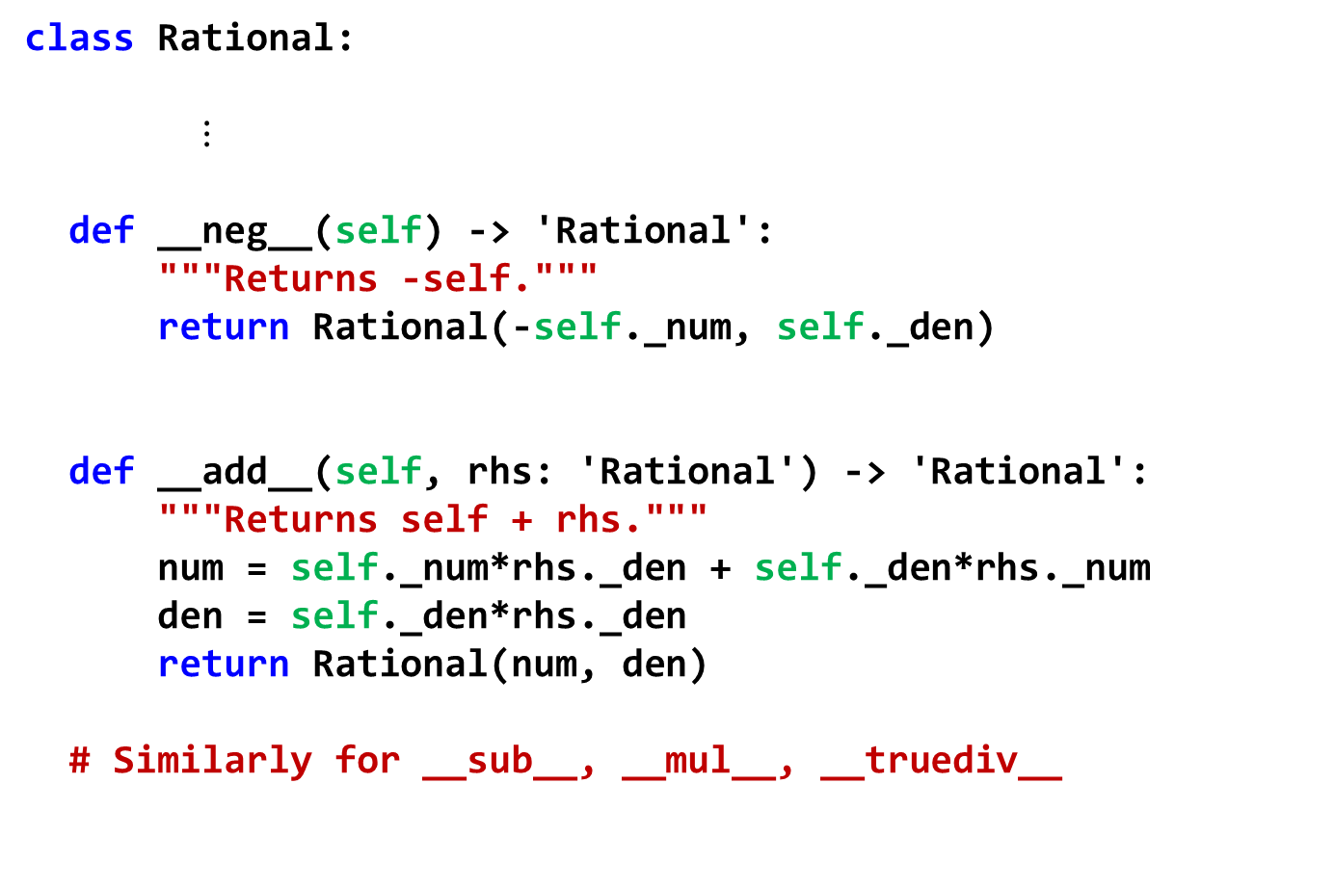
Magic arithmetic methods
class Rational: $⋮$ def __neg__(self) -> 'Rational': """Returns -self.""" return Rational(-self._num, self._den) def __add__(self, rhs: 'Rational') -> 'Rational': """Returns self + rhs.""" num = self._num*rhs._den + self._den*rhs._num den = self._den*rhs._den return Rational(num, den) # Similarly for __sub__, __mul__, __truediv__

Slide 20
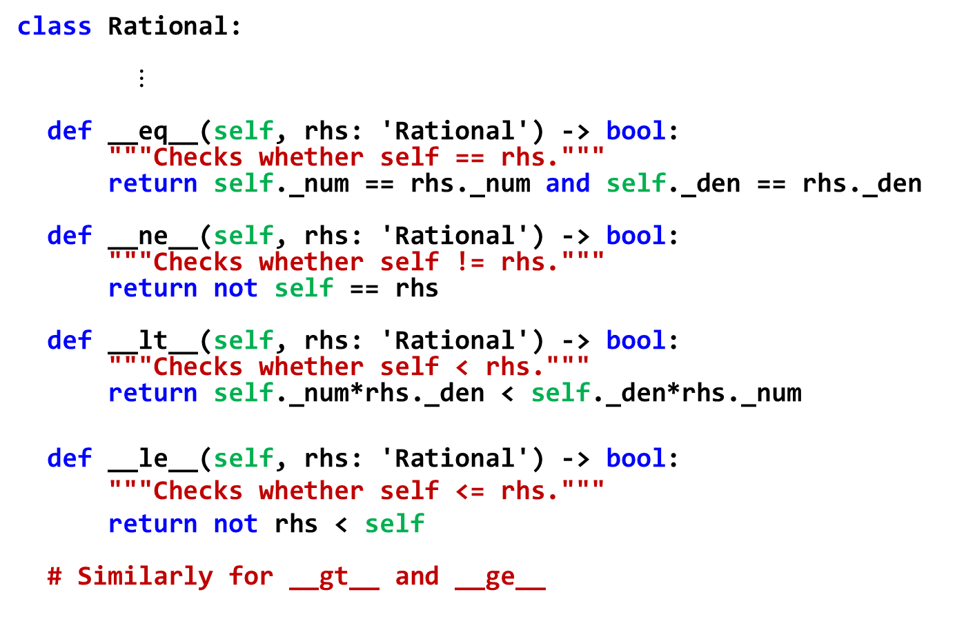
Magic relational methods
class Rational: $⋮$ def __eq__(self, rhs: 'Rational') -> bool: """Checks whether self == rhs.""" return self._num == rhs._num and self._den == rhs._den def __ne__(self, rhs: 'Rational') -> bool: """Checks whether self != rhs.""" return not self == rhs def __lt__(self, rhs: 'Rational') -> bool: """Checks whether self < rhs.""" return self._num*rhs._den < self._den*rhs._num
def __le__(self, rhs: 'Rational') -> bool:
"""Checks whether self <= rhs."""
return not rhs < self # Similarly for __gt__ and __ge__

Slide 21
Python documentation: docstrings
>>> from rational import Rational
>>> help(Rational.__add__)
Help on function __add__ in module rational:
__add__(self, rhs)
Returns self + rhs.
>>> help(Rational)
class Rational(builtins.object)
| Rational(num=0, den=1)
|
| Class to represent rational numbers.
|
| The class includes the basic arithmetic and relational
| operators.
|
| Methods defined here:
|
| __add__(self, rhs)
| Returns self + rhs.
|
| __eq__(self, rhs)
| Checks whether self == rhs.

Slide 22
Python documentation: docstrings
The first line after a module, class or function can be used to insert a string that documents the component.
Triple quotes (""") are very convenient to insert multi-line strings.
The docstrings are stored in a special attribute of the component named __doc__.
Different ways of print the docstrings associated to a component:
print(Rational.num.__doc__)
help(Rational.num)

Slide 23
Designing a module: example
Documentation of the module
# geometry.py """geometry.py Provides two classes for representing Polygons and Circles.""" # author: Euclid of Alexandria from math import pi, sin, cos
class Polygon: """Represents polygons and provides methods to calculate area, intersection, convex hull, etc."""
def __init__(self, list_vertices: list[Point]): """Creates a polygon from a list of vertices.""" ...
class Circle:
...
Documentation of the class
Documentation of the method

Slide 24
Using a module: example
import geometry p = geometry.Poligon(…) c = geometry.Circle(…)
Imports the module. Now all classes can be used with the prefix of the module.
import geometry as geo p = geo.Poligon(…) c = geo.Circle(…)
Imports and renames the module.
from geometry import * p = Poligon(…) c = Circle(…)
Imports all classes in the module. No need to add the prefix of the module.
from geometry import Poligon as plg, Circle as cir p = plg(…) c = cir(…)
Imports and renames the classes in the module.

Slide 25
Conclusions
Finding the appropriate hierarchy is a fundamental step towards the design of a complex system.
User-friendly documentation is indispensable.

Slide 26
Exercises

Slide 27
Implement methods
Implement the following methods for the class Rectangle:
def rotate(self, clockwise: bool) -> None: """Rotate the rectangle 90 degrees clockwise or counterclockwise, depending on the value of the parameter. The rotation should be done around the lower-left corner of the rectangle""" def flip(self, horizontally: bool) -> None: """Flip horizontally (around the left edge) or vertically (around the bottom edge), depending on the value of the parameter.""" def isPointInside(self, p: Point) -> bool: """ Check whether point p is inside the rectangle"""

Slide 28
Re-implement a class
Re-implement the class Rectangle using an internal representation with two Points:
Lower-Left (LL)
Upper-Right(UR)
Make the minimum number of changes to preserve the API of the class.

Slide 29
Distance between rectangles
Implement the following method for the class Rectangle:
def distance(self, r: 'Rectangle') -> float: """Calculates the shortest distance between two rectangles. If two rectangles intersect, their distance is zero."""
Hint: try to make the code simple and elegant, possibly defining some reusable private method.

