Slide 1
Voltage Noise Analysis with Ring Oscillator Clocks
Lucas Machado, Antoni Roca and Jordi Cortadella
Universitat Politècnica de Catalunya (UPC)
Barcelona, Spain
Notes:
I’m Lucas, PhD candidate at UPC, Barcelona, and I will be presenting our work on ring oscillators and how they can help on the task of mitigating the effects of voltage noise.
Ring oscillators offer robustness considering all types of variability, but in this work we focused on voltage variations. Why?

Slide 2
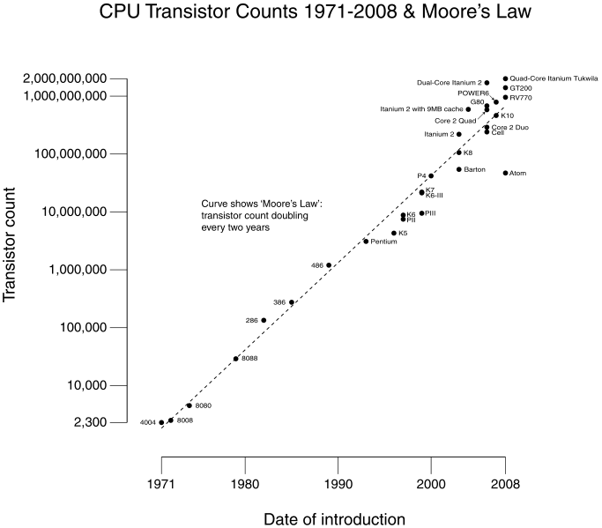
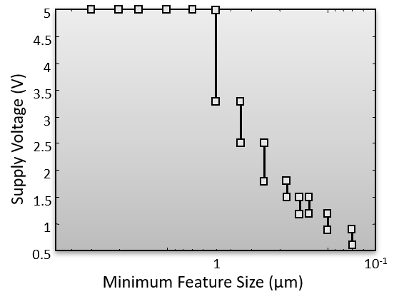
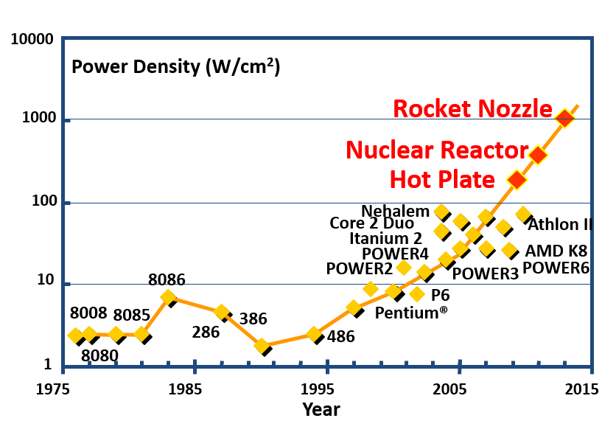
Power integrity
Notes:
Because power integrity has become an important issue
- (o) due to the lowering of the supply voltage, as the feature size of the circuits decrease
(o) and due to the power density increase, which clearly reached a physical limit.

Slide 3
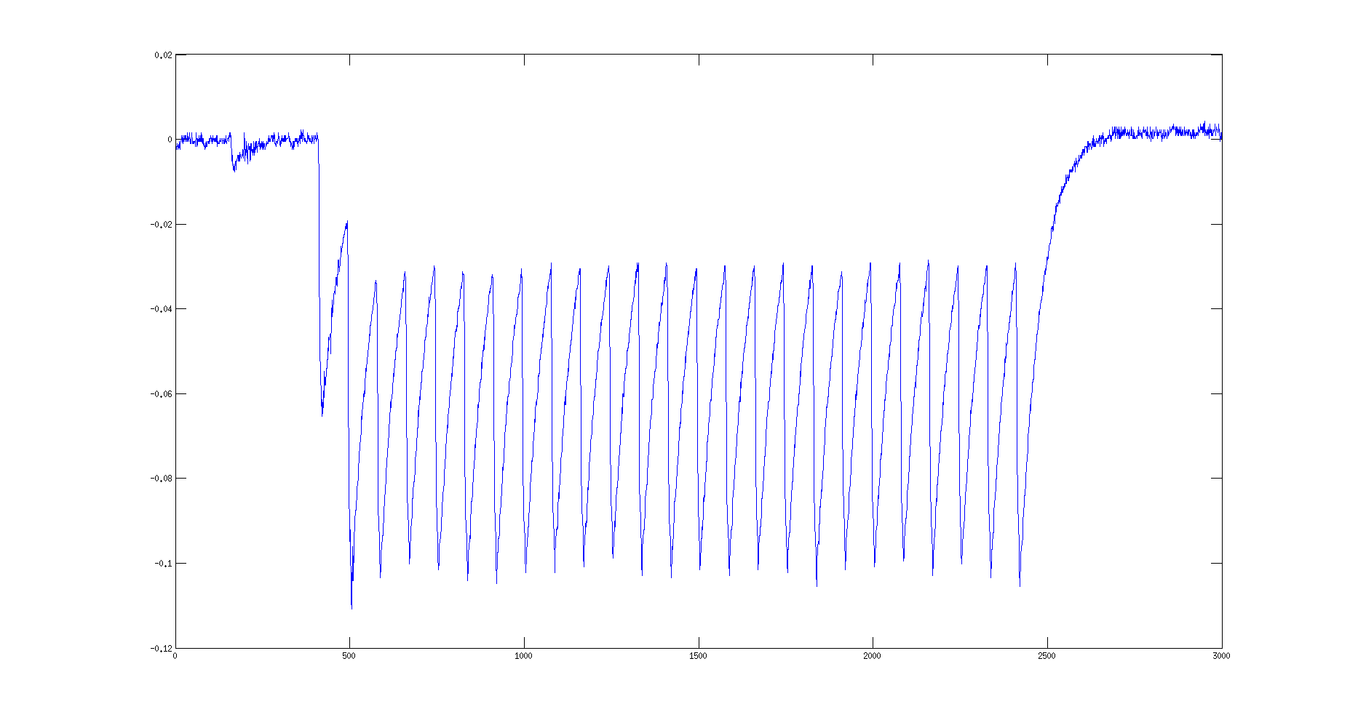
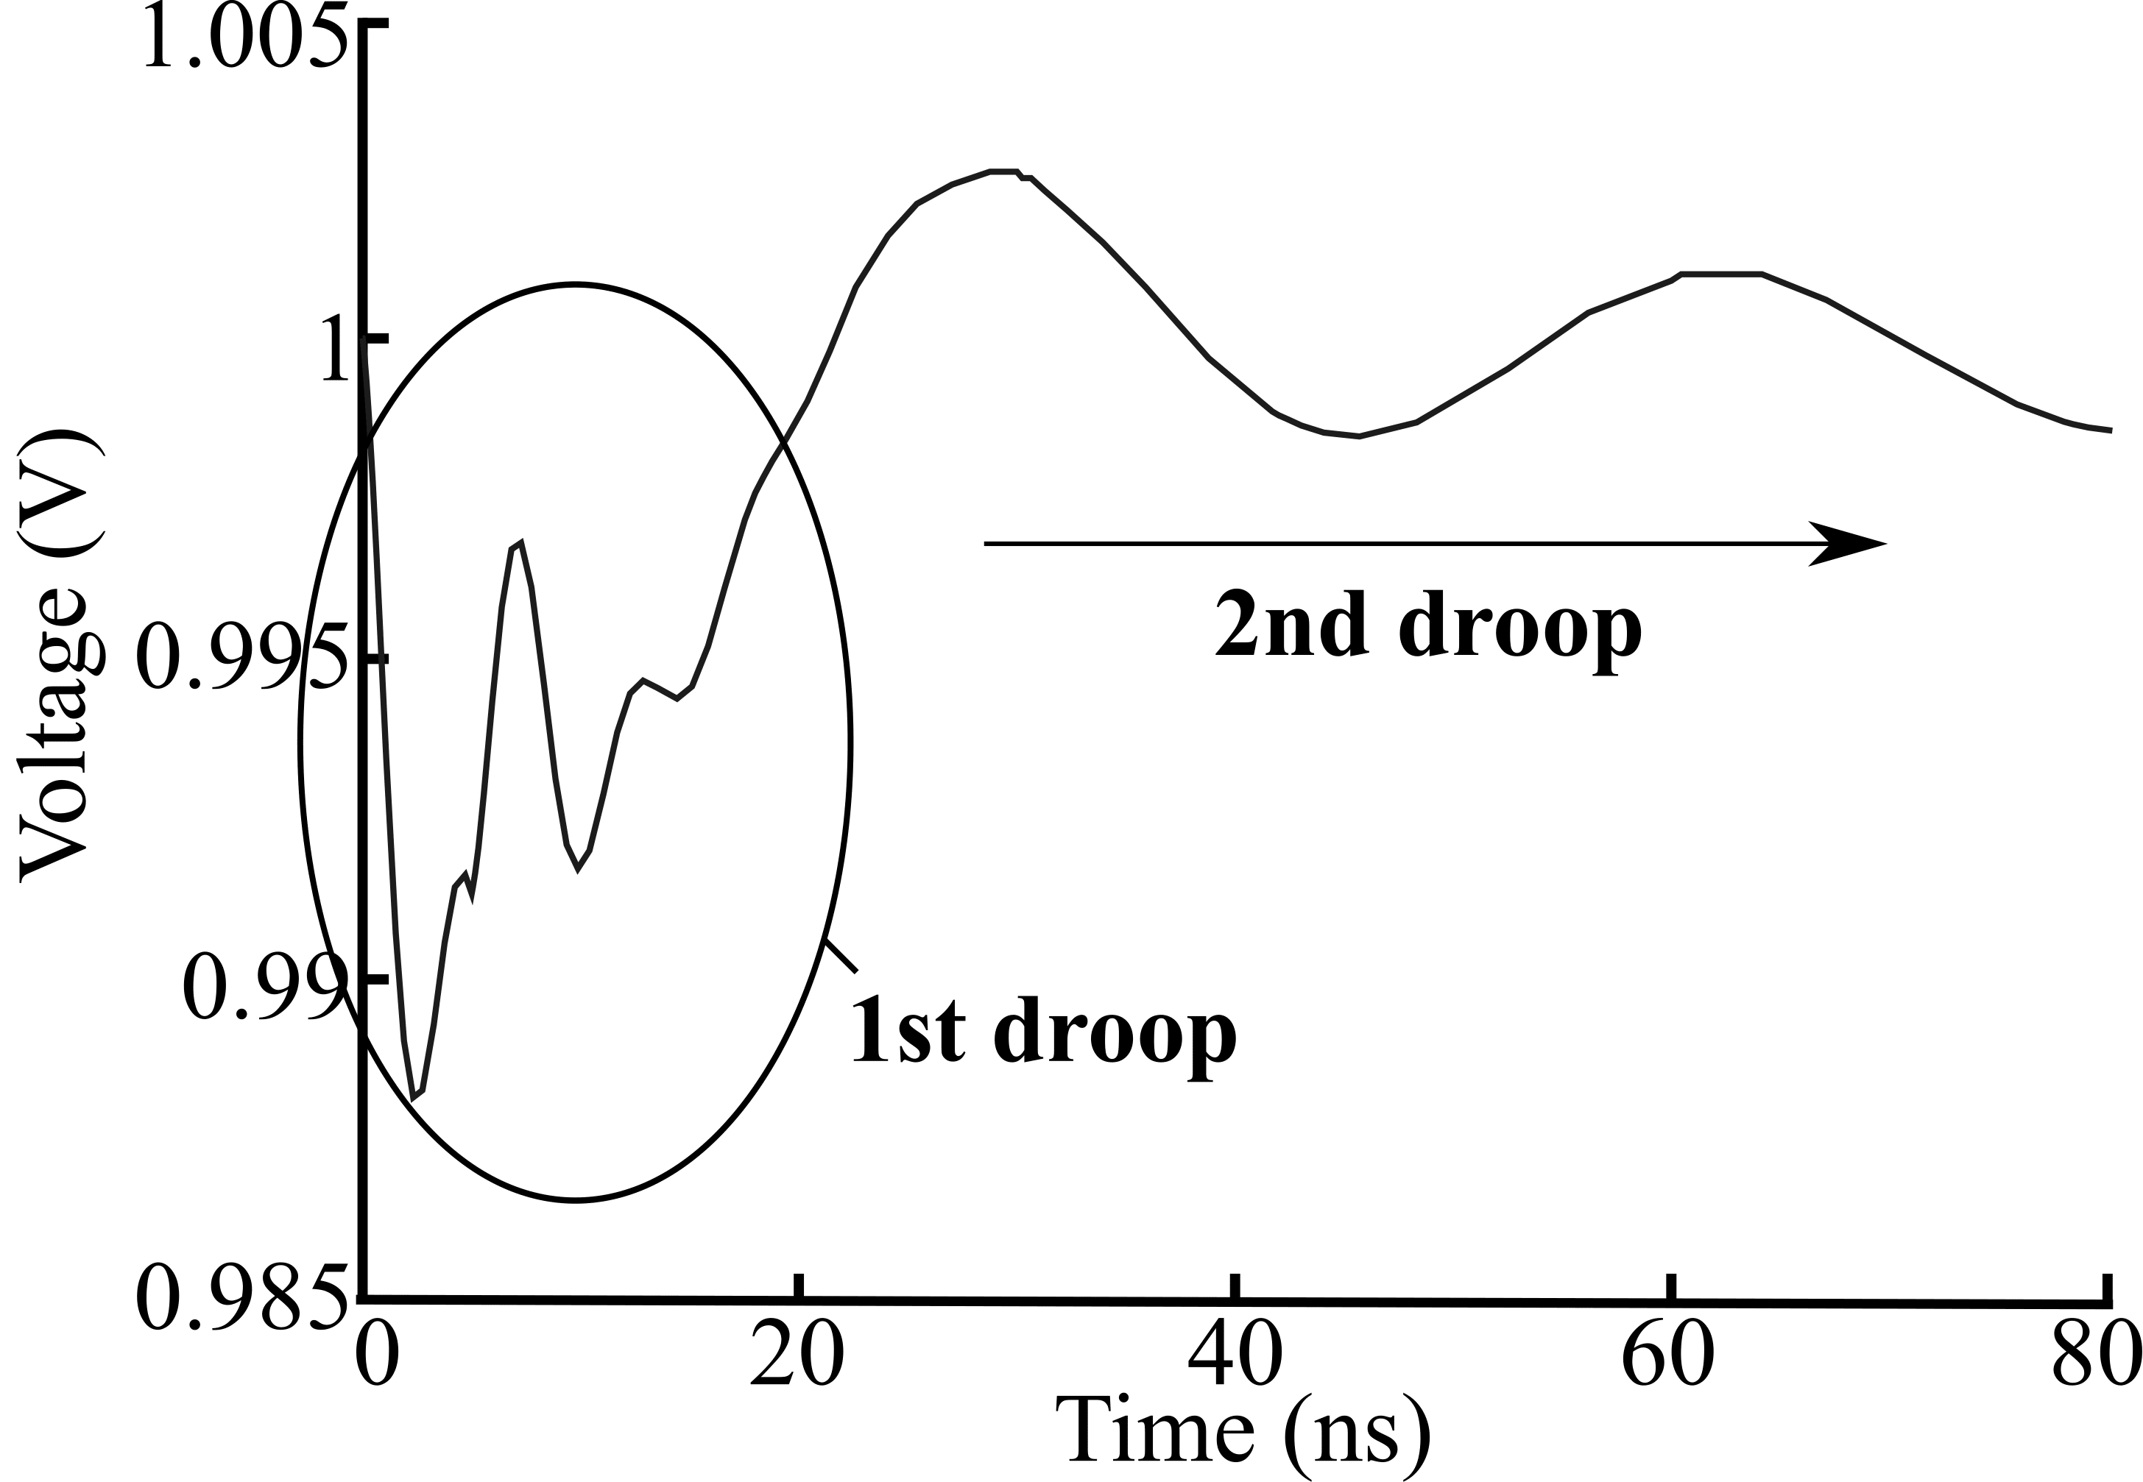
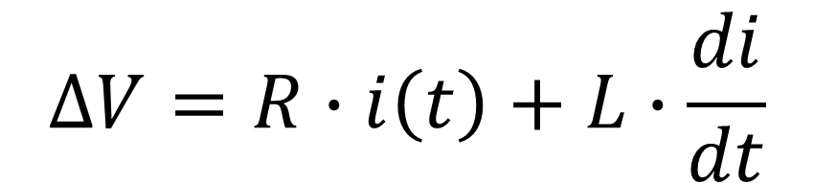
Voltage noise
$$∆V=R∙i\left(t\right)+L∙\frac{di}{dt}$$
Notes:
To understand this a little bit more, consider an example of the transfer function for a simple inverter (o).
When the supply voltage is reduced (o), the noise margins are also reduced, making it more difficult to define if it is 0 or 1
Also, considering the main sources (o) of voltage noise, both are affected by a larger power consumption:
(o) the IR drop, linked to the resistance
and the switching noise, due to the equivalent inductance

Slide 4

Mitigating the impacts of voltage noise
Timing margins
Performance
Decoupling Capacitors
(Voltage regulators)
Area and power
Error recovery
Performance
Performance stalling
Area, power,
complexity
Adaptive clocking (sensors)
Notes:
The voltage noise problem reflects as an increase in delay that may generate timing problems.
A simple (and expensive) solution is to increase the timing margins (o), and as a consequence (o) have the average performance reduced.
Another way is to increase the decoupling capacitance (o), which reduces the amplitude of the voltage noise.
This is also the case for voltage regulators (which generally require capacitors).
So both solutions imply an increase in area and power (o).
Other solutions include (o):
Circuits with error recovery, which bet that the voltage noise is transient
Performance stalling, with voltage sensors, stopping the processor when voltage is too low
Adaptive clocking, which also require high quality sensors, with low latency response
All these solutions have penalties in performance, area, power and complexity

Slide 5
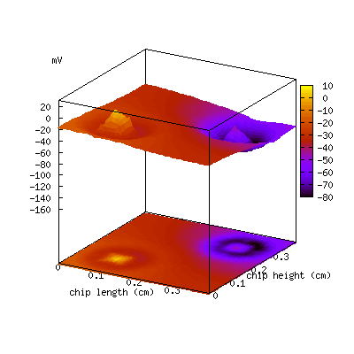
Dynamic voltage noise
Δ(VDD-VSS)
Raj Nair (Anasim Corp.),
IC floorplanning and Power Integrity, SOCcentral, Aug 2, 2010.
http://www.soccentral.com/results.asp?entryID=31901
Notes:
It is important to notice that all these solutions may not solve the problem, as there are many dynamic variations that cannot be assured and can be larger than estimated.
Also, several integrated circuits depend on software and techniques such as power and clock gating, which may unintentionally stimulate voltage droops and generate voltage emergencies.

Slide 6
Ring Oscillator Clocks
Notes:
But how ring oscillators can help with these issues?

Slide 7
Setup constraint (timing paths)
Comb. Logic
PVT variability
Two competing paths:
Launching path
Capturing path
Launching path < Capturing path + Period
No variability
(or very little)
1
2
PLL
2
1
1
2
+
Margins
Notes:
Here is an animation of a synchronous circuit: the clock pulses represented by black dots go through the clock tree and reach the FFs.
The FFs let the data, represented with these green dots, pass and go through the combinational logic.
Notice that there are two competing paths (o) and the general idea is to the launching path delay to be smaller than the capturing path delay plus the clock period.
As the (o) environment conditions may vary, which affect the delay of the logic paths.
But these variations do not affect the period (o) of the clock generated by a PLL, so margins are necessary in order to the circuit work in the worst estimated delay, given the operating condition corners.

Slide 8
Ring Oscillator Clock (ROC)
Comb. Logic
PVT variability
Correlated!
Launching path < Capturing path + Period
PLL
+
Margins
Notes:
If we replace the PLL by a Ring oscillator (o), the clock period and the delay variability of the circuit paths become correlated (o).
This happens because the ring oscillator and the combinational logic are implemented with similar gates and react similarly to the variations in the operation conditions.
This correlation enables the reduction of margins (o), and therefore achieve a larger average performance.

Slide 9
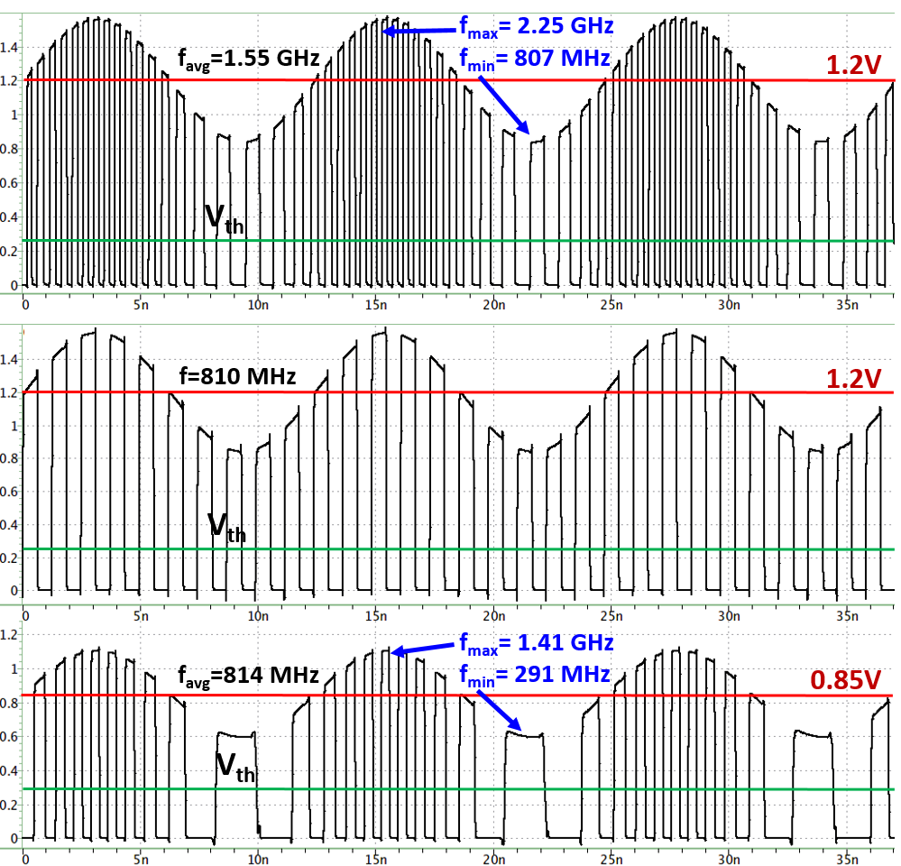
PLL vs. Ring Oscillator Clock
Ring Osc.
Clk (1.2V)
Adaptive frequency
PLL
(1.2V)
30%
Fixed frequency
Ring Osc.
Clk (0.85V)
Vdd = 1.2V ± 30%
Notes:
So, consider a voltage source like this, with a large variation of +/- 30%.
With a fixed frequency (o), the performance is limited by the lowest voltage, which is 1.2V -30%.
The ring oscillator (o) ADAPTS to the voltage, achieving a much higher average performance, almost doubling it.
Additionally, (o) for the same average performance as the PLL, we could reduce power significantly by changing the supply voltage to 0.85V with the ring oscillator.

Slide 10
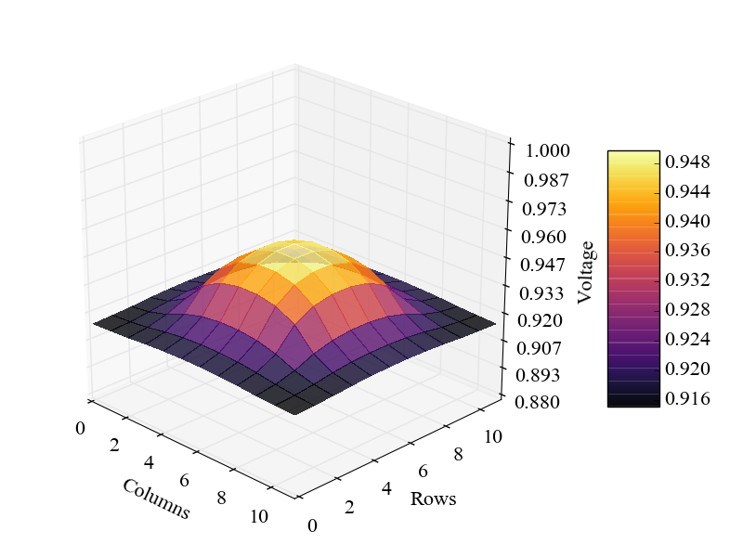
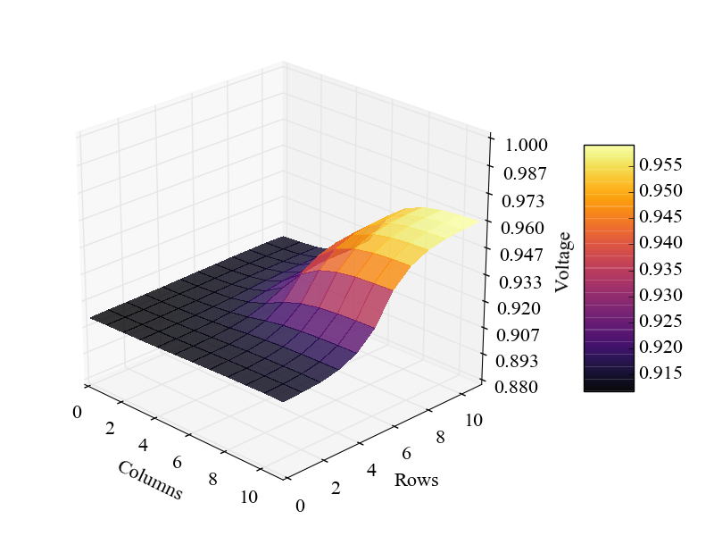
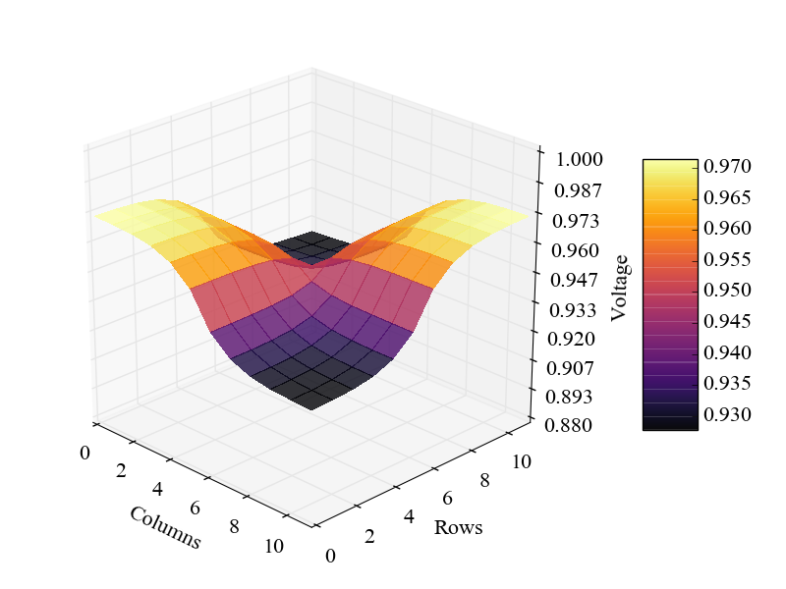
Voltage differences
Global
Local
Notes:
How is this possible?
Explain figures.
It is possible because ring oscillators take advantage of the similar variation to voltage compared to the critical paths of the circuit.
Therefore (o), it is not necessary to add margins for the global component of a voltage droop, which usually is the larger component.
Only the local (o) component of the voltage droop must be considered for ROCs, which can be reduced with the size of the clock domain and the placement of the ROC with respect to the critical paths.

Slide 11
Models
Notes:
In order to analyze the global and local componentes of the voltage noise, we used some models.

Slide 12
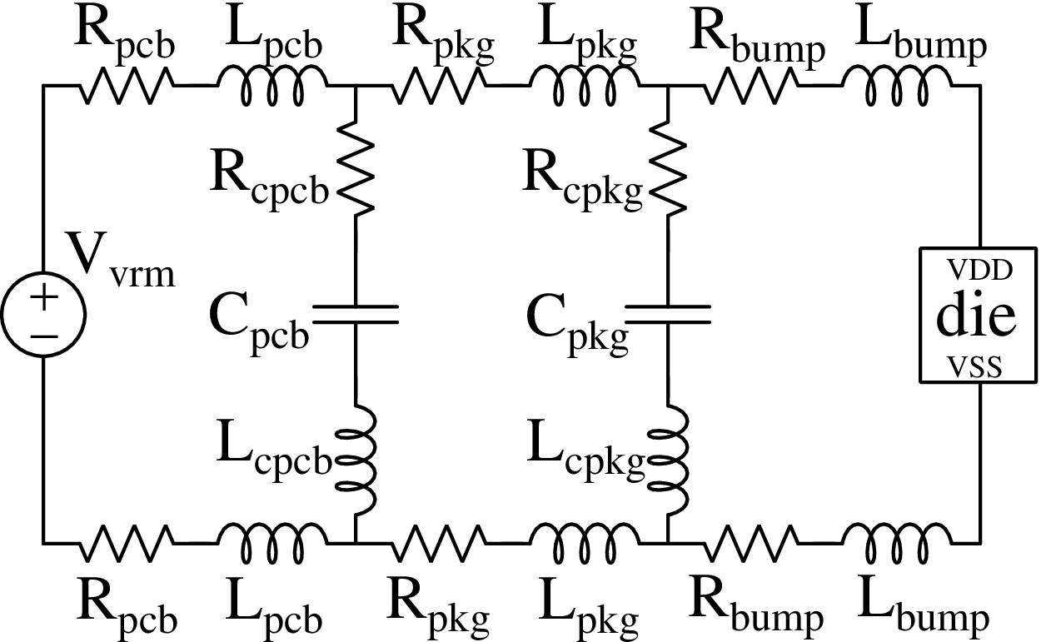
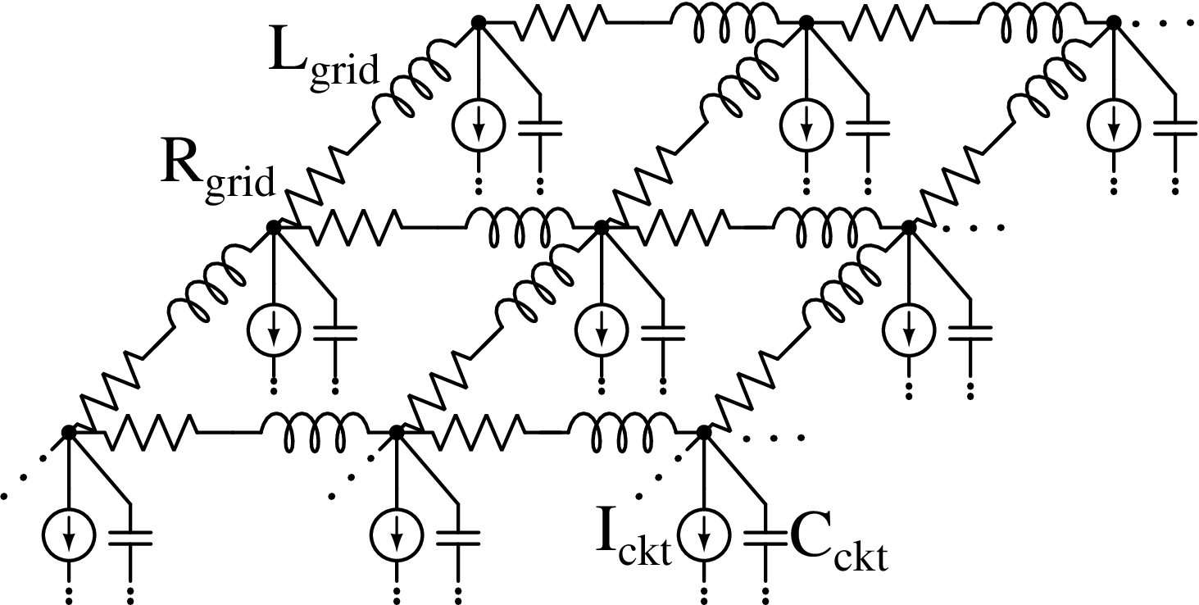
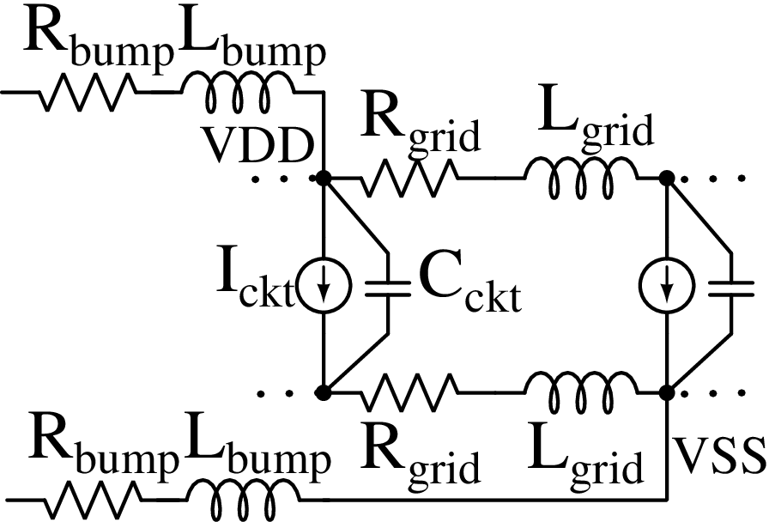
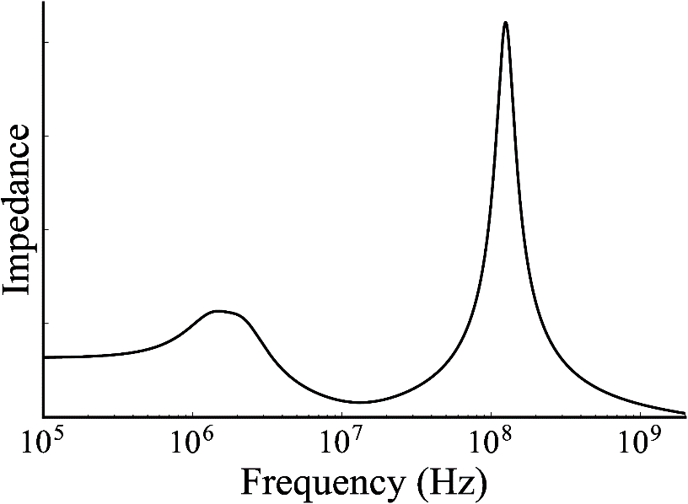
Power delivery network model
12
12
* Model based on M. S. Gupta et. al. “Understanding voltage variations in chip multiprocessors using a distributed power-delivery network”, DATE 2007
Notes:
The model for the power delivery network was based on the DATE 2007 paper that analyses voltage emergencies, and models four cores of Pentium 4, with a typical power delivery network: the board (o), with voltage regulator and decoupling capacitors, the package (o) with its decoupling capacitors, the C4 connection bumps (o), and the circuit (o).
The on-chip power delivery network (o) is modeled as a 12 by 12 grid, where each point models a portion of the circuit, with an intrinsic capacitance and a current source.
Also, notice that (o) there is either a power or ground interconnection at each grid point.
And the frequency response obtained (o) is similar to previous work, with first droop frequency at 100MHz.

Slide 13
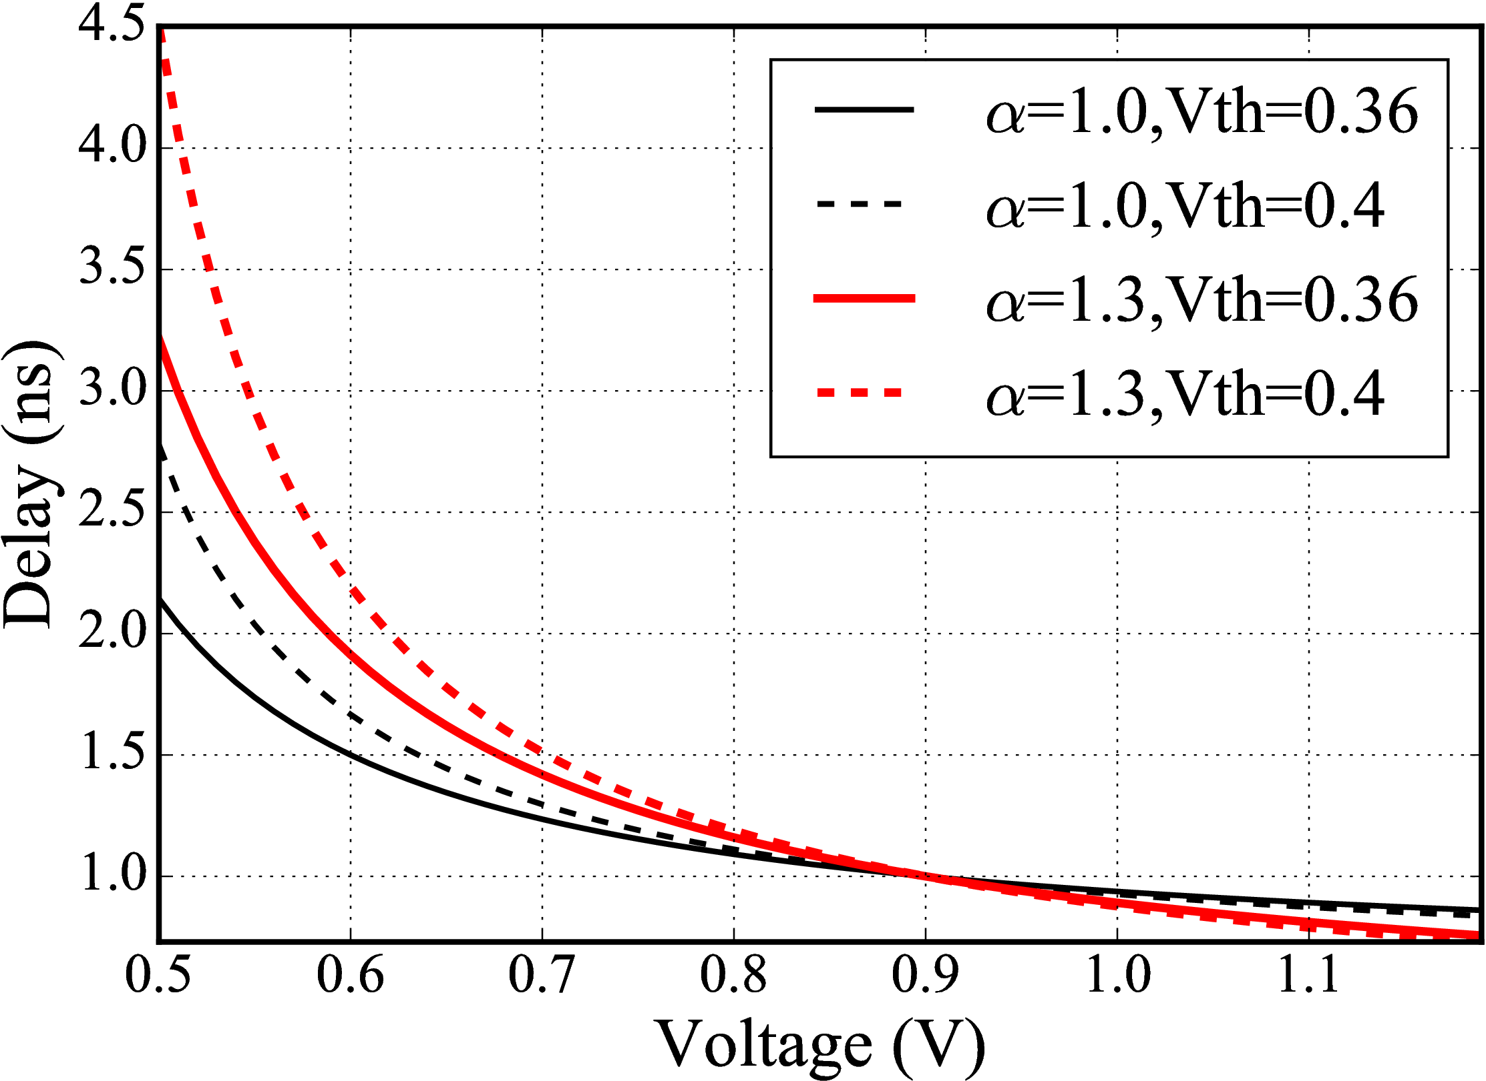
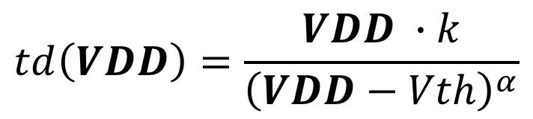
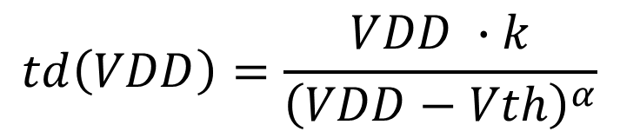
Delay model
$$td\left(VDD\right)=\frac{VDD ∙k}{{\left(VDD−Vth\right)}^{α}}$$
$$td\left(VDD\right)=\frac{VDD ∙k}{{\left(VDD−Vth\right)}^{α}}$$
Different k values are obtained for
td=1ns at VDD=0.9V
k=0.45 is defined with α=1.3 and Vth=0.4V
* Model based on T. Sakurai, “A JSSC classic paper: the simple model of CMOS drain current,” IEEE Solid State Circuits Society Newsletter, 2004.
Notes:
For the delay model, we used this very simple equation that relates the gate delay with the voltage.
The idea is that the values for the constant k, the threshold voltage and the tech parameter alpha have little or no influence by the voltage (o).
Therefore, we can relate directly the delay of the critical paths with the voltage (o).
In order to define the values for the constant k, the threshold voltage and the tech parameter alpha, we explored the values for k obtained with delay of 1ns at 0.9V of supply voltage(o), which is the typical 10% variation for the supply voltage of 1V, and typical values for alpha and threshold voltage.
After defining the k value, we plotted (o) the delay variation with voltage.
As it possible to see here, 1.3 for alpha and 0.4V for threshold voltage generate the larger variation in delay for smaller variations in voltage, therefore we selected these values in order to perform an conservative analysis.
(o) These values derive a k value of 0.45, which is the one we used to compare the performance of static clocks and ring oscillator clocks.

Slide 14
Performance metric (PLL)
For the PLL, the timing margin required regards the delay at nominal voltage and at minimum voltage
$$\left.marginPLL≥td\left(Vnom\right)−td(Vmin\right)$$
D
time
clock tree
Q
critical path
D
Q
launching path
clock tree
clock period
capturing path
Voltage droop
D
Q
D
Q
clock period
margin
Notes:
The margin necessary for a static clock, or in other words: the performance loss, is the difference of the delay of the critical paths at the typical operating voltage and at the minimum estimated voltage at design.
(o) This picture illustrates the typical case, where the time is represented in the horizontal axis.
This picture represents the (o) launching path, with the clock tree and the critical path, and the (o) capturing path, with the clock period and the clock tree.
If the operating conditions never change, this is perfect, but this is not the case (o).
When the supply voltage of this circuit decreases due to a droop (o), for example, everything becomes slower but the clock period, which is static. To avoid timing errors, we have to add the margin (o) considering the delay at minimum voltage.

Slide 15
Performance metric (ROC)
For the ROC, the timing margin required regards the maximum voltage difference in the clock domain
$$\left.marginROC≥td\left(\left.Vmin+max{(}∆VDD\right)\right)−td(Vmin\right)$$
D
time
clock tree
Q
critical path
D
Q
launching path
clock tree
clock period
capturing path
D
Voltage droop
Q
D
Q
Ring Oscillator
only margins for
the difference!
Notes:
On a different perspective, the margin required for a ring oscillator clock must consider only the maximum voltage difference between the ring oscillator and the critical paths.
Notice that this must be valid for any voltage at any given time. However, as the largest delay variations are obtained at lower voltages, we consider the minimum voltage to define the margin.
So, if we replace the PLL by a ring oscillator (o), and a voltage droop happens (o), the ring oscillator becomes slower similarly to the critical path, and it is required to add margins only for the variations in the clock domain.

Slide 16
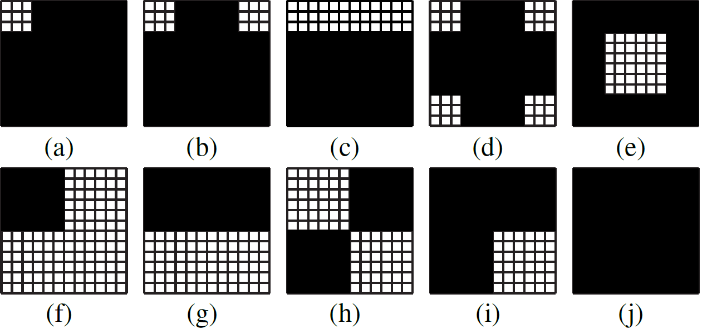
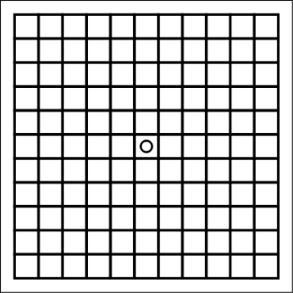
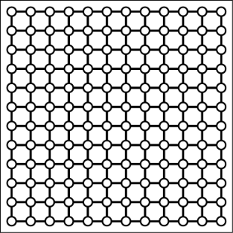
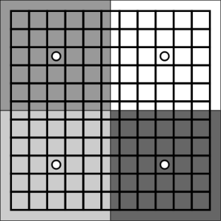
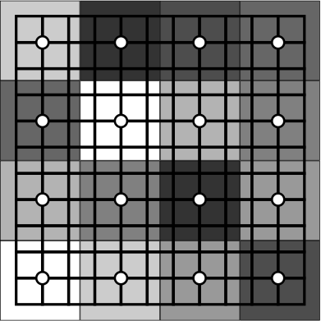
Scenarios analyzed
12
Activity pattern (10)
ROC placement (4)
Frequency (2)
12
Voltage noise
Activity @ 100MHz
1 ROC at the center
1 ROC at any point
Voltage noise
Activity @ 1GHz
4 ROC domains
16 ROC domains
Notes:
In order to stimulate voltage differences in the on-chip power delivery network, we proposed a few activity patterns, where the black areas of the grid are active. So we have from all cores active, three cores, two cores, one core, and only portions of the chip not active.
Also, (o) the voltage difference between the ring oscillator and the critical paths varies with the placement of both, and the size of the clock domain, we proposed 4 different placement strategies to be analyzed: 1 ring oscillator at the center, 1 ring oscillator at any point, looking at the point with largest voltage difference, and also increasing the number of clock domains at 4 and 16.
Additionally, (o) we also analyze the activity frequency at two points: at the typical 1GHz case, with low impedance, and the worst case, the first droop, which is 100MHz for this power delivery network.

Slide 17
Results
Notes:
And now we will see the results for these scenarios.

Slide 18
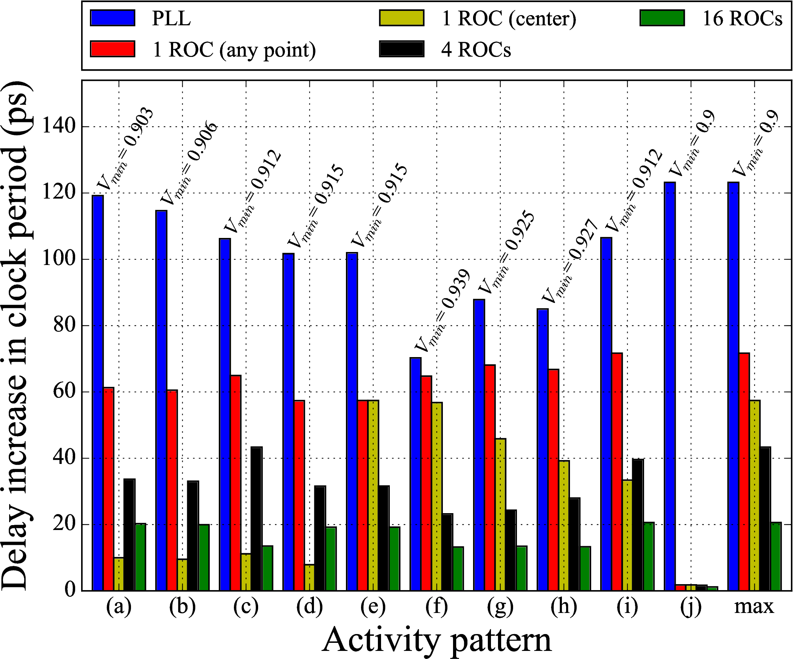
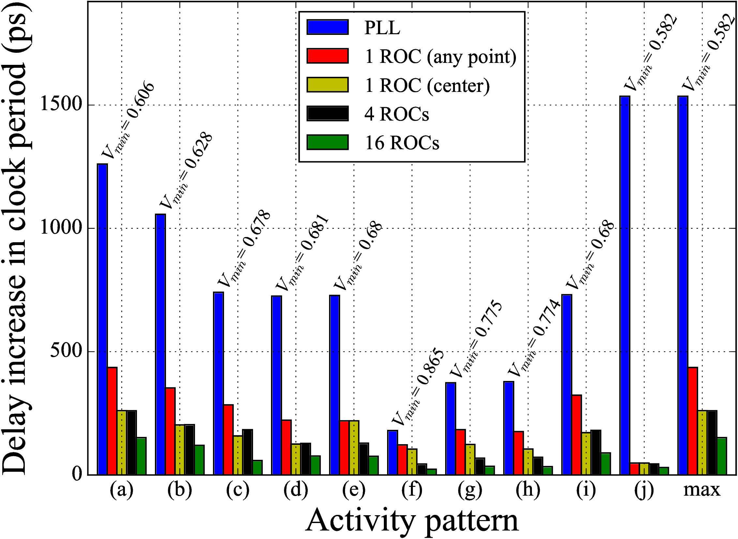
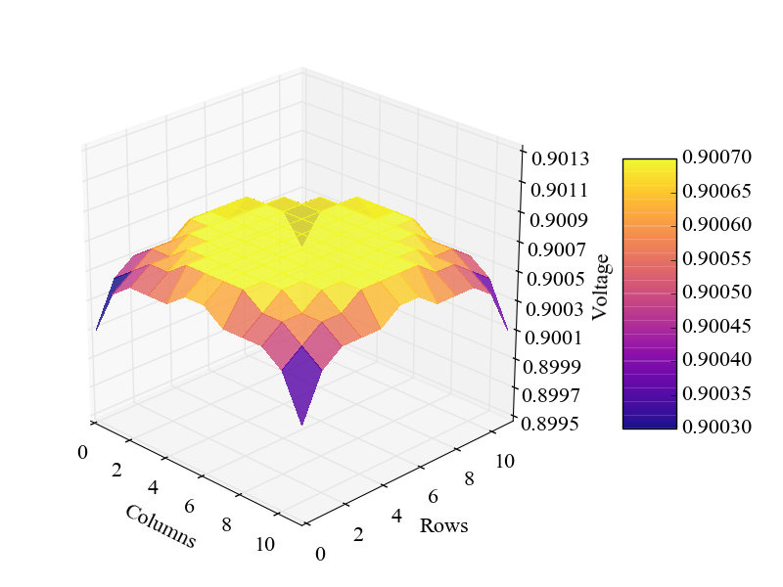
Delay comparison: PLL vs ROCs
Activity @ 1GHz
Activity @ 100MHz
Notes:
These bars represent the delay increase in the clock period in order to support the typical and the worst voltage noise.
For any activity pattern, the average performance loss of the static clocks (in blue) is larger than the ring oscillator clocks, due to the global effect of the voltage droops.
Ring oscillator clocks achieve an even better result if we consider worst voltage noise, as the global component of the voltage droops in this case is way larger than the local component.
(o) Notice that, in this pattern the ring oscillator result is excellent, while it is the worst result for the PLL. When all the chip is working, the voltage differences are minimal, but it is also the case that the minimum voltage is reached.
This indicates that the margins for ring oscillators can be reduced by having an uniform activity across the die.
(o) Also, if we look at the worst case considering all activity patterns, it is possible to see this ladder, that indicates that the margins are smaller with ring oscillators if we have smaller distances between the critical path and the ring oscillator.

Slide 19
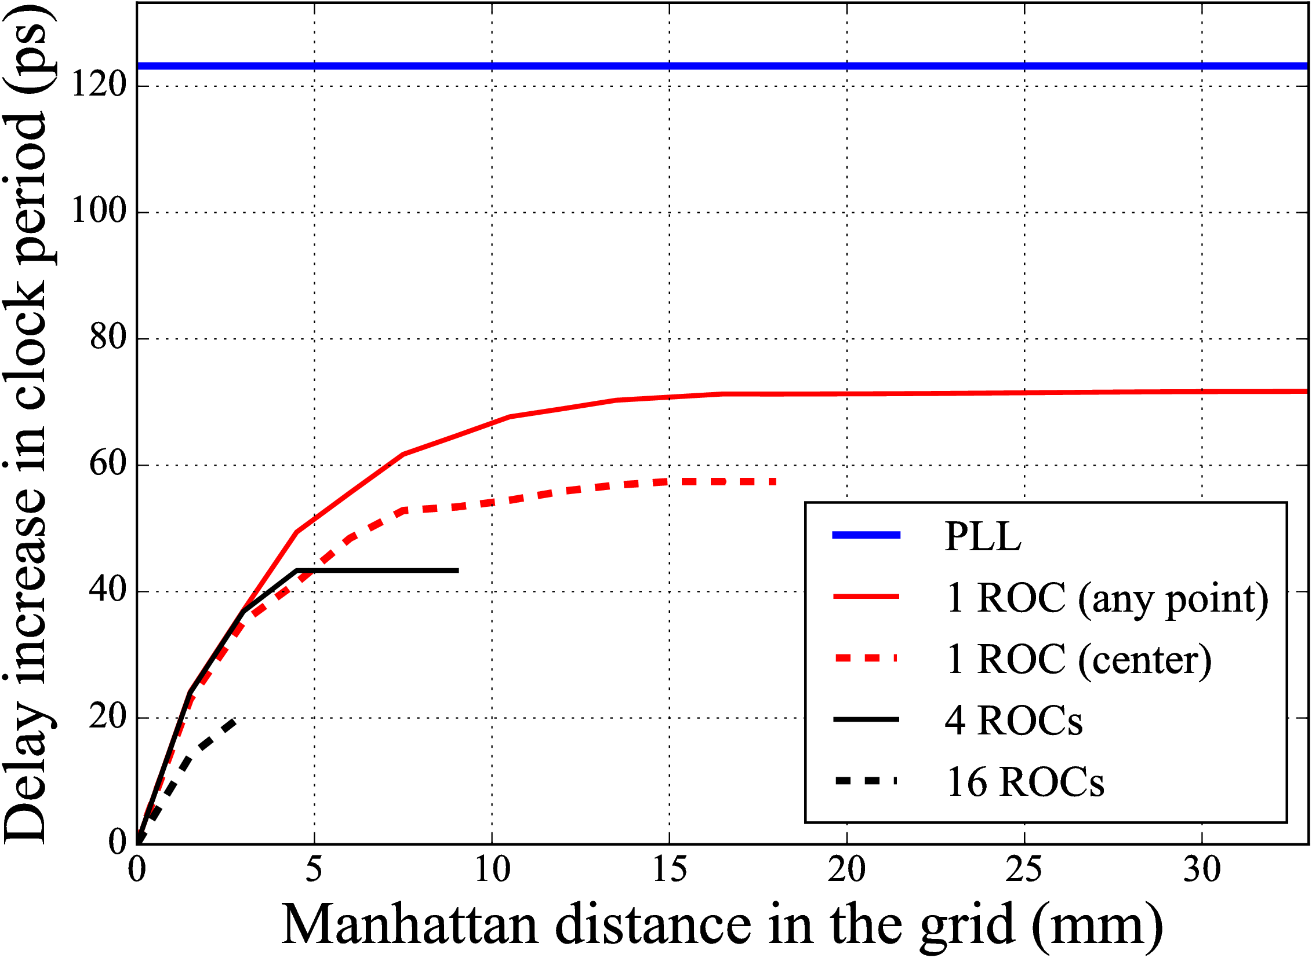
Delay variation with distance
Notes:
This distance effect is better seen in this graph, where we show the delay increase, or the performance loss, versus the distance in the chip grid.
For the PLL, the distance does not matter, so it is the same delay for any distance.
But for any placement of the ring oscillator, if the critical path is closer to the ring oscillator, then the margins are smaller.

Slide 20
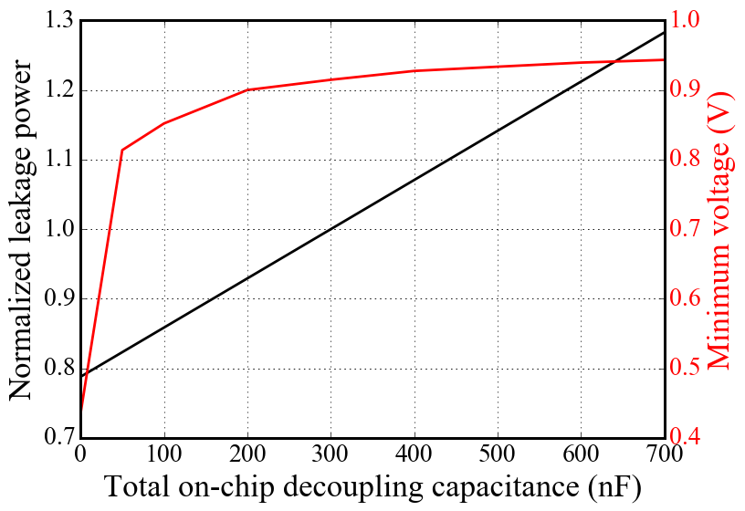
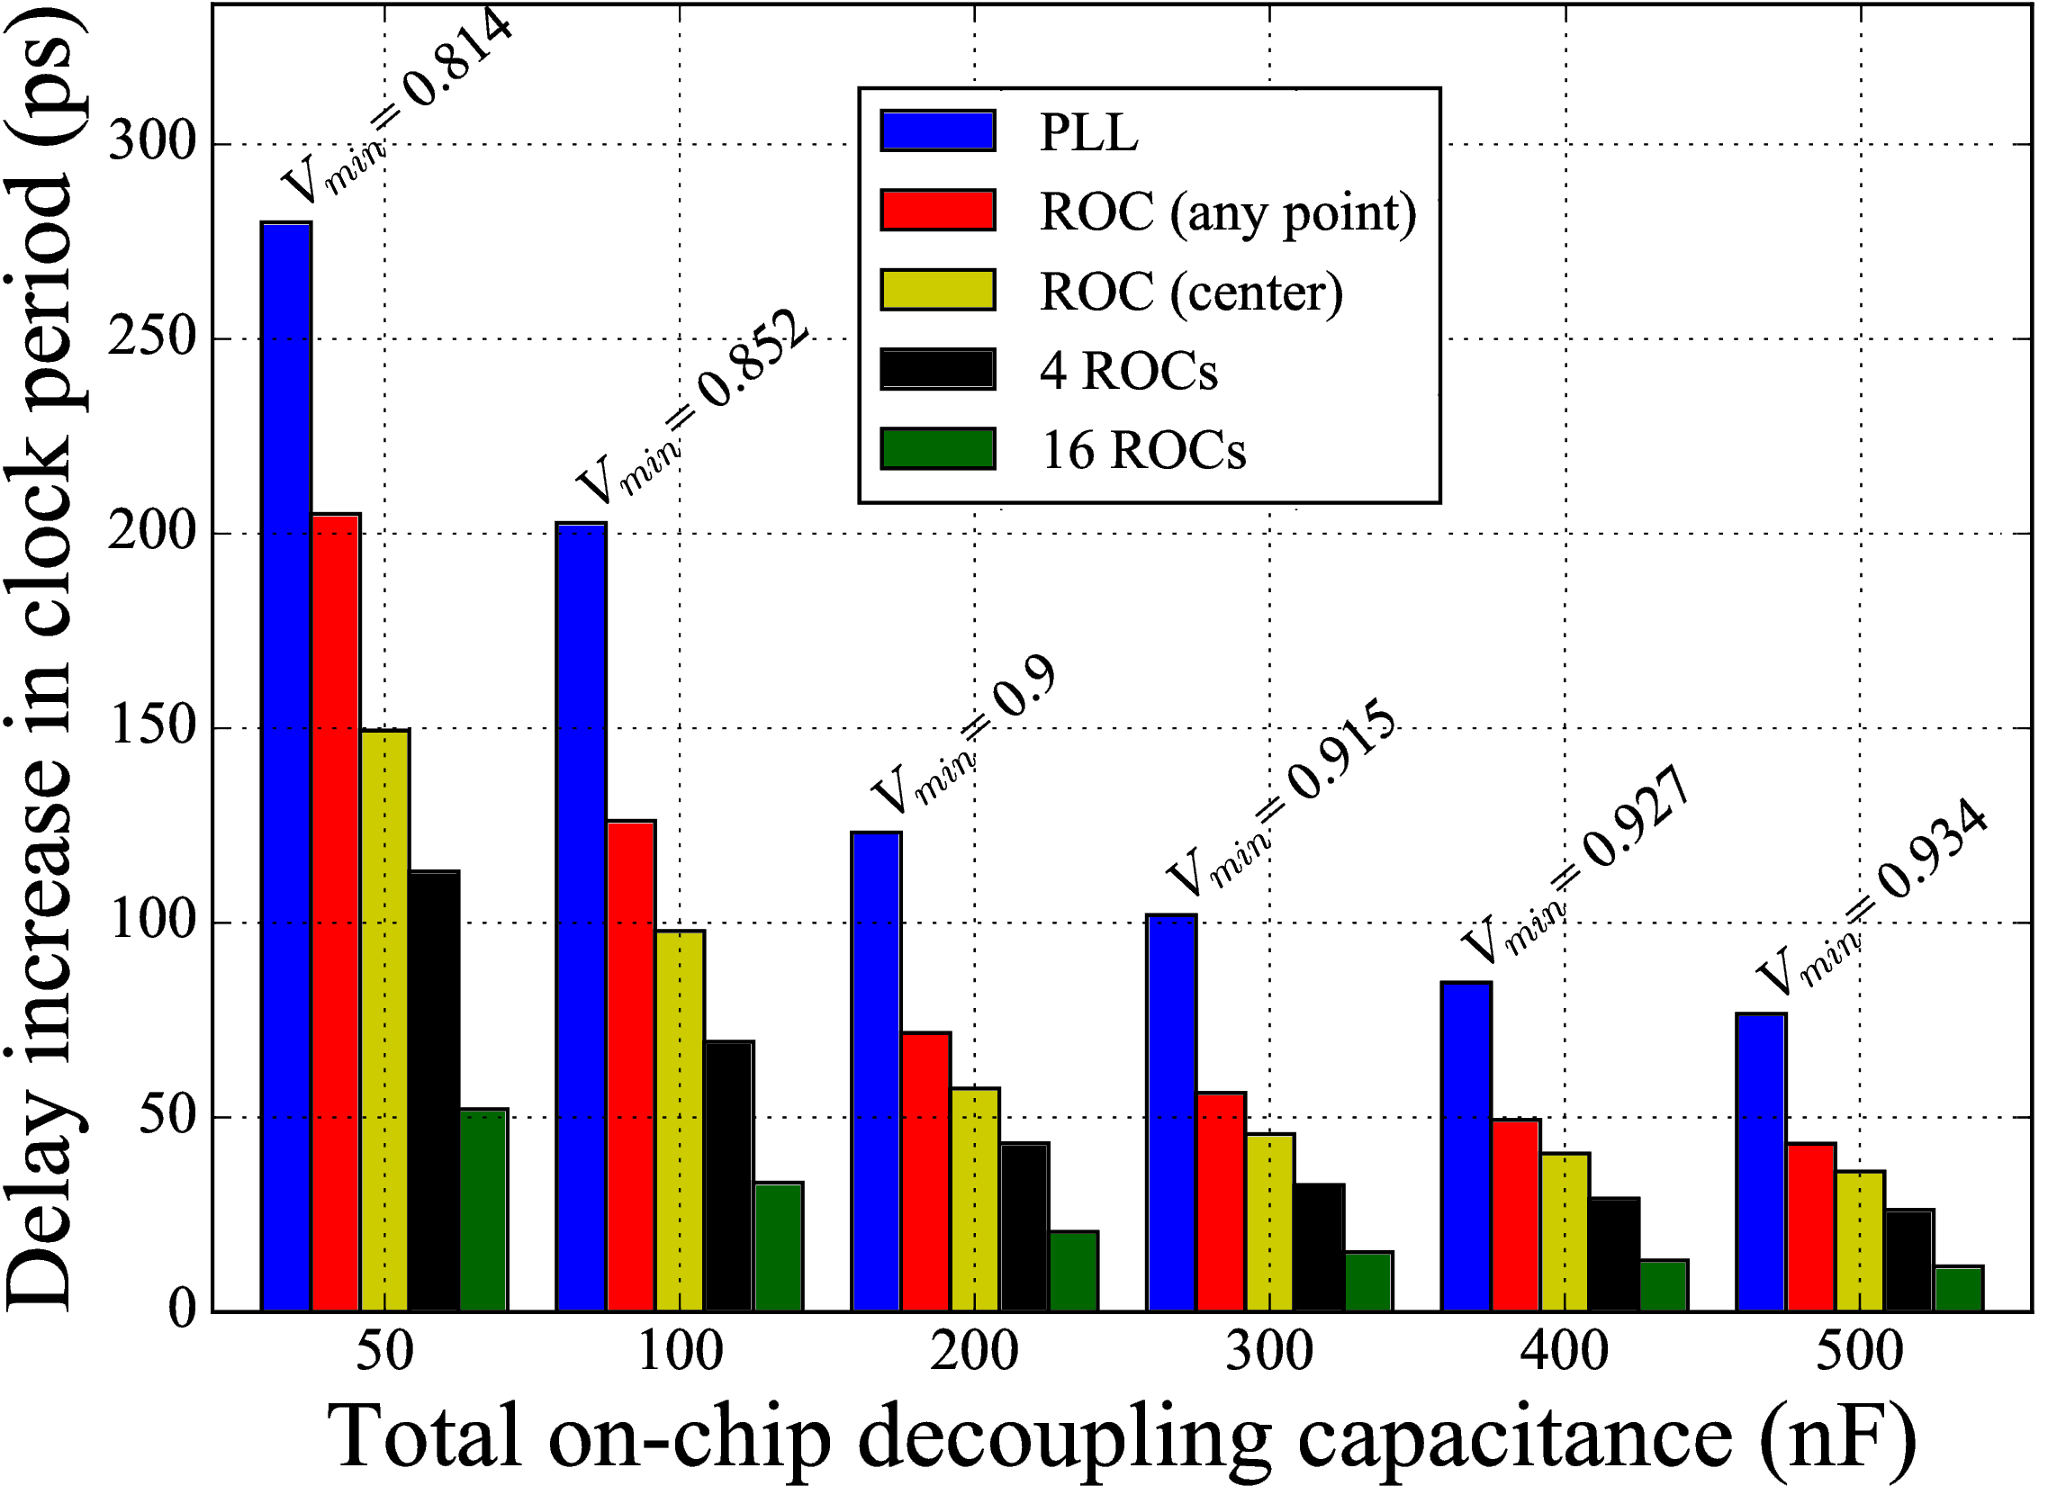
On-chip decaps (1GHz)
14%
200nF
Notes:
One of the well-known methods to mitigate the voltage noise is to increase the amount of on-chip decoupling capacitance. And this is easily seen in this plot, as we increase the on-chip decaps, the voltage noise is reduced and consequentially the delay increase is also reduced.
However, capacitances have an important cost in leakage power, and maybe also in area.
So, here we compared the reduction in leakage power that can be achieved by using ring oscillators instead of increasing the on-chip decoupling capacitance (o).
As it is possible to see, we can have 100nF instead of 300nF by using ring oscillator clocks. (o)
This represents (o) a 14% reduction in the total leakage power for this design.

Slide 21
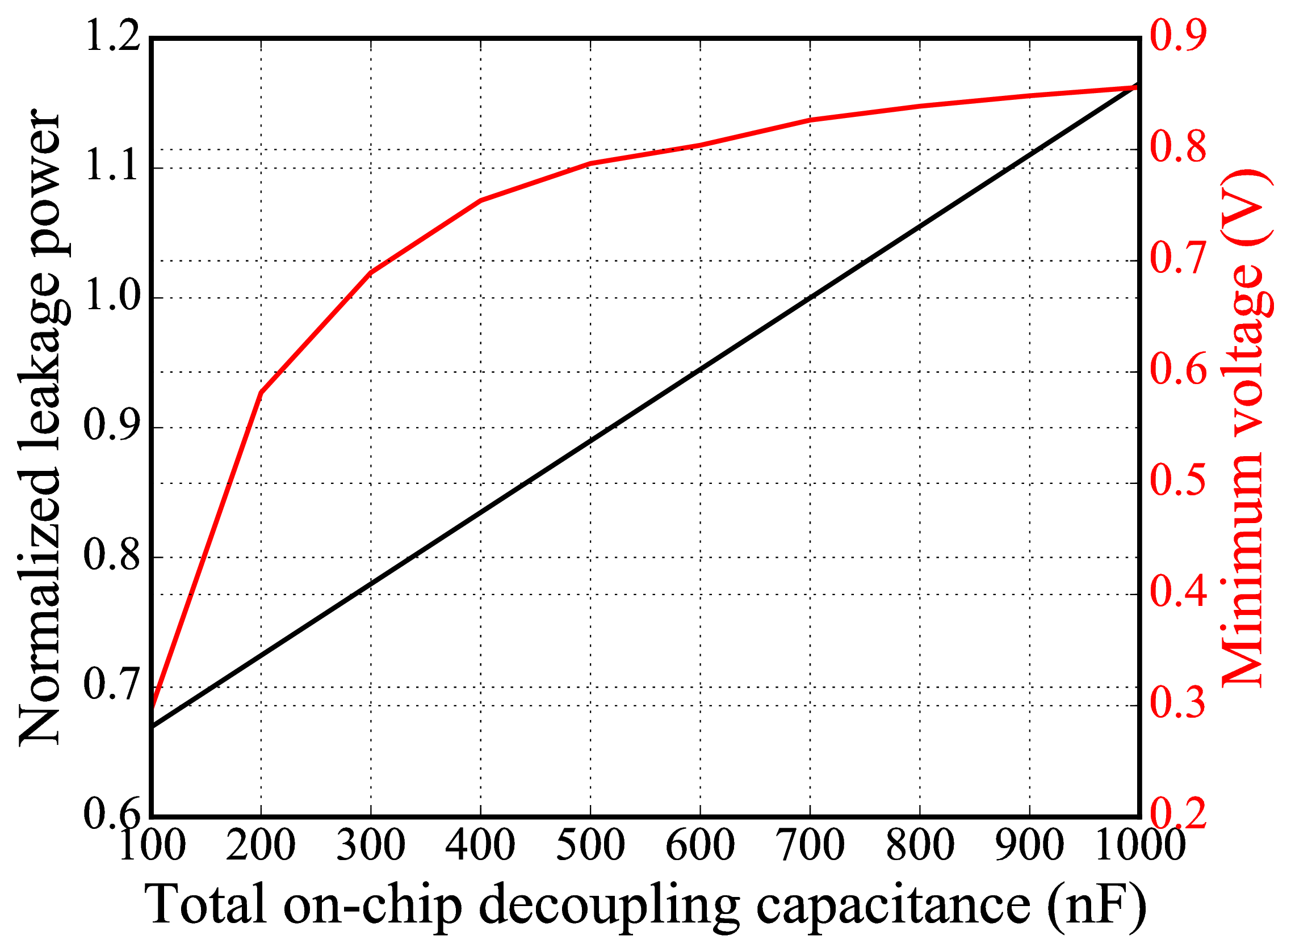
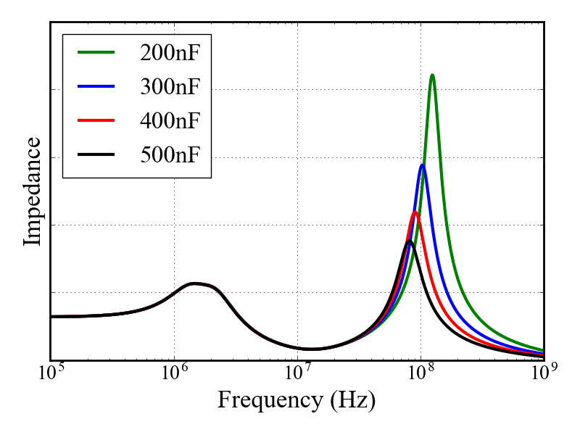
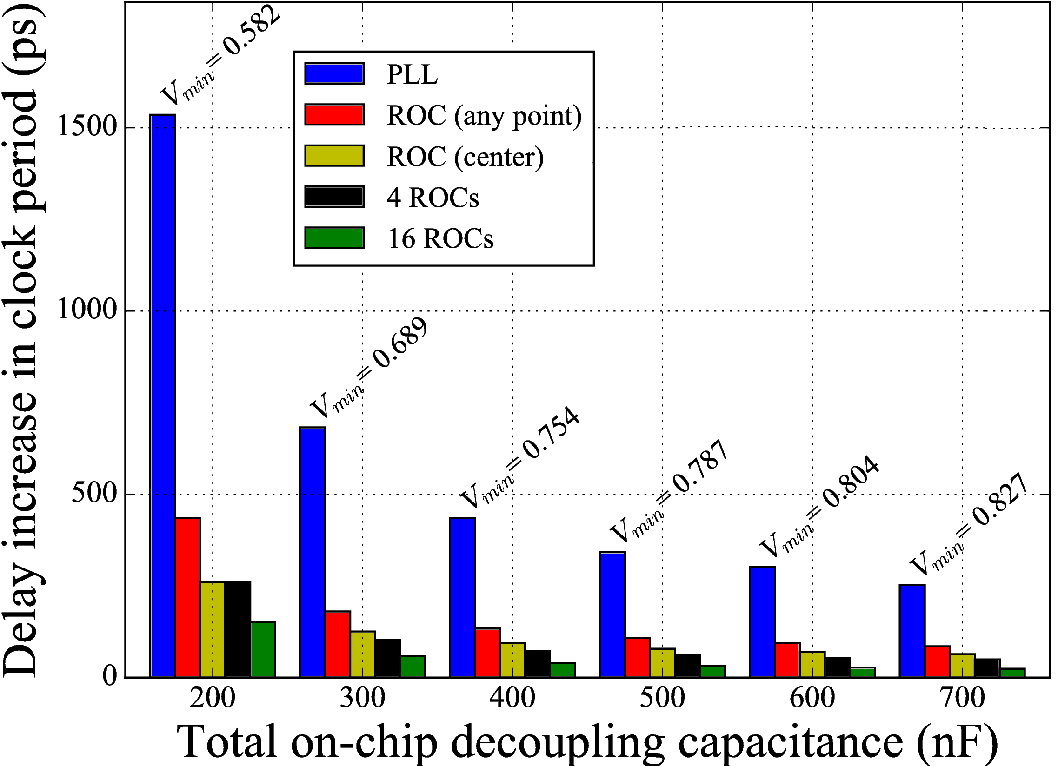
On-chip decaps (first droop)
27%
500nF
Notes:
The effect of increasing on-chip decoupling capacitance has an even better effect for the worst voltage noise.
When we increase the amount of on-chip decaps, the impedance decreases, which has a very important effect in the delay (o).
Considering worst voltage noise, (o) we should have 700nF with static clocks in order to obtain the same performance as a ring oscillator clock with 200nF (o).
This represents a reduction of 27% (o), considering that we want to have this level of robustness.

Slide 22
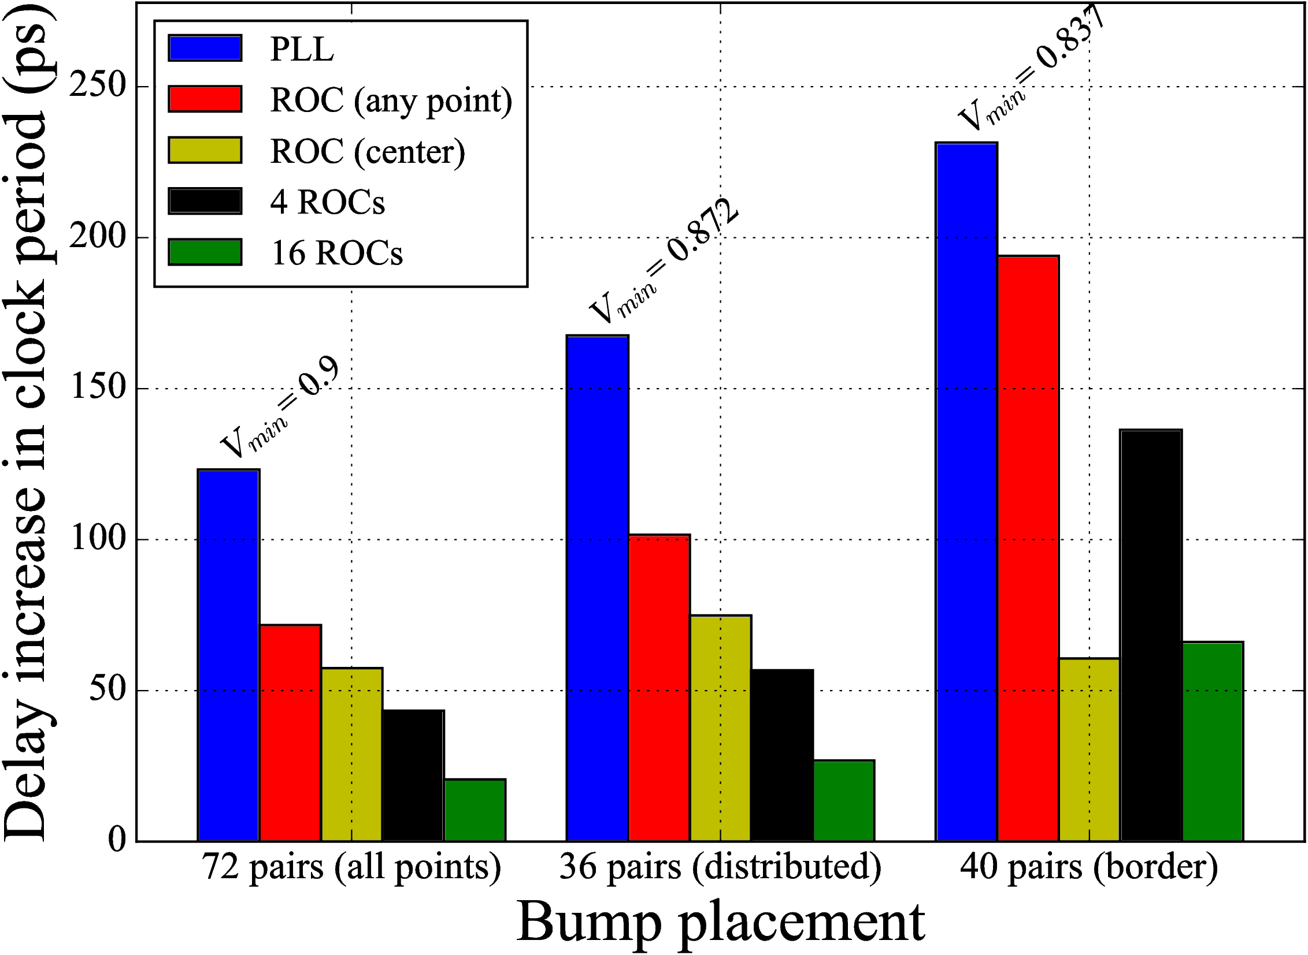
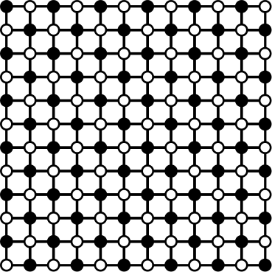
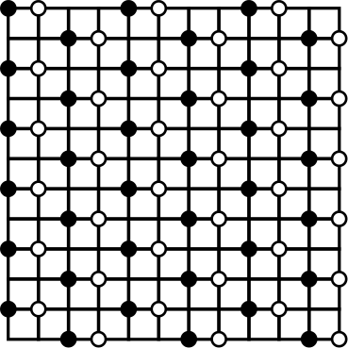
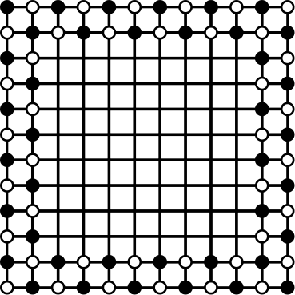
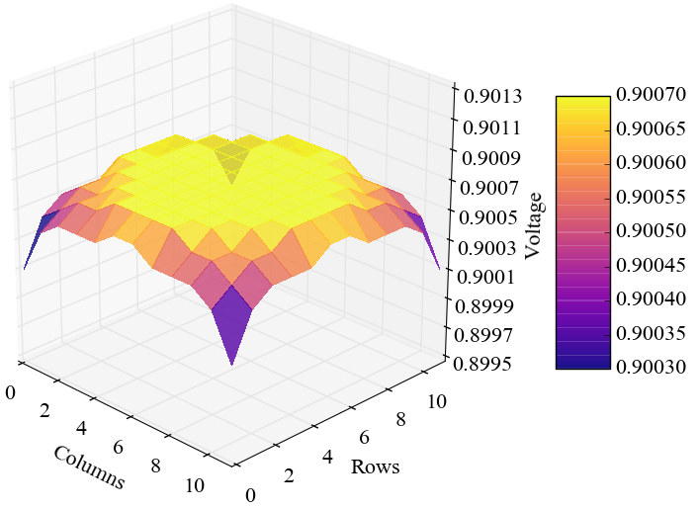
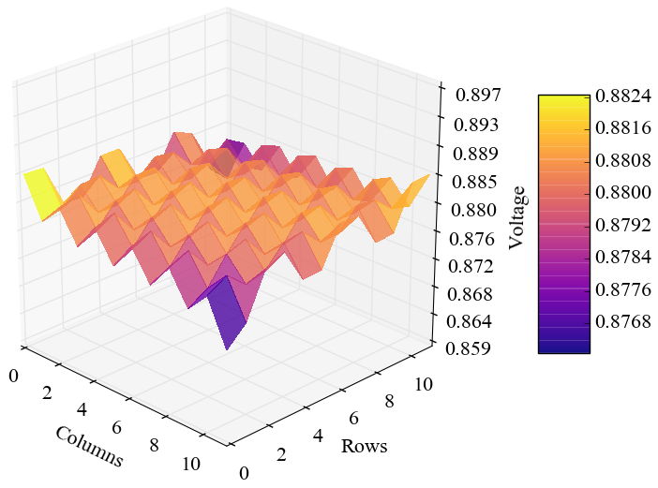
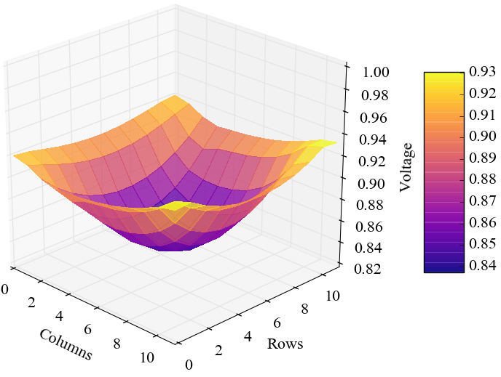
Power interconnections (bumps)
Notes:
We did another experiment, varying the placement of the power bumps, only for typical voltage noise.
Here we compared the same amount of bumps we had on the other experiments, one bump of power or ground for each grid point, with two other strategies: 50% reduction of power bumps, but distributed uniformly; and placing bumps only on the borders of the grid, similarly to a wire bonding scheme.
(o) The effect of reducing the number of bumps in the on-chip voltage variation is clear, with much larger voltage differences between grid points.
Still, (o) the results obtained considering all activity patterns show that it is possible to change the bump placement strategy with ring oscillator clocks and still have better performance than static clocks (o).
Furthermore, if we look at the border placement case (o), we can have a much smaller margin, as the center of the chip will typically have the lowest voltage in the chip.

Slide 23
Conclusions
Ring Oscillators are a competitive
alternative to PLLs
Advantages in performance (up to 83%) and leakage power (up to -27%)
Robustness to unpredictable
power supply fluctuations
A potential solution to operate in hostile environments with unreliable power supplies
Notes:
Power integrity is major design concern nowadays due to the low supply voltages and power density of the circuits, and ring oscillators can be a better solution than static clocks.
We shown that ring oscillators can provide better performance or power, and to achieve these results even with power delivery networks of bad quality.
We are facing a reality in which many devices will have to operate in environments with scarce energy, in which providing reliable voltages may be too difficult or too costly, and ring oscillators can be a great solution for these applications.

