Slide 1
Elastic Systems
Jordi Cortadella Universitat Politècnica de Catalunya
Marc Galceran-Oms Universitat Politècnica de Catalunya
Mike Kishinevsky Intel Corp.

Slide 2
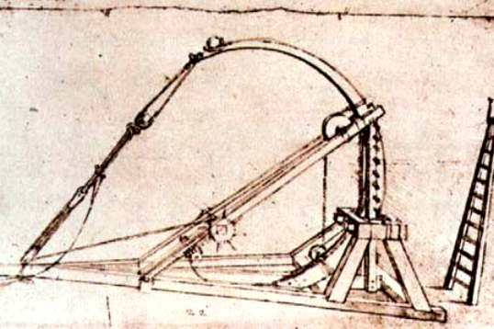
Elasticity
Leonardo da Vinci’s catapult

Slide 3
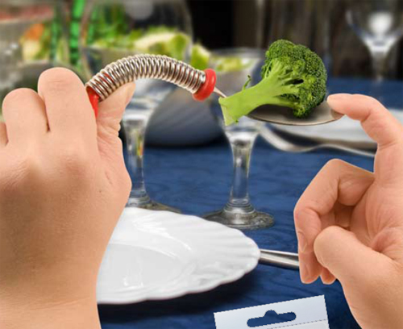

Slide 4
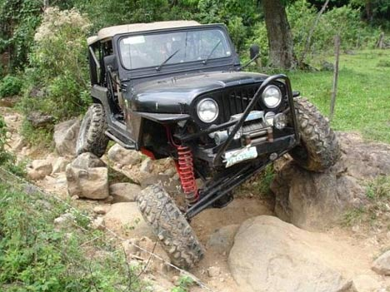

Slide 5


Slide 6


Slide 7
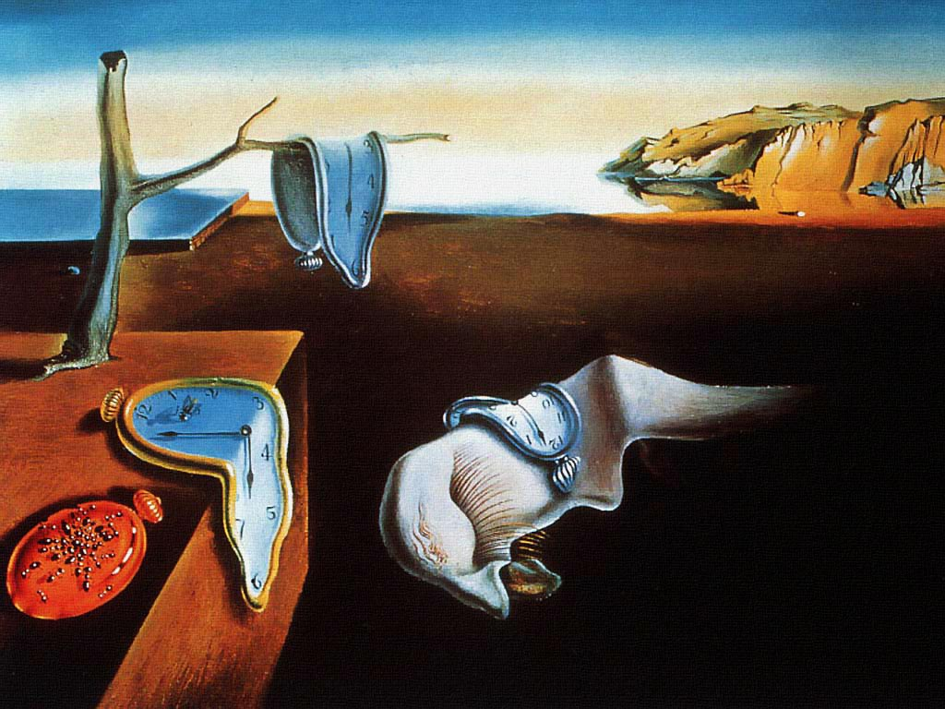

Slide 8
Asynchronous elastic pipeline
ReqIn
ReqOut
C
C
C
C
AckIn
AckOut
David Muller’s pipeline (late 50’s)
Sutherland’s Micropipelines (1989)

Slide 9
The specification of a complex system is usually
asynchronous (functional units, messages, queues, …),
… however the clock appears when we move down
to the implementation levels
(Bill Grundmann, 2004)

Slide 10
Asynchronous elasticity
req
ack
CLK

Slide 11
Synchronous elasticity
valid
stop
CLK
Latency-insensitive systems (Carloni et al., 1999)
Synchronous handshake circuits (Peeters et al, 2001)
Synchronous elastic systems (Cortadella et al., 2006)
Latency-Insensitive Bounded Dataflow Networks (Vijayaraghavan et al., 2009)
Synchronous emulation of asynchronous circuits (O’Leary, 1997)

Slide 12
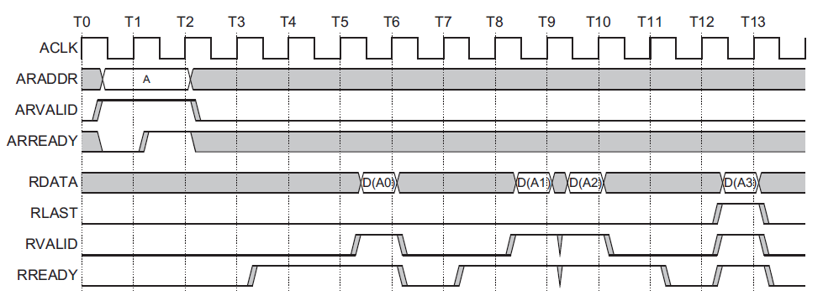
Many systems are already elastic
AMBA AXI bus protocol
Handshake signals

Slide 13
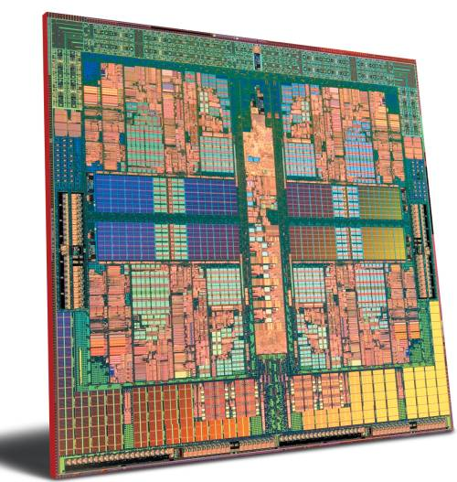
Time uncertainty in chip design
How many
cycles ?

Slide 14
Why elastic circuits now ?
Need to live with time uncertainty
Need to formalize time uncertainty
  For synthesis
  For verification
Need for modularity

Slide 15
Behavioral equivalence in Elastic Circuits
…
7
4
1
+
…
…
8
4
3
1
0
2
…
7
4
1
+
…
e
…
8
4
3
1
0
2

Slide 16
Behavioral equivalence in Elastic Circuits
…
7
4
1
+
…
…
8
4
3
1
0
2
…
7
4
1
+
…
e
…
8
4
3
1
0
2
bubble
token
Traces a preserved after hiding bubbles
(stream-based equivalence)

Slide 17
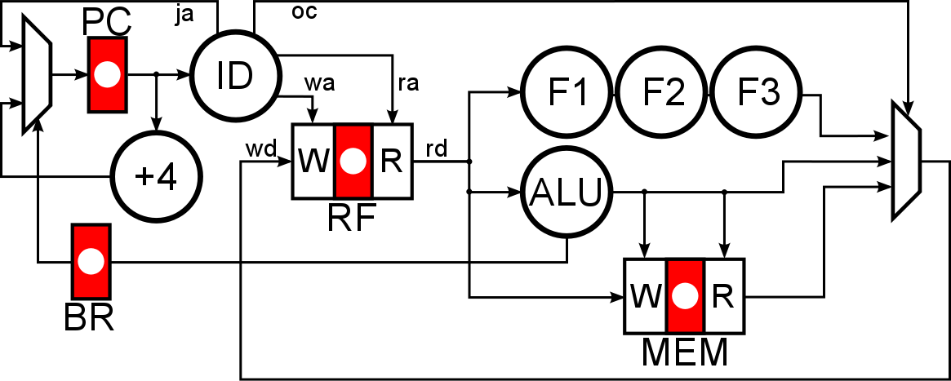
Unpipelined system

Slide 18
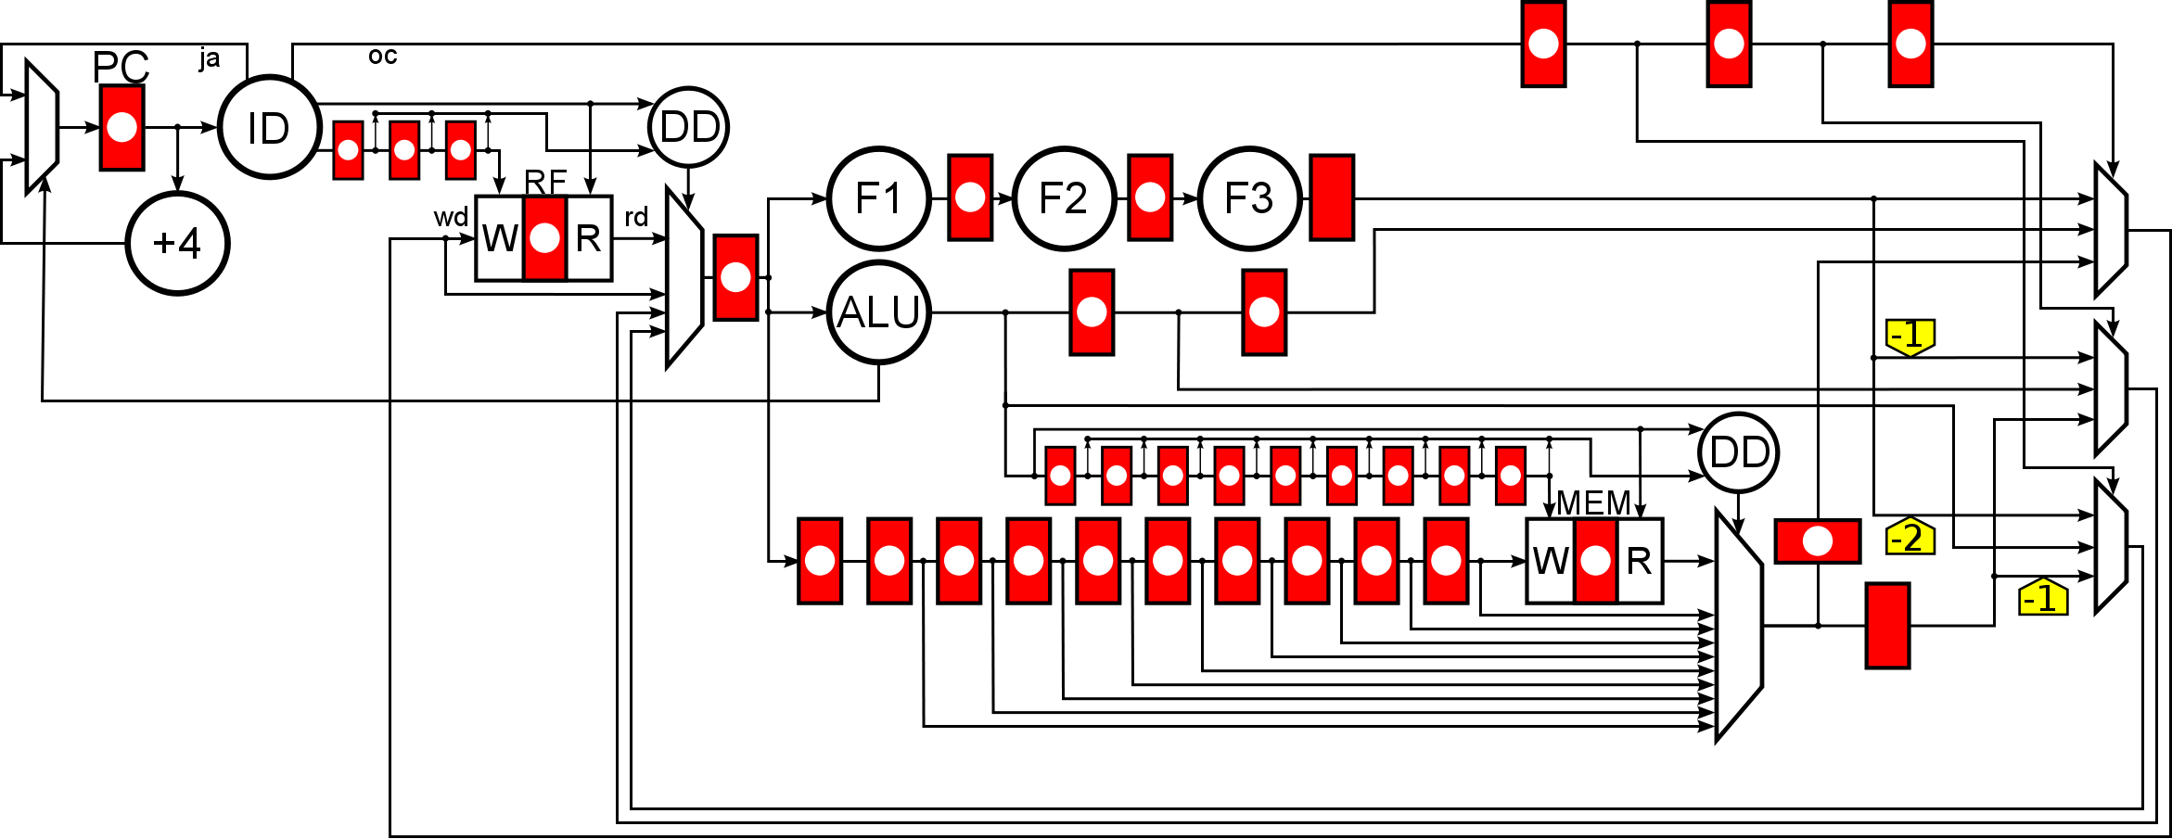
Pipelined system

Slide 19
Write Buffer

Slide 20
Communication channel
sender
receiver
Data
Data
Long wires: slow transmission

Slide 21
Pipelined communication
sender
receiver
Data
Data

Slide 22
Pipelined communication
sender
receiver
Data
Data

Slide 23
The Valid bit
sender
receiver
Data
Data
Valid
Valid

Slide 24
The Stop bit
sender
receiver
Data
Data
Valid
Valid
Stop
Stop
0
0
0
0
0

Slide 25
The Stop bit
sender
receiver
Data
Data
Valid
Valid
Stop
Stop
0
0
0
1
1

Slide 26
The Stop bit
sender
receiver
Data
Data
Valid
Valid
Stop
Stop
0
0
1
1
1

Slide 27
The Stop bit
sender
receiver
Data
Data
Valid
Valid
Stop
Stop
1
1
1
1
1
Back-pressure

Slide 28
The Stop bit
sender
receiver
Data
Data
Valid
Valid
Stop
Stop
1
1
1
1
0

Slide 29
The Stop bit
sender
receiver
Data
Data
Valid
Valid
Stop
Stop
0
0
0
0
0

Slide 30
The Stop bit
sender
receiver
Data
Data
Valid
Valid
Stop
Stop
0
0
0
0
0

Slide 31
The Stop bit
sender
receiver
Data
Data
Valid
Valid
Stop
Stop
0
0
0
0
0

Slide 32
The Stop bit
sender
receiver
Data
Data
Valid
Valid
Stop
Stop
0
0
0
0
1
Long combinational path

Slide 33
Carloni’s relay stations (double storage)
sender
receiver
shell
main
main
main
shell
pearl
pearl
aux
aux
aux

Slide 34
Carloni’s relay stations (double storage)
sender
receiver
shell
main
main
main
shell
pearl
pearl
aux
aux
aux

Slide 35
Carloni’s relay stations (double storage)
sender
receiver
shell
main
main
main
shell
pearl
pearl
aux
aux
aux

Slide 36
Carloni’s relay stations (double storage)
sender
receiver
shell
main
main
main
shell
pearl
pearl
aux
aux
aux

Slide 37
Carloni’s relay stations (double storage)
sender
receiver
shell
main
main
main
shell
pearl
pearl
aux
aux
aux

Slide 38
Carloni’s relay stations (double storage)
sender
receiver
shell
main
main
main
shell
pearl
pearl
aux
aux
aux

Slide 39
Carloni’s relay stations (double storage)
sender
receiver
shell
main
main
main
shell
pearl
pearl
aux
aux
aux

Slide 40
Carloni’s relay stations (double storage)
sender
receiver
shell
main
main
main
shell
pearl
pearl
aux
aux
aux

Slide 41
Carloni’s relay stations (double storage)
sender
receiver
shell
main
main
main
shell
pearl
pearl
aux
aux
aux
Handshakes with short wires
Double storage required

Slide 42
Flip-flops vs. latches
sender
receiver
FF
FF
1 cycle

Slide 43
Flip-flops vs. latches
sender
receiver
H
L
H
L
1 cycle

Slide 44
Flip-flops vs. latches
sender
receiver
H
L
H
L
1 cycle

Slide 45
Flip-flops vs. latches
sender
receiver
H
L
H
L
1 cycle

Slide 46
Flip-flops vs. latches
sender
receiver
H
L
H
L
1 cycle

Slide 47
Flip-flops vs. latches
sender
receiver
H
L
H
L
1 cycle
Flip-flops already have a
double storage capability, but …

Slide 48
Flip-flops vs. latches
sender
receiver
H
L
H
L
1 cycle
Not allowed in conventional
FF-based design !

Slide 49
Flip-flops vs. latches
sender
receiver
H
L
H
L
1 cycle
Let’s make the master/slave latches independent

Slide 50
Flip-flops vs. latches
sender
receiver
H
L
H
L
½ cycle
½ cycle
Let’s make the master/slave latches independent
Only half of the latches (H or L) can move tokens

Slide 51
Latch-based elasticity
sender
receiver
Data
Data
En
En
En
En
V
V
V
V
Valid
Valid
1
1
1
1
Stop
Stop
S
S
S
S

Slide 52
Elastic netlists
Enable signal
to data latches
EB
Fork
Join
EB
Join / Fork
EB
EB

Slide 53
Basic VS block
En_{i}
En_{i}
V_{i-1}
V_{i}
V_{i-1}
VS
V_{i}
S_{i-1}
S_{i}
S_{i-1}
S_{i}

Slide 54
Join
+
V₁
V
VS
S₁
S
VS
V₂
VS
S₂

Slide 55
(Lazy) Fork
V
V₁
S₁
V₂
S
S₂

Slide 56

Eager Fork
S₁
^
V₁
V
V₂
^
S
S₂

Slide 57
Variable Latency Units
[0 - k]
cycles
go
done
clear
V/S
V/S

Slide 58
Generalization: FIFOs
(Bounded Dataflow Networks)
Out
In
B1
B3
B2

Slide 59
Elastic Buffers
•
=
•
Elastic Buffer with Token
=
Elastic Buffer with Bubble
=
Skid-Buffer (zero latency)
m
m
Anti-token injector
-k

Slide 60
Let’s do transformations
Goal:
  Transform the system to improve performance, either preserving or not preserving time (but preserving behavior)
Few transformations have been re-invented from asynchronous design and dataflow computation:
  Adding bubbles preserves behavior
  Early evaluation and anti-tokens
  Buffer resizing and slack matching to balance fork/join structures

Slide 61
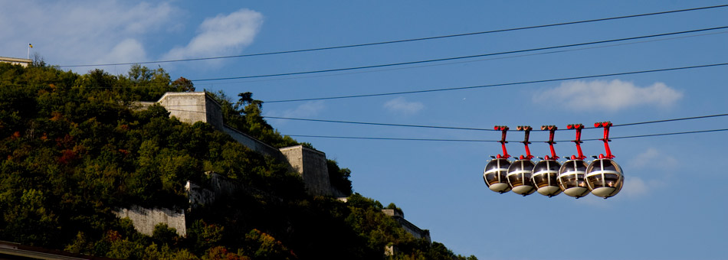
Performance is about tokens and bubbles

Slide 62
How many bubbles do we need?

Slide 63
How many bubbles do we need?

Slide 64
How many bubbles do we need?

Slide 65
How many bubbles do we need?

Slide 66
How many bubbles do we need?

Slide 67
How many bubbles do we need?

Slide 68
How many bubbles do we need?
O(n²) cycles

Slide 69
How many bubbles do we need?
O(n²) cycles

Slide 70
How many bubbles do we need?
O(n²) cycles

Slide 71
How many bubbles do we need?
O(n²) cycles

Slide 72
How many bubbles do we need?
O(n²) cycles

Slide 73
How many bubbles do we need?
O(n²) cycles

Slide 74
How many bubbles do we need?
O(n²) cycles

Slide 75
How many bubbles do we need?
O(n²) cycles
O(n) cycles

Slide 76
How many bubbles do we need?
At least one bubble and one token per cycle, otherwise neither tokens nor bubbles can move (deadlock)
n/2 bubbles for optimum performance
(in a balanced cycle)

Slide 77
Performance of an N-stage ring
Throughput
Deadlock
tokens
0
N / 2
N

Slide 78
Adding bubbles (retiming & recycling)
Retiming graph
4
4
10
- Combinational block with delay 10
- Initialized register (dot)
9
3
4
19
21
5 registers, 4 tokens
12
Cycle time is
16
Throughput is 4/5
10
9
8
6
Throughput is 1
Effective cycle time is 12 * 5/4 = 15
Effective cycle time is 21
Effective cycle time is 16
Effective cycle time is 19
cycle time/throughput
The longest combinational path delay
The number of valid data/clock cycle
Retiming and Recycling (R&R) can
Find a minimal effective cycle time of the circuit represented as retiming graph (RG)!
Retiming can not do better!
Notes:
78

Slide 79
Retiming
  Any integer solution for r:
Final token
assignment
Initial register assignment
Retiming vectors
R' contain tokens and anti-tokens
Notes:
79

Slide 80

Retiming & Recycling
  Any integer solution for R:
Retiming subset
R – max(R' ,0) = num of bubbles
•
-1
Notes:
80

Slide 81

Mixed Integer Program for R&R
Effective cycle time
(delay/throughput)
Retiming & Recycling configuration
Throughput upper bound of R
(Júlvez et al 2006)
Cycle time of R is at most τ
(Bufistov et al 2007)
Non-convex quadratic optimization problem
Can be transformed into a Mixed Integer
Linear Programming model
Notes:
81

Slide 82
Early Evaluation
Only wait for required inputs
Late arriving tokens are cancelled by anti-tokens
Branch target
address
PC+4
No branch
Take branch
Example: next-PC calculation
Notes:
82

Slide 83
How to implement anti-tokens ?
Valid⁺
Valid⁺
+
Valid⁺
Stop⁺
Stop⁺
-
Valid–
Valid–
Stop–
Stop–

Slide 84
Dual elastic controllers
En
En
V
+
V
+
S
+
S
+
V
-
V
-
-
-
S
S

Slide 85
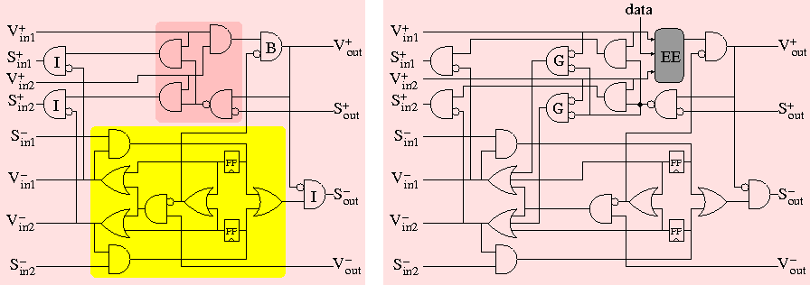
Fork/join
Dual fork/join
Join with early evaluation

Slide 86
Re-designing for average performance
F
F_{slow}
Early evaluation
F_{fast}
slow / fast

Slide 87
How can elasticity be used for design optimization?
In “regular” designs:
  Take advantage of Don’t Cares = behaviors that never occur
In elastic designs:
  Take advantage of “Little Cares” (LCs) = behaviors that rarely occur
  and “Critical Cores” (CC) = behaviors that occur often
  Can use variable latency: LCs can be made slower

Slide 88
Exploiting “Little cares”
F
100
•
G
100
•
Goal: minimize time per token (operation) execution
Measured by Effective Cycle Time, ECT
ECT = Clock Period / Throughput = 100 / 1 = 100
Design executes one token per 100 time units

Slide 89
Exploiting “Little cares”
F
100
•
G
100
•
CC1
100
CC1
50
CC2
100
•
CC2
50
p
•
LC1
100
•
LC2
100
1-p

Slide 90
Exploiting “Little cares”
F
100
•
G
100
•
CC1
50
•
CC2
50
p
•
LC1’
50
LC1’’
50
•
LC2’
50
LC2’’
50
1-p

Slide 91
Performance as function of “critical core” probability
Throughput
Probability
Effective CT
1.67x performance improvement
new design @ p = 0.9
original
design
Probability

Slide 92
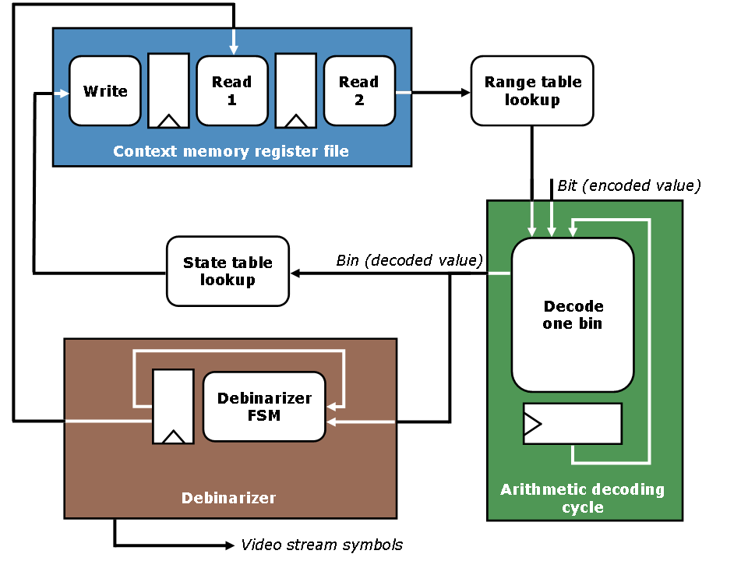
H.264 CABAC decoder
Gotmanov, Kishinevsky and Galceran-Oms
Evaluation of flexible latencies: designing synchronous elastic H.264 CABAC decoder
Proc. Problems in design of micro- and nano-electronic systems
Moscow, Oct. 2010 (in Russian)

Slide 93
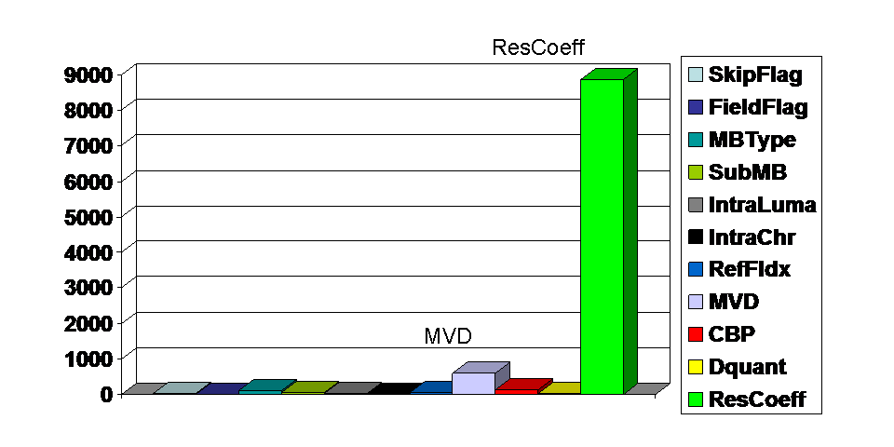
Profiling

Slide 94
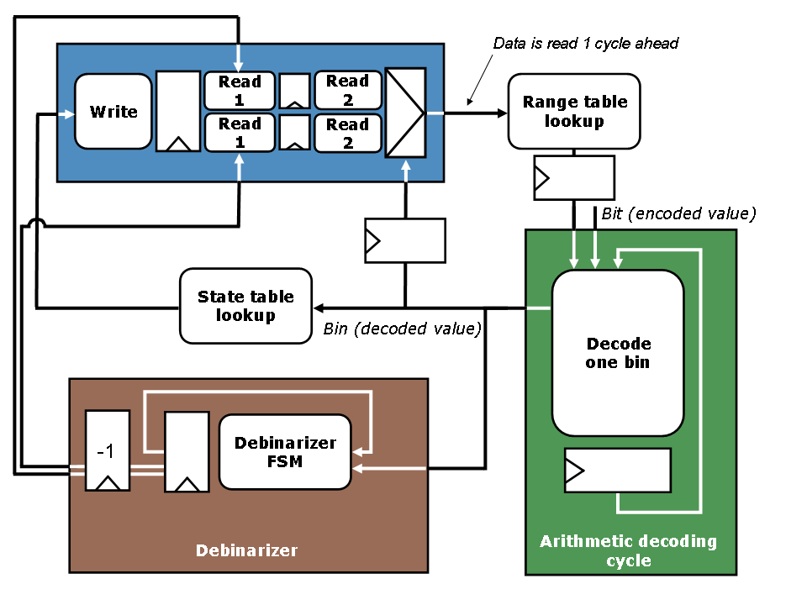
H.264 CABAC decoder

Slide 95
Area
Effective Cycle Time

Slide 96
Elastic Transforms
Bubble Insertion :
(recycling)
=
Anti-token Insertion :
=
-1
kernel
Anti-token Grouping :
=
-i
-j
-(i+j)
Add Capacity:
=
k
Anti-token retiming:
=
-1
-1
-1
-1
Multiple
derivative
Anti-token Insertion:
=
...
-k
k
Notes:
18’
BI : It is possible to insert and remove an empty EB in any channel of an elastic system
AI : An empty EB is equivalent to an EB with one token of information followed by an anti-token. (1-1=0)
AG : one can group to anti-token counters into a single anti-token counter
AC : adding capacity is always correct. It does not modify forward latency of the FIFO. 0-latency fifo
AR : Anti-token retiming, can be dangerous. In this case it is correct, should not traverse tokens unless it is a token we know we will kill
MAI : derived one

Slide 97
Retiming
B
B
A
F
A
F
C
C
B
2
B
A
F
A
F
C
2
C
Capacity sizing may be needed in case of sharing

Slide 98
Register File Bypass
wa
ra
wa
ra
wa’
=
wd
rd
=
wd
wd’
rd
WRITE
READ
READ
0
WRITE
1
Read data rd is forwarded from previous write wd’
iff read address ra is the same as previous write address wa’.

Slide 99
Pipelining using elasticity
wa
ra
A
wd
rd
WRITE
READ
B1
B2
Sequential
execution:
R A
R B1 B2
R B1 B2
R A
Kam, et al. Correct-by-construction Microarchitectural Pipelining, ICCAD 08

Slide 100
Pipelining using elasticity
wa
ra
A
wd
rd
WRITE
READ
B1
B2
Pipelined
execution:
R
A
Bypass if data dependency
R
B1
B2
???
R
B1
B2
R
A
R
B1
B2
R
B1
B2

Slide 101
Pipelining using elasticity
wa
ra
A
wd
rd
WRITE
READ
B1
B2
Pipelined
execution:
R
A
R
B1
B2
R
B1
B2
R
A
R
B1
B2
R
B1
B2

Slide 102
Pipelining using elasticity
wa
ra
A
wd
rd
WRITE
READ
B1
B2

Slide 103
Pipelining using elasticity
2 bypasses
wa
ra
wa’
wa’’
=
A
wd
wd’
wd’’
READ
WRITE
B1
B2
rd

Slide 104
Pipelining using elasticity
Forwarding
wa
ra
wa’
wa’’
=
A
READ
WRITE
B1
B2
rd

Slide 105
Pipelining using elasticity
Retiming
wa
ra
wa’
wa’’
=
A
READ
WRITE
B1
B2
rd

Slide 106
Pipelining using elasticity
Retiming with anti-tokens
wa
ra
wa’
wa’’
=
A
READ
WRITE
B1
B2
rd
Anti-token insertion allows retiming combinations that are not possible in a conventional synchronous circuit
-1

Slide 107
Pipelining using elasticity
wa
ra
wa’
wa’’
=
A
READ
WRITE
B1
B2
rd
System only stalls in case of RAW
dependencies with B1-B2
0
-1
Latency=2, Tokens=1

Slide 108
Exploration Algorithm
Initial
Graph
Since throughput analysis methods are not exact for early evaluation, the best design points found during exploration must be simulated in a second phase of the algorithm to determine the best one.
Add bypasses to one or more memory elements
Set of near-optimal design points
R&R MILP method
Improve?
Simulate near-optimal design points to obtain actual performance
Yes
No

Slide 109
Write Buffer

Slide 110
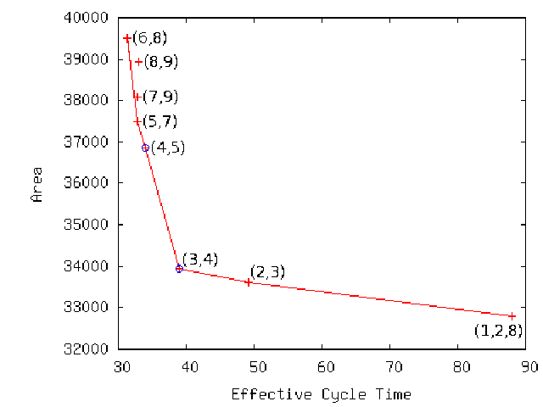
Micro-architectural exploration

Slide 111
Conclusions
Rigid systems preserve timing equivalence
(data always valid at every cycle)
Elastic systems waive timing equivalence to enable
more concurrency
(bubbles decrease throughput, but reduce cycle time)
A new avenue of performance optimizations can emerge to build correct-by-construction pipelines
•
•
•
•
•
•
•
•
•
•
•
Θ
•
Θ

Slide 112
Backup slides

Slide 113
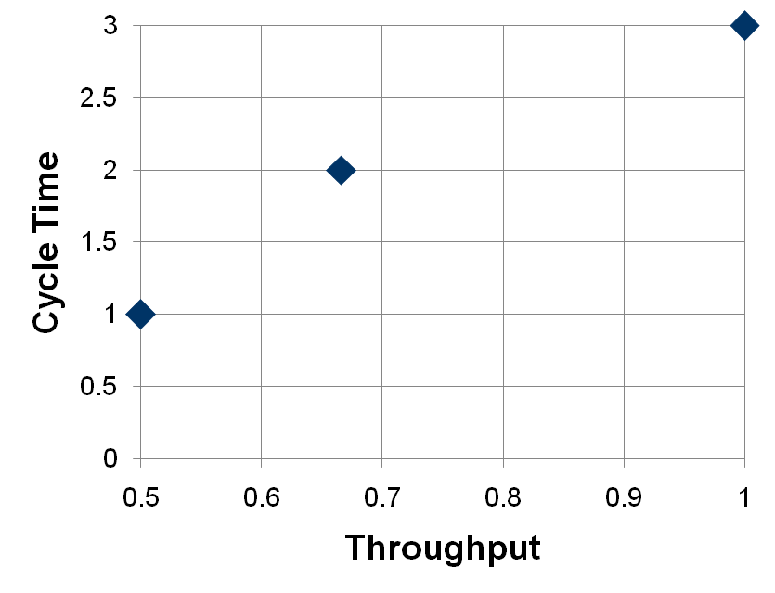
Retiming and Recycling
delays at nodes
elastic buffers and anti-tokens at edges
3/1=3
1
1
2/0.66=3
0
1
1/0.5=2
MILP-based approach
1
1
0
1
R&R finds a set of pareto-point designs with different cycle time / throughput trade-offs
-2
-1
Bufistov, et al. Retiming and Recycling for Elastic Systems with
Early Evaluation. DAC 09

Slide 114
Coarse grain elasticity
114

Slide 115
Deadlocks
Optimal throughput

Slide 116
Notation for elastic systems
Latches=2
Capacity=2
Tokens=1
Elastic buffer with one token of information
Latches=2
Capacity=2
Tokens=0
Empty elastic buffer (bubble)
Latches=0
Capacity=0
Tokens= -k
Channel with an injector of k negative tokens
-k
Latches=0
Capacity=m
Tokens=0
m
Empty elastic buffer with bypass
(Skid-buffer with no tokens of information)

Slide 117
Marked Graph model

Slide 118
Marked Graph model

Slide 119
Marked Graph model

Slide 120
Dual Marked Graph model
Enabled !

Slide 121
How to implement anti-tokens ?
Positive tokens
Negative tokens

Slide 122
How to implement anti-tokens ?
Positive tokens
Negative tokens

Slide 123
Elastic controllers
L
H
Data
En
En
L
H
V
V
V
V
H
L
S
S
S
S

Slide 124
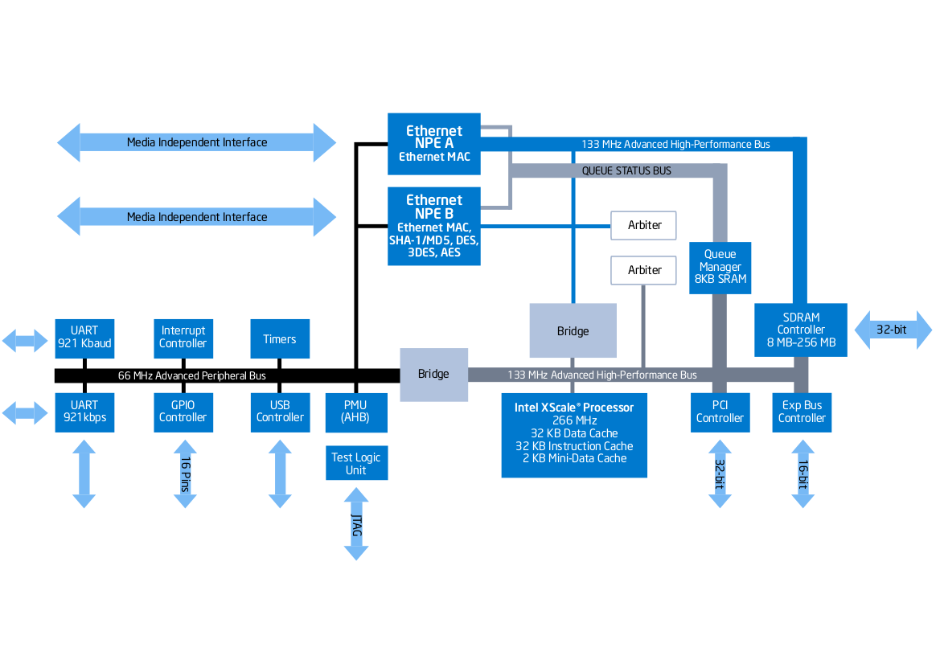
Complex systems need to be elastic
Intel IXP422 Network Processor

Slide 125
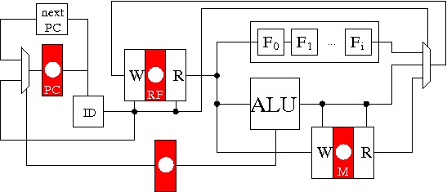
Example: DLX Pipeline
Memory read latency = 10
P(ALU)=0.35
P(F) = 0.2
P(M_{LOAD})=0.25
P(M_{STORE})=0.075
P(BR) = 0.125
Mem dependency = 0.5
RF dependency = 0.2
Depth(F) = [1,…,8]
Block | mux2 | EB | ID | nextPC | ALU | F | RF W | RF R
Delay | 1.5 | 3.15 | 6.0 | 3.75 | 13.0 | 80.0 | 6.0 | 11.0
Area | 1.5 | 4.5 | 72 | 24 | 1600 | 8000 | 6000

Slide 126
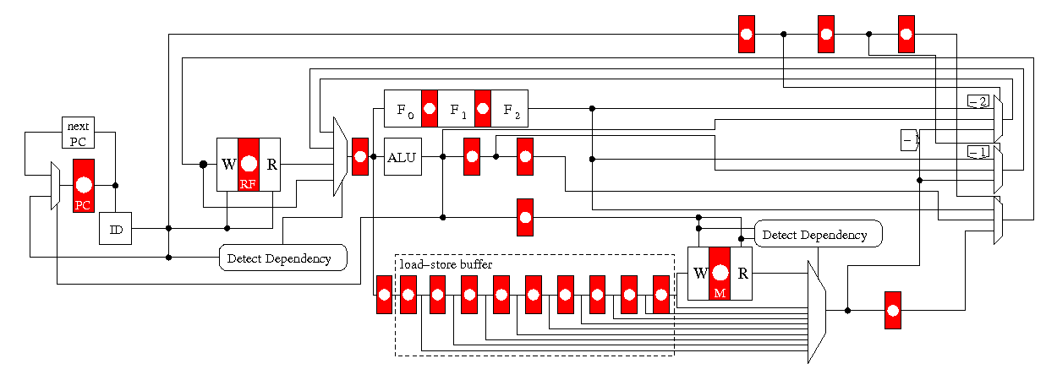
Pipelined DLX

Slide 127
Preserving behavioral equivalence
Combinational logic synthesis
Combinational equivalence checking

Slide 128
Preserving behavioral equivalence
Sequential logic synthesis
Sequential equivalence checking

Slide 129
Different flavors of Elastic Buffers
•
Flip-flop = Master & Slave
main
•
•
aux
(Carloni, 1999)
•
•
Jacobson 2002
Synchronous Interlocked Pipelines

Slide 130
Early Evaluation
Only wait for required inputs
Late arriving tokens are cancelled by anti-tokens
Branch target
address
PC+4
No branch
Take branch
Example: next-PC calculation
Notes:
130

Slide 131
Early evaluation is useless!!!
0
F
1
Critical cycle
(late arrival)
Shannon decomposition
F
0
F
1
Shorter cycle
(but F duplicated)

Slide 132
Speculation with Shared Units
Speculate which channel the mux will choose next cycle and exec F on it
Stop the other elastic channel
If next cycle we realize a mistake has been made, exec F on the other channel
Shared unit
0
F
1
Scheduler

Slide 133

Sequence of correct predictions
Shared unit
Cycle : 1
p=0.95
2
1
0
F
2
1
1
p=0.05
0
0
Scheduler

Slide 134
Sequence of correct predictions
Shared unit
Cycle : 2
F
0
3
2
1
1
2
1
1
0
0
Scheduler
Notes:
buffer sizing in slow channel: presentation not clear. discuss

Slide 135

Misprediction
Shared unit
Shared unit
Cycle : 3
F
0
4
3
2
3
2
1
1
1
0
0
Scheduler

Slide 136

Correction
Shared unit
Shared unit
Cycle : 4
F
0
5
4
3
2
4
3
2
1
1
1
Correction
0
Scheduler

Slide 137
Correction
Misprediction stalled 2 cycles
Shared unit
Shared unit
Cycle : 5
5
4
3
2
0
2
F
1
4
3
2
1
Scheduler

Slide 138
Error Correction using Speculation
REGFILE
wd
rd
READ
WRITE
F1
F2
ECC

Slide 139
Error Correction using Speculation
REGFILE
shared
wd
rd
READ
WRITE
F1
F2
ECC

Slide 140
Pipelining using elasticity
Retiming
wa
ra
wa’
wa’’
=
A
READ
WRITE
B1
B2

Slide 141
Pipelining using elasticity
wa
ra
wa’
wa’’
=
A
READ
WRITE
B1
B2

Slide 142
Pipelining using elasticity
wa
ra
wa’
wa’’
=
A
READ
WRITE
B1
B2
-1

Slide 143
Pipelining using elasticity
2 bypasses
wa
ra
wa’
wa’’
=
A
READ
WRITE
B1
B2
-1
System only stalls in case of RAW
dependencies with B1-B2

